Slide 1
The Carson’s
in
Dandenong

Slide 2
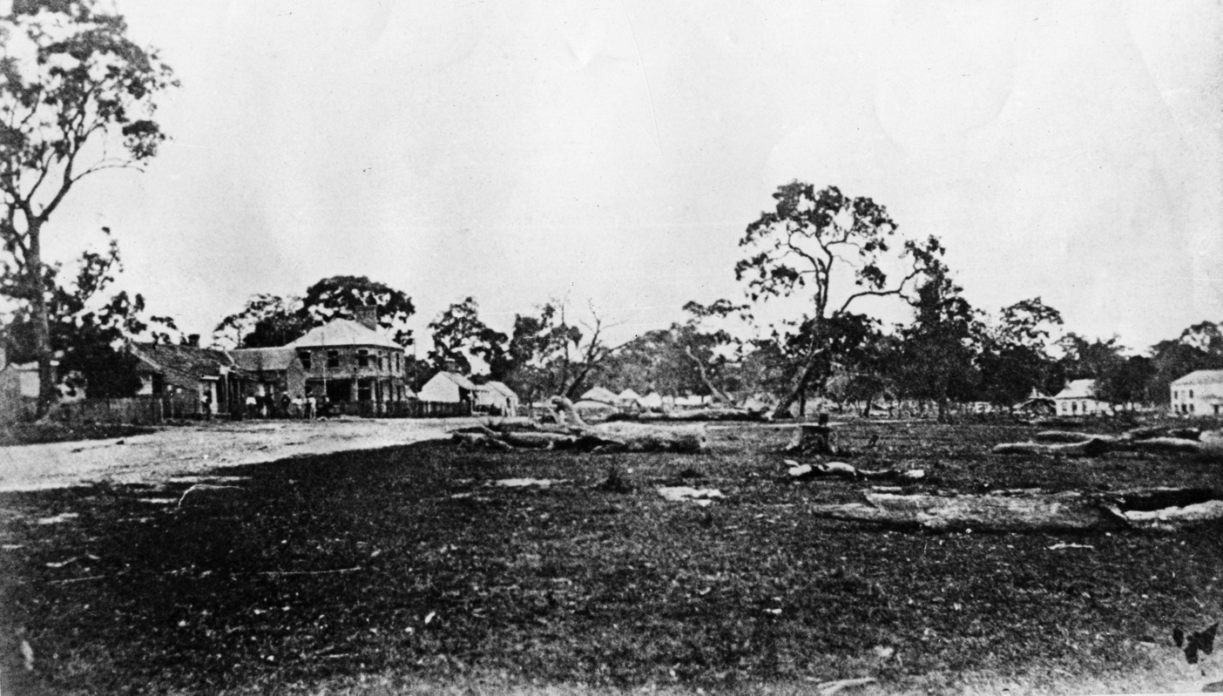
Main Street, Dandenong. 1850’s
John Carson

Slide 3
Carson Family Tree
John Carson
1844 - 1906
William James
1885 - 1937
Leonard Charles
1911 - 1958
William John
1943 -
Andrew Leonard
1971-

Slide 4
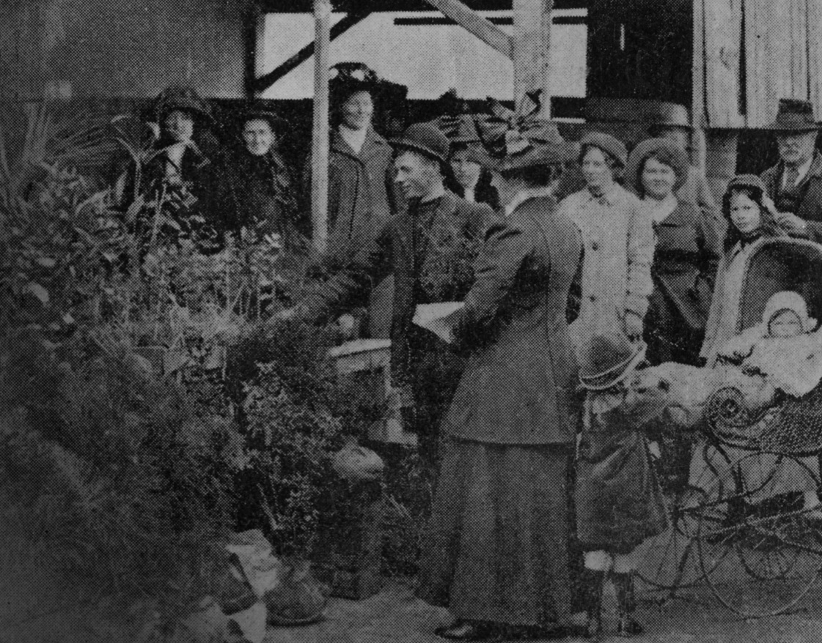
Murray House. 1912
Leonard Charles

Slide 5
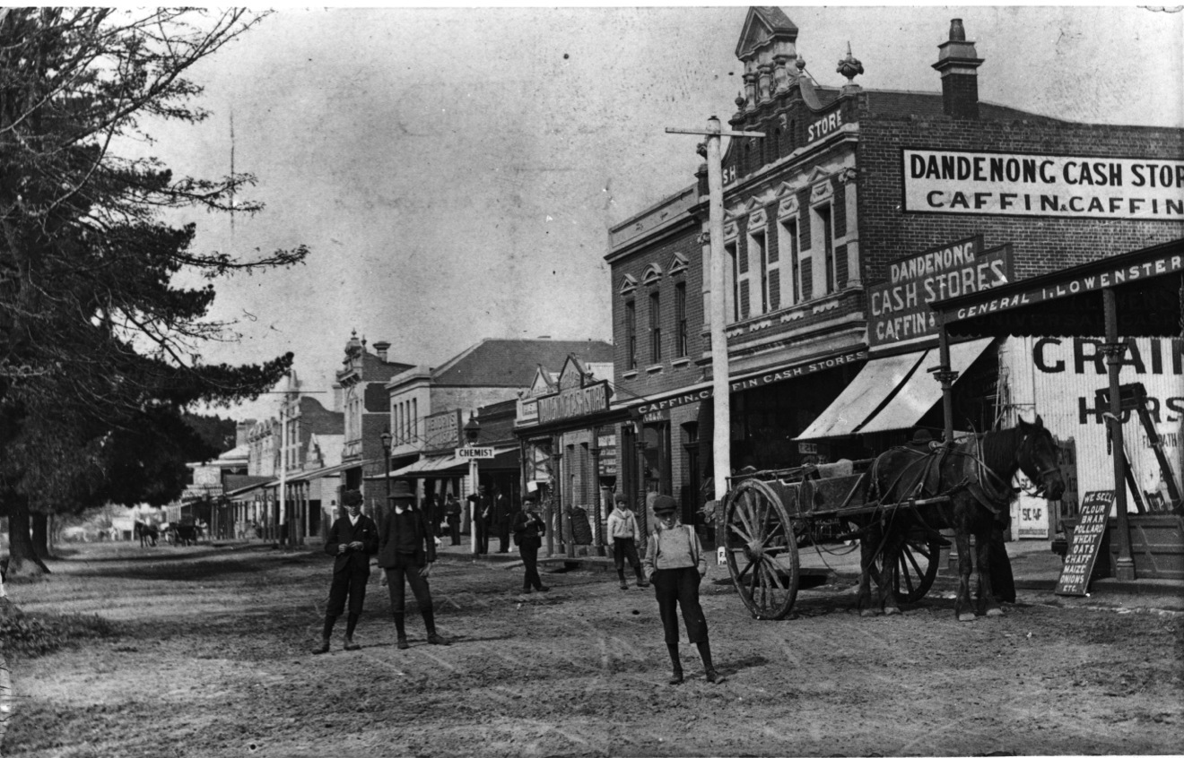
Lonsdale Street, Dandenong. 1850’s
William James

Slide 6
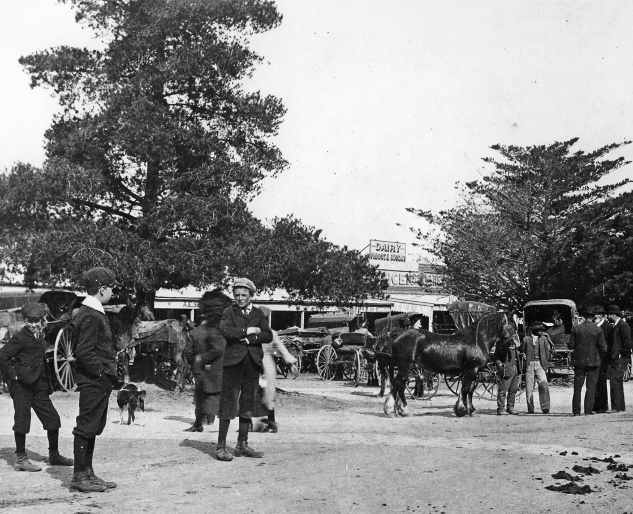
Dandenong Market.
Leonard Charles

Slide 7
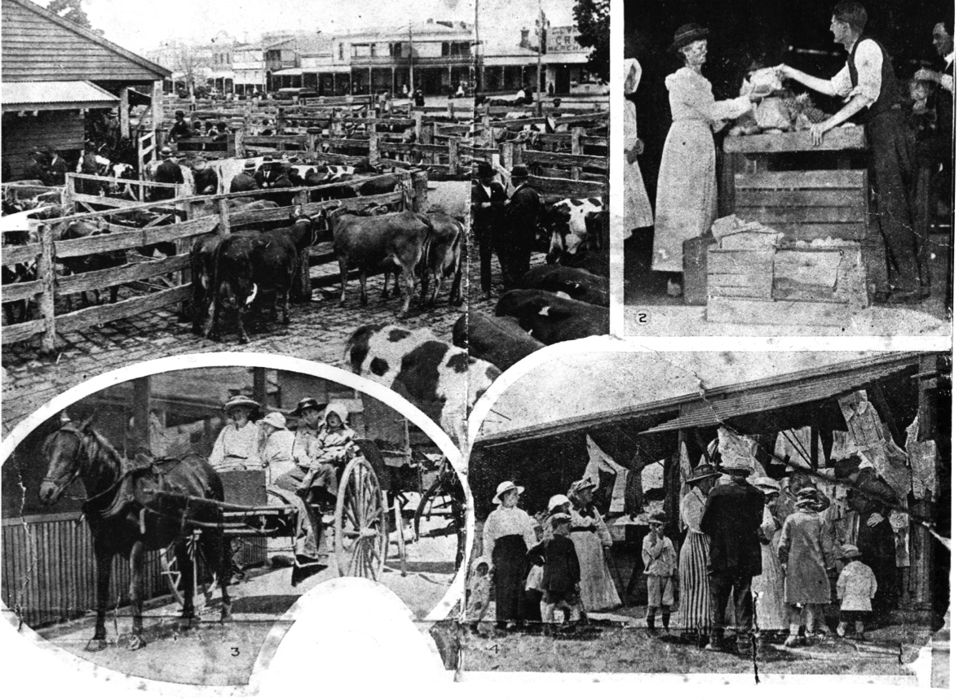
Dandenong Market. Early 1900’s
Leonard Charles

Slide 8
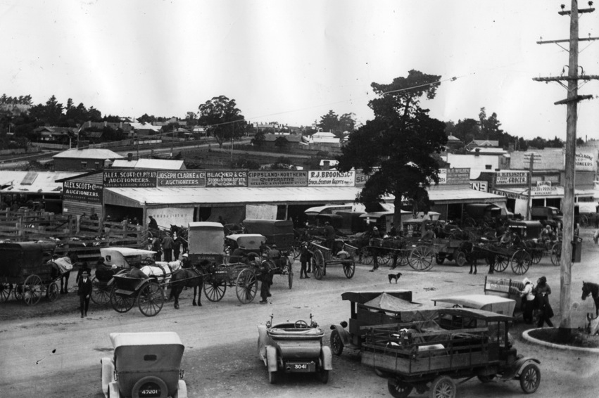
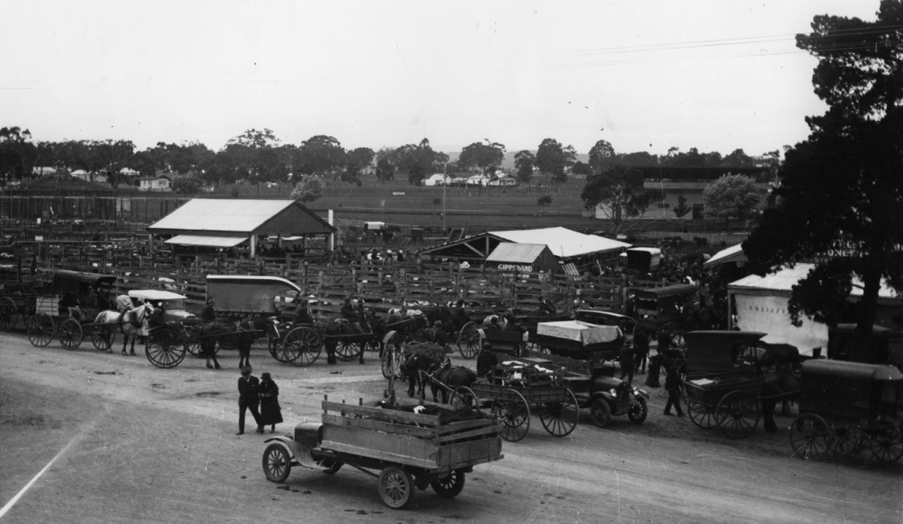
Dandenong Market
Leonard Charles

Slide 9
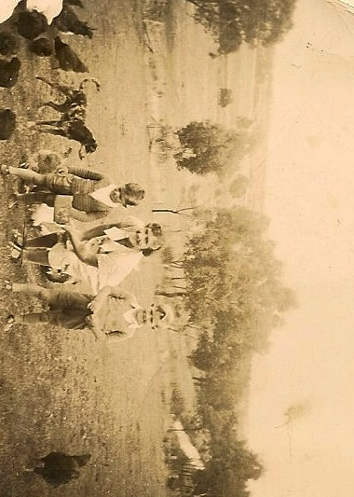
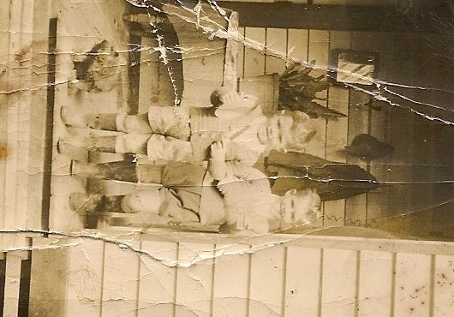
Farm - Narre Warren
Leonard Charles

Slide 10
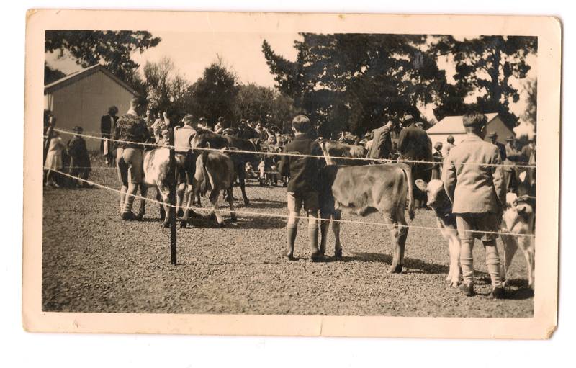
Leonard Charles
Field day – Narre Warren Primary School

Slide 11
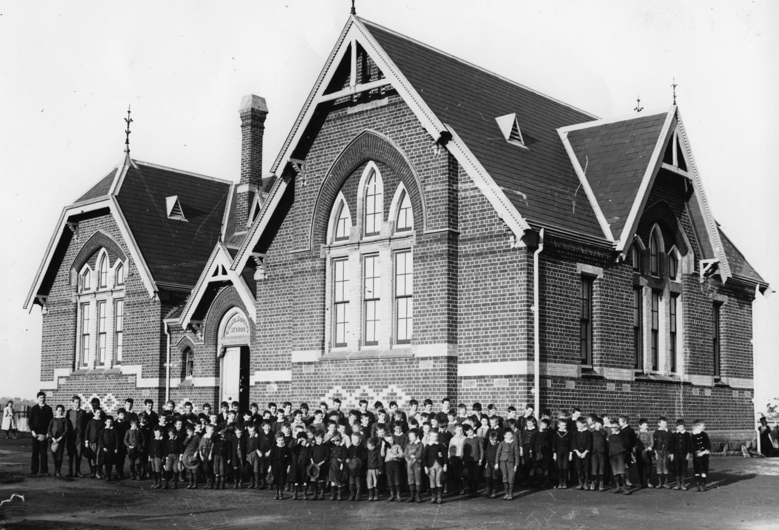
Dandenong East Primary School.
William John

Slide 12

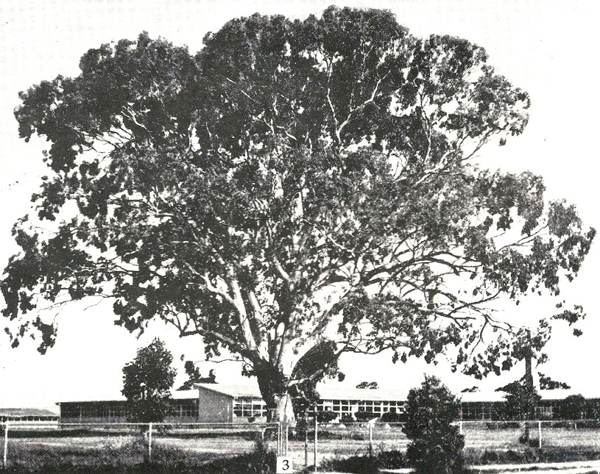
DANDENONG TECHNICAL SCHOOL
1953 – 1991

Slide 13


Slide 14
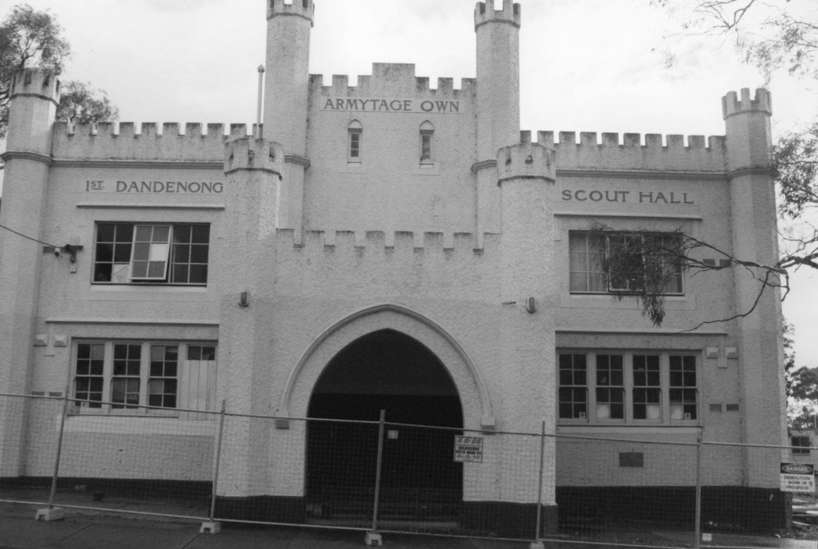
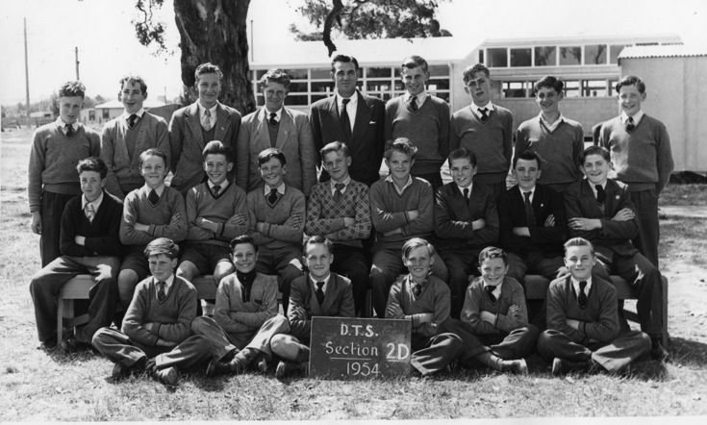

Slide 15
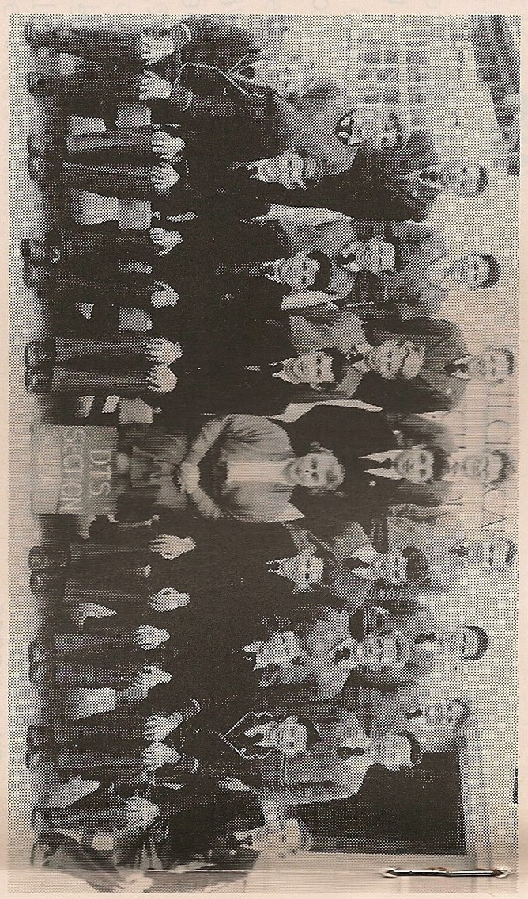
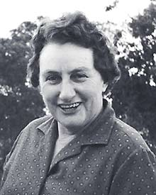
Leslie Moorhead, O.B.E.

Slide 16
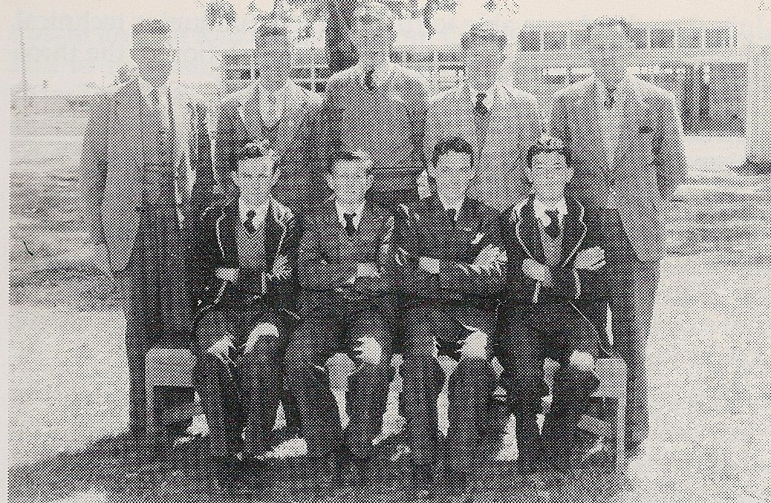
Prefect’s

Slide 17
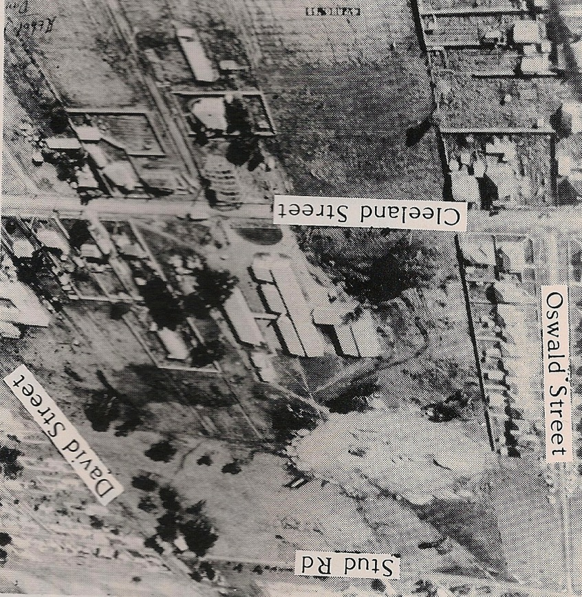

Slide 18

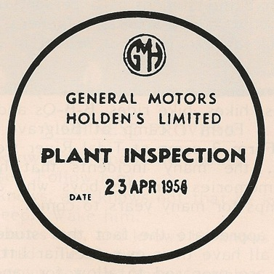
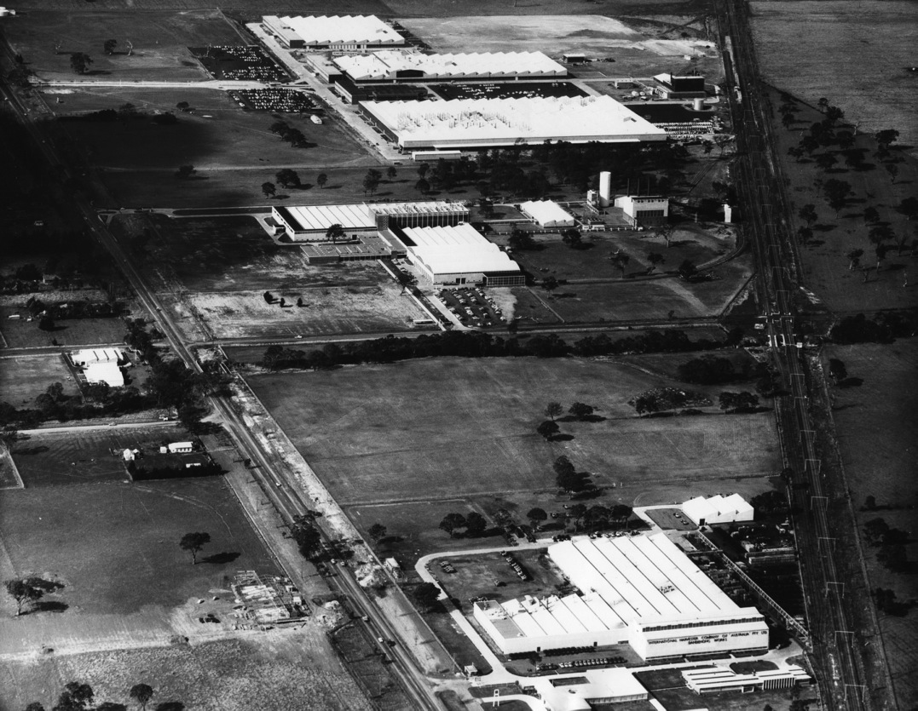

Slide 19
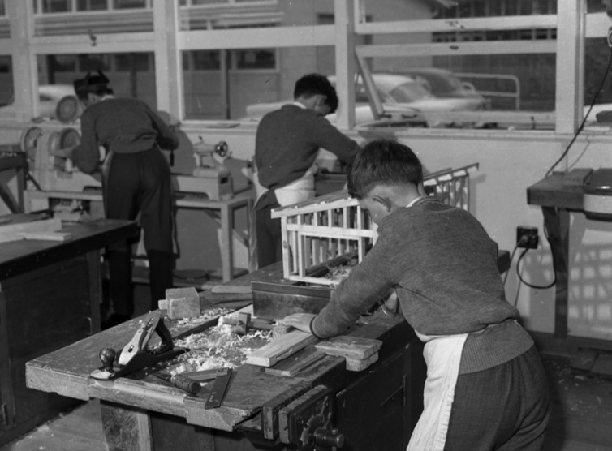
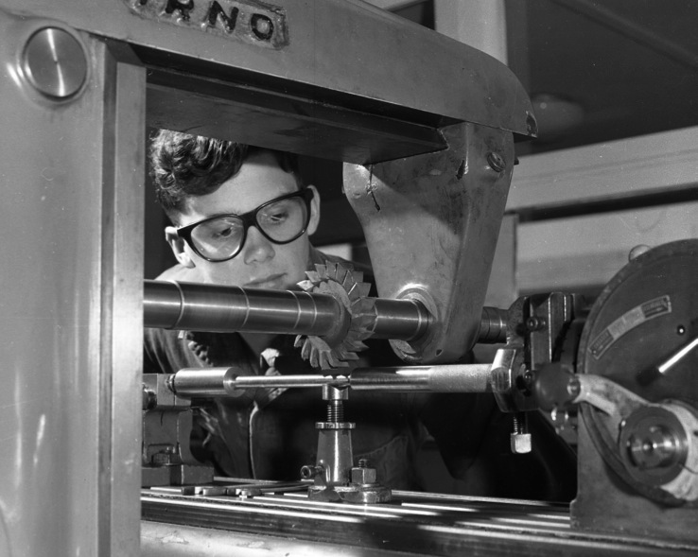

Slide 20
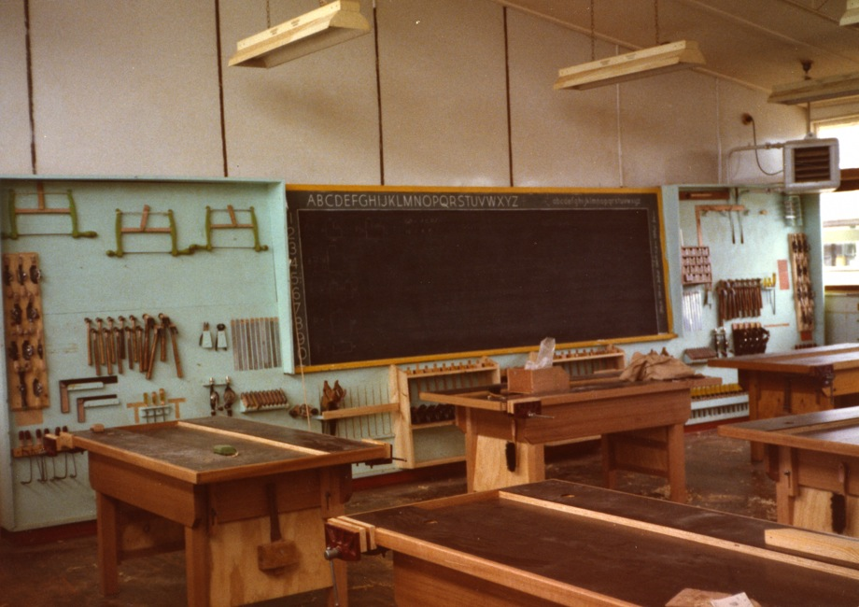
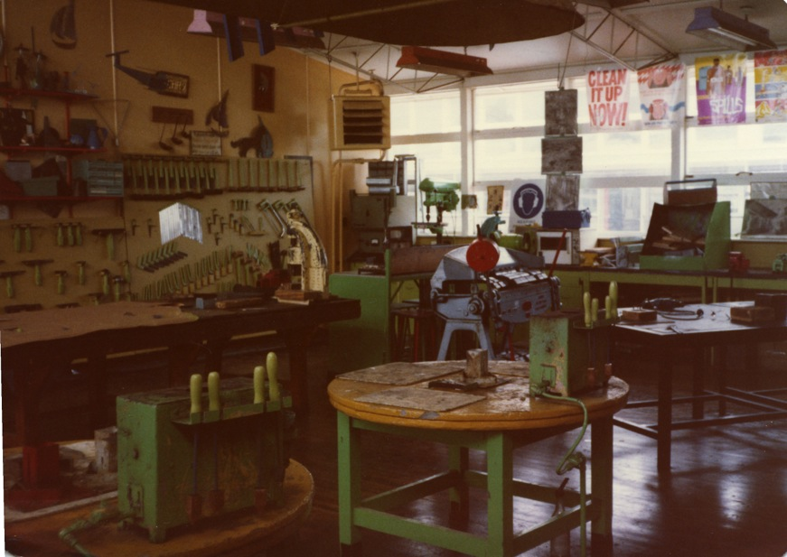

Slide 21
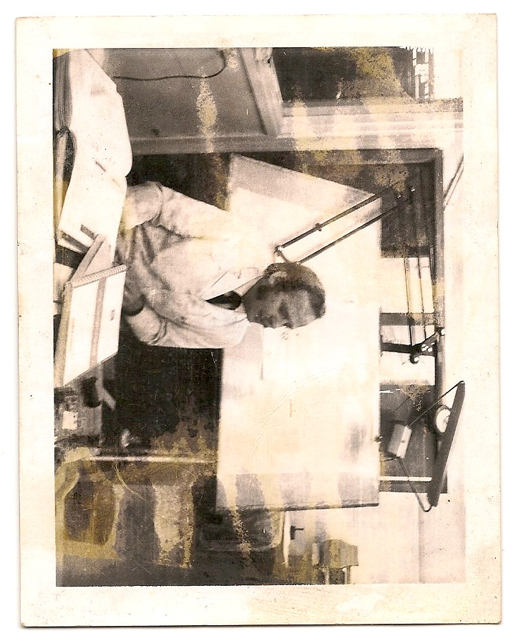
William John
First job

Slide 22
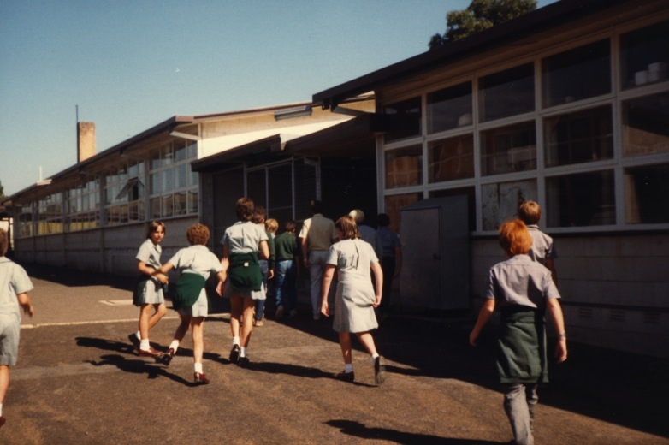
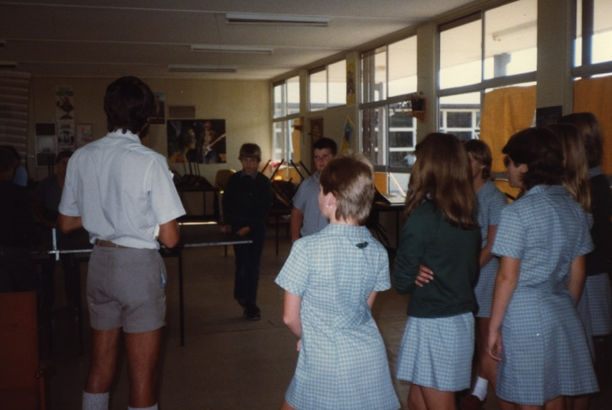
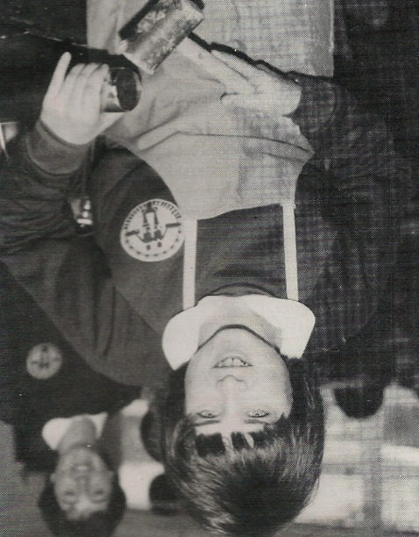
Co-education. 1984

Slide 23
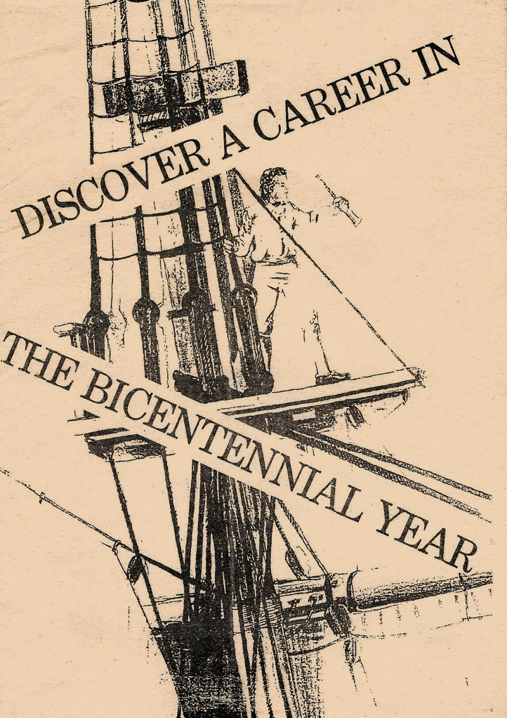
Careers

Slide 24
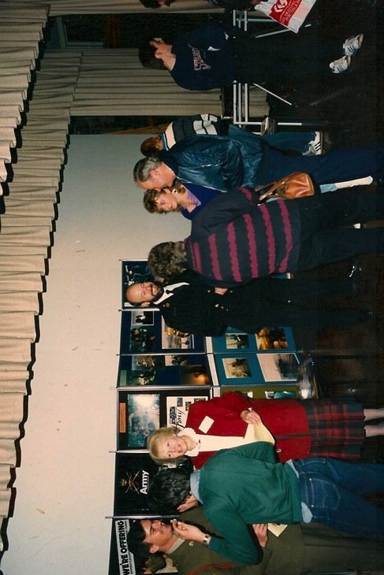

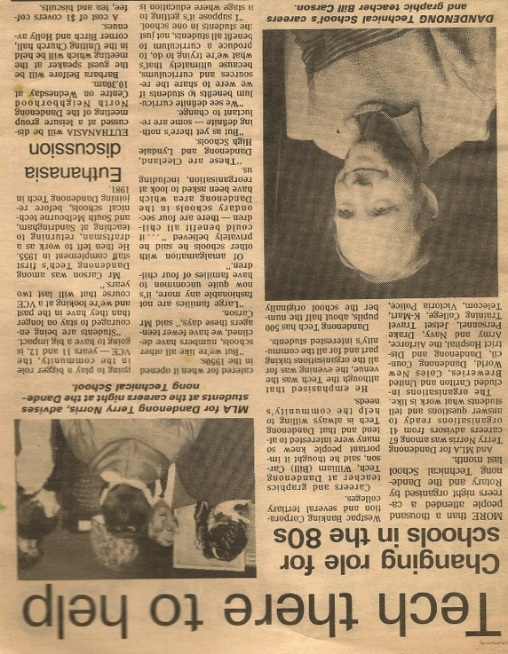
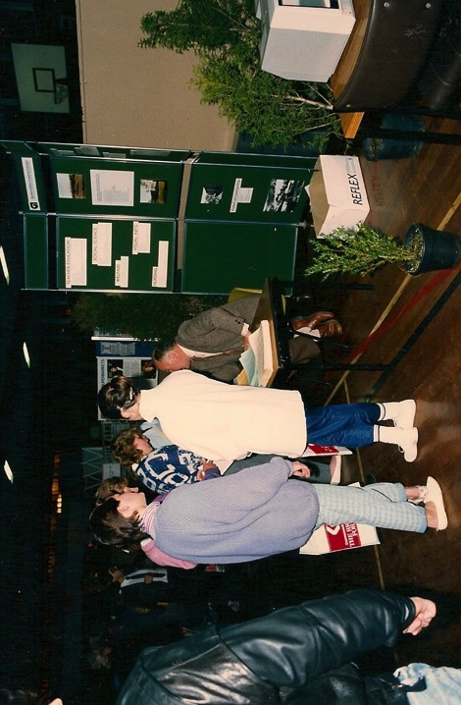
Terry Norris
Careers Nights. 1988

Slide 25
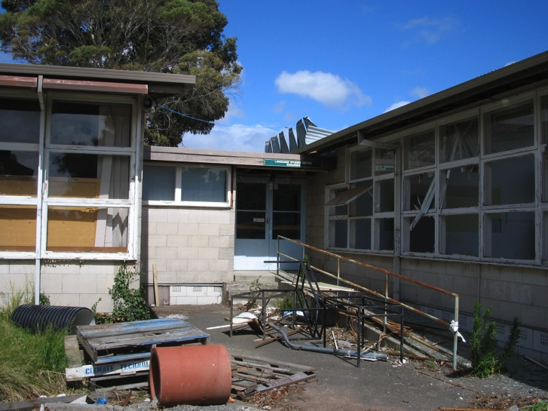
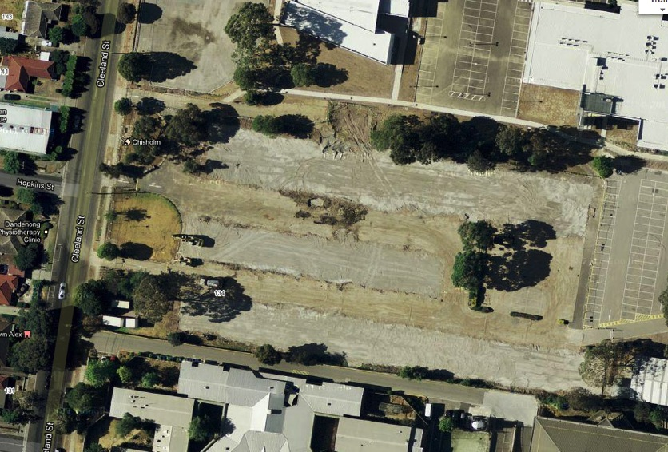
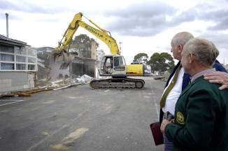
Demolition of school

Slide 26
Thank you
Bill Carson 2013

