Slide 2
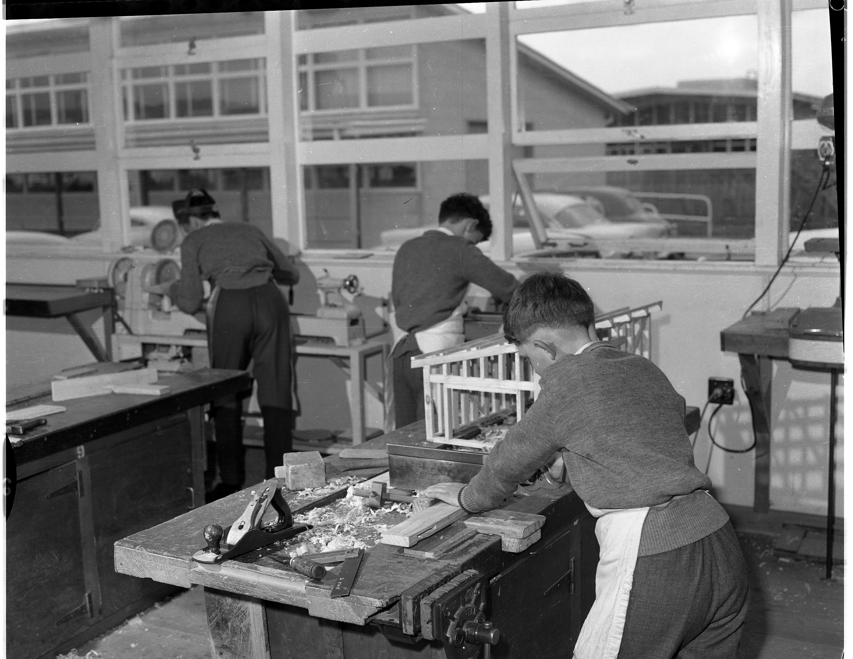
Dandenong Tech

Slide 3
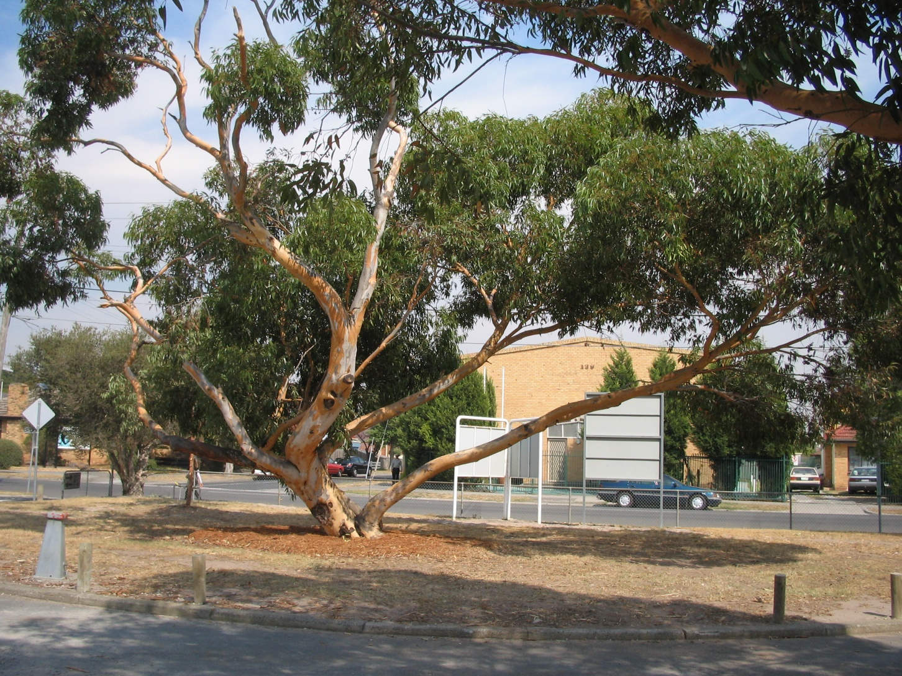
Dandy Tech

Slide 4
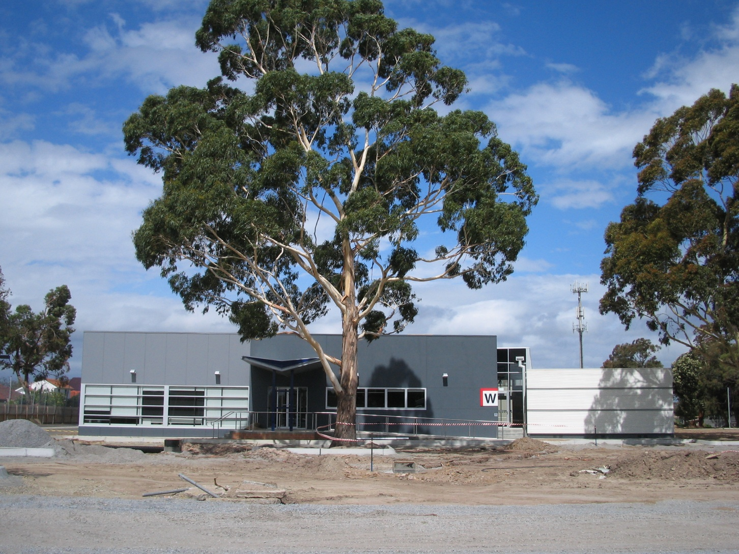
Dandy Tech 2009

Slide 5
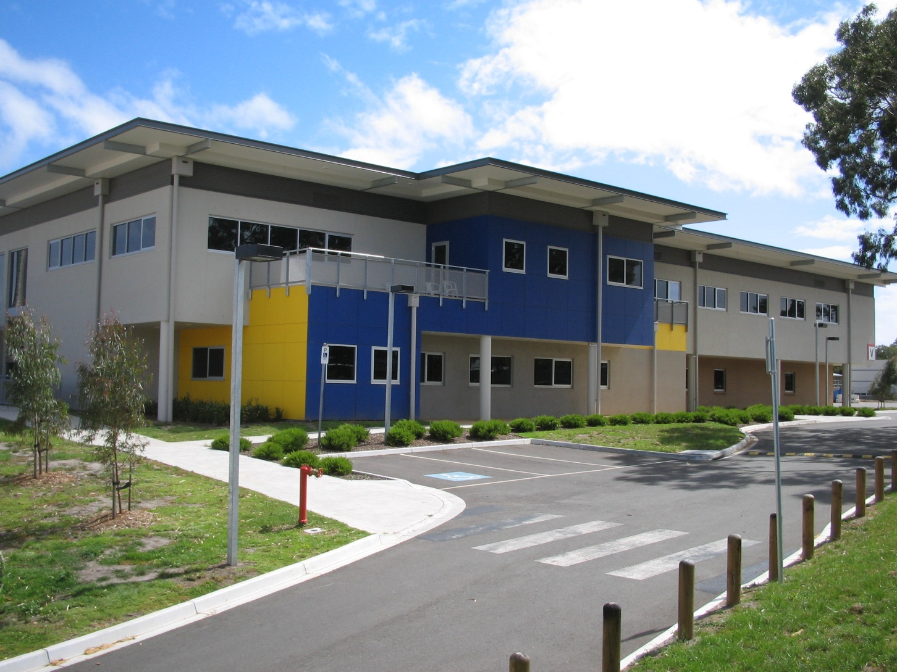
Dandy Tech 2009

Slide 6
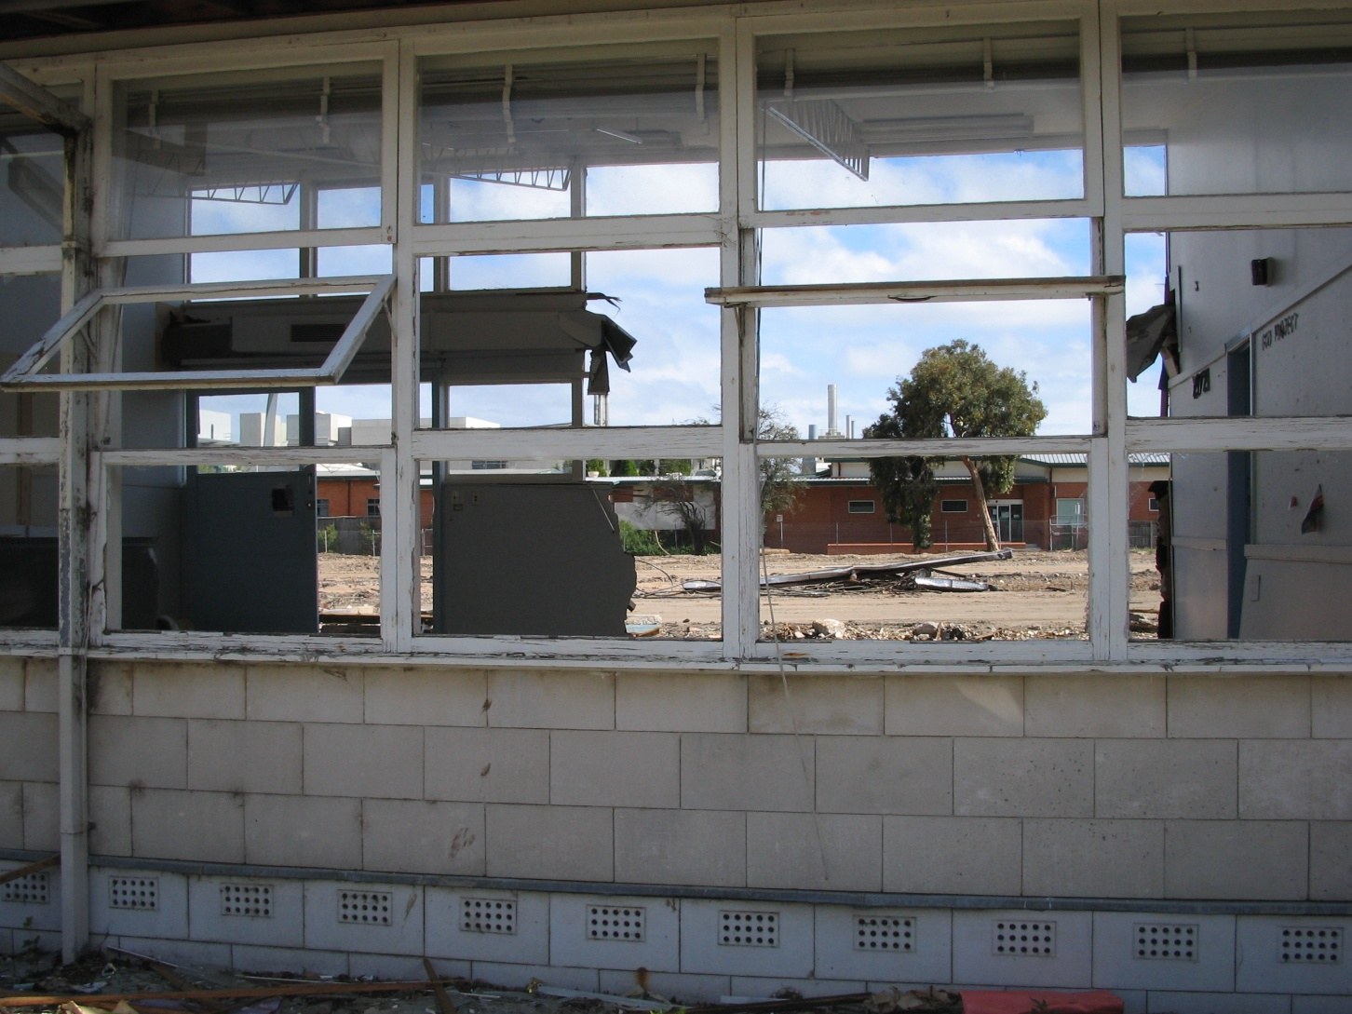
Pulling down old Tech 2009

Slide 7
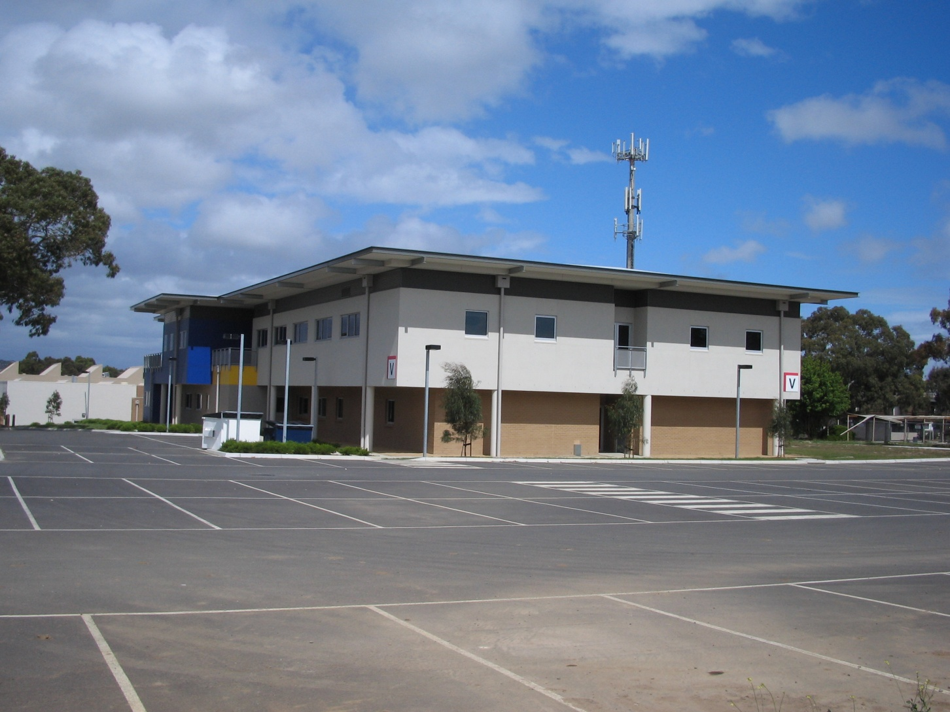
New Tech end 2009

Slide 8
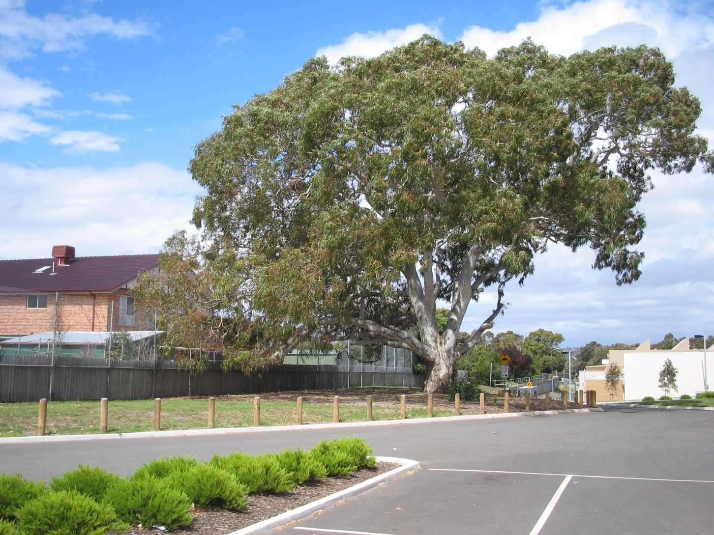
New Tech end 2009

