Slide 1


Slide 2
THE DEVELOPMENT OF TEACHING HORTICULTURE AT BURNLEY CAMPUS
THE FIRST 100 YEARS

Slide 3
1891
BURNLEY SCHOOL OF HORTICULTURE
Under the control of the Department of Agriculture, Victoria

Slide 4
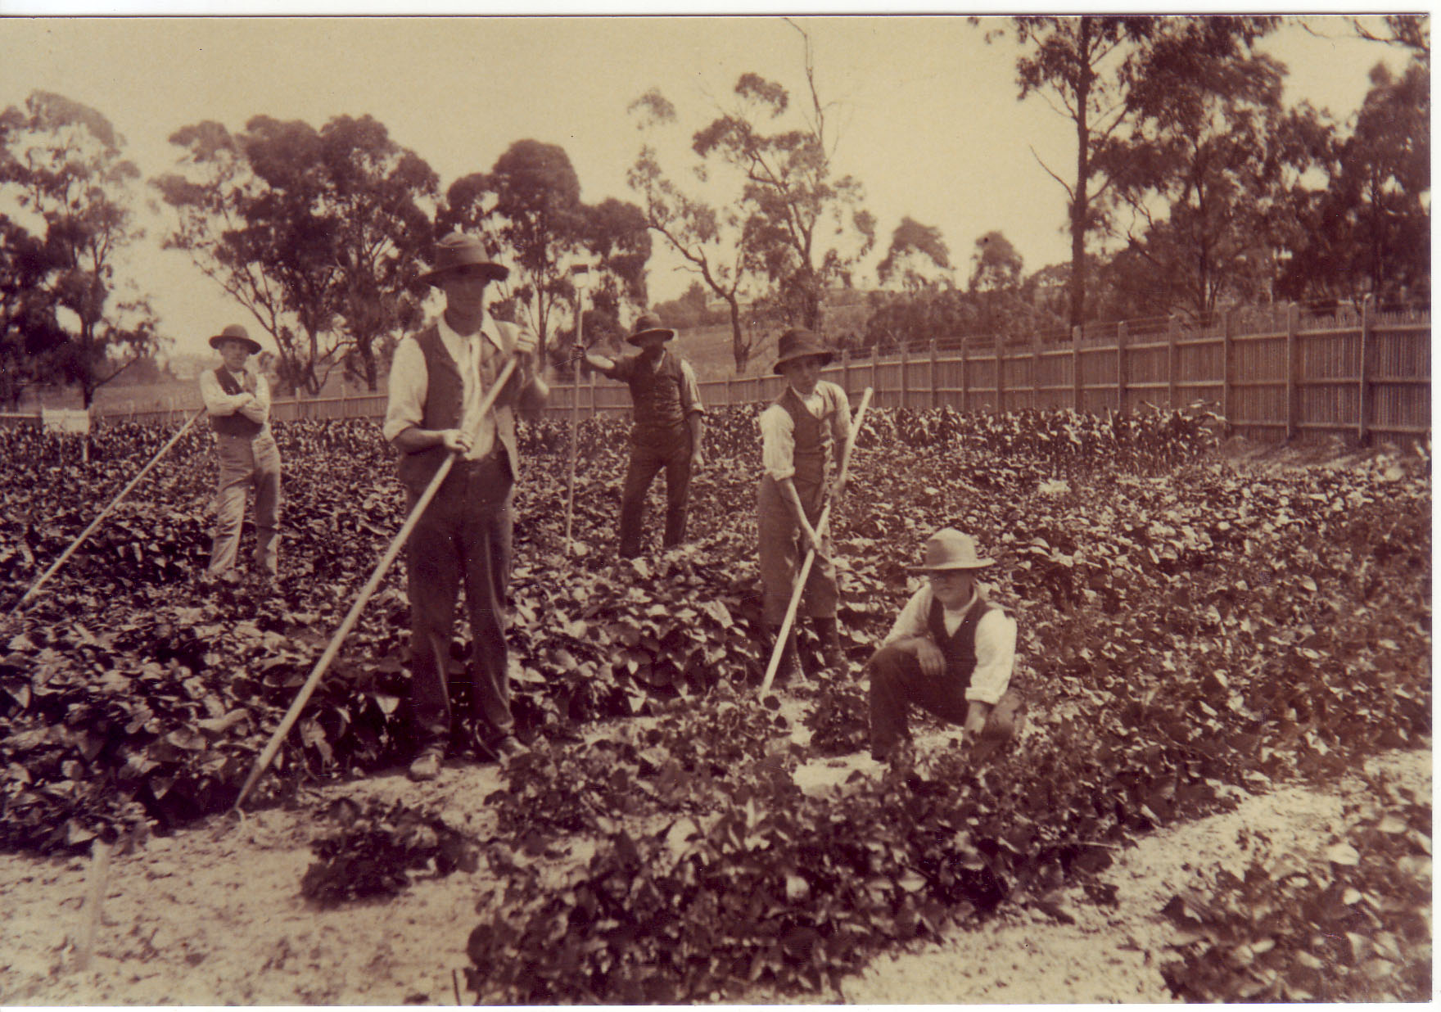
The first Horticultural College in Australia and one of the first in the world

Slide 5
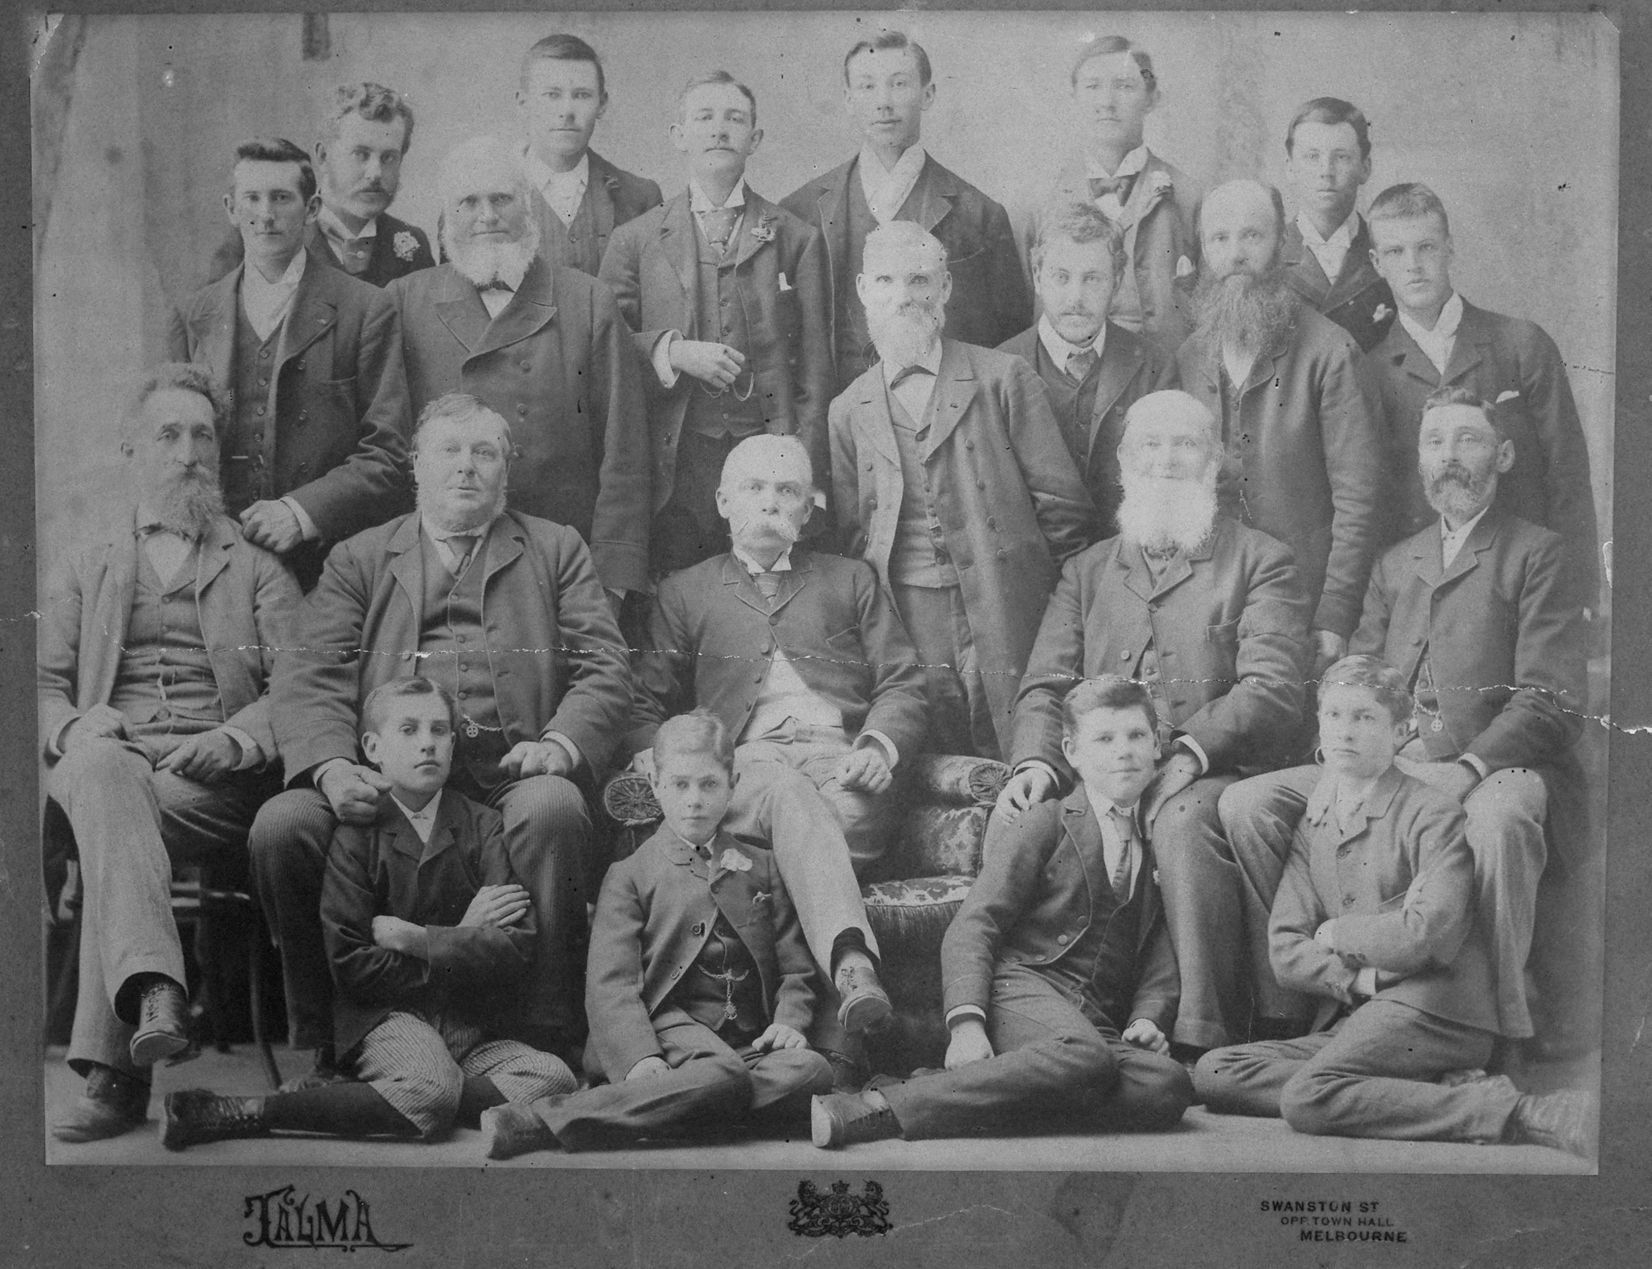
The Horticultural Board of Advice assisted with guidance on how to run the School

Slide 6
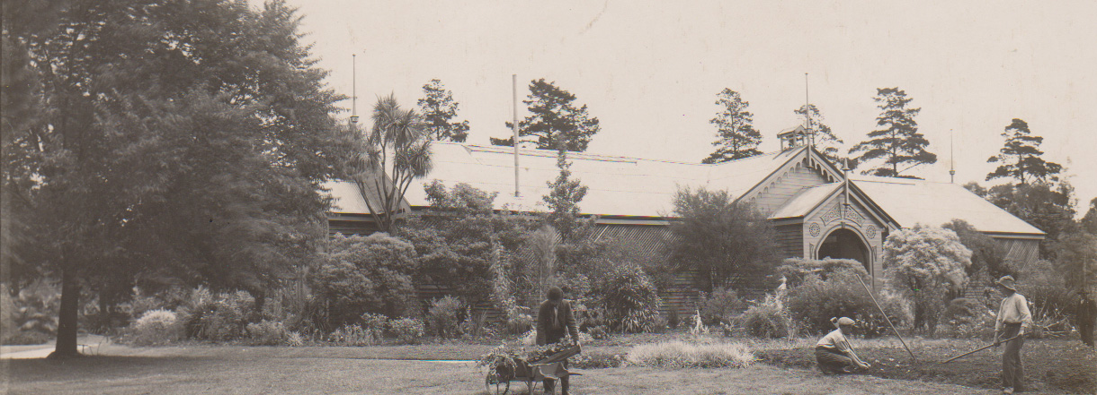
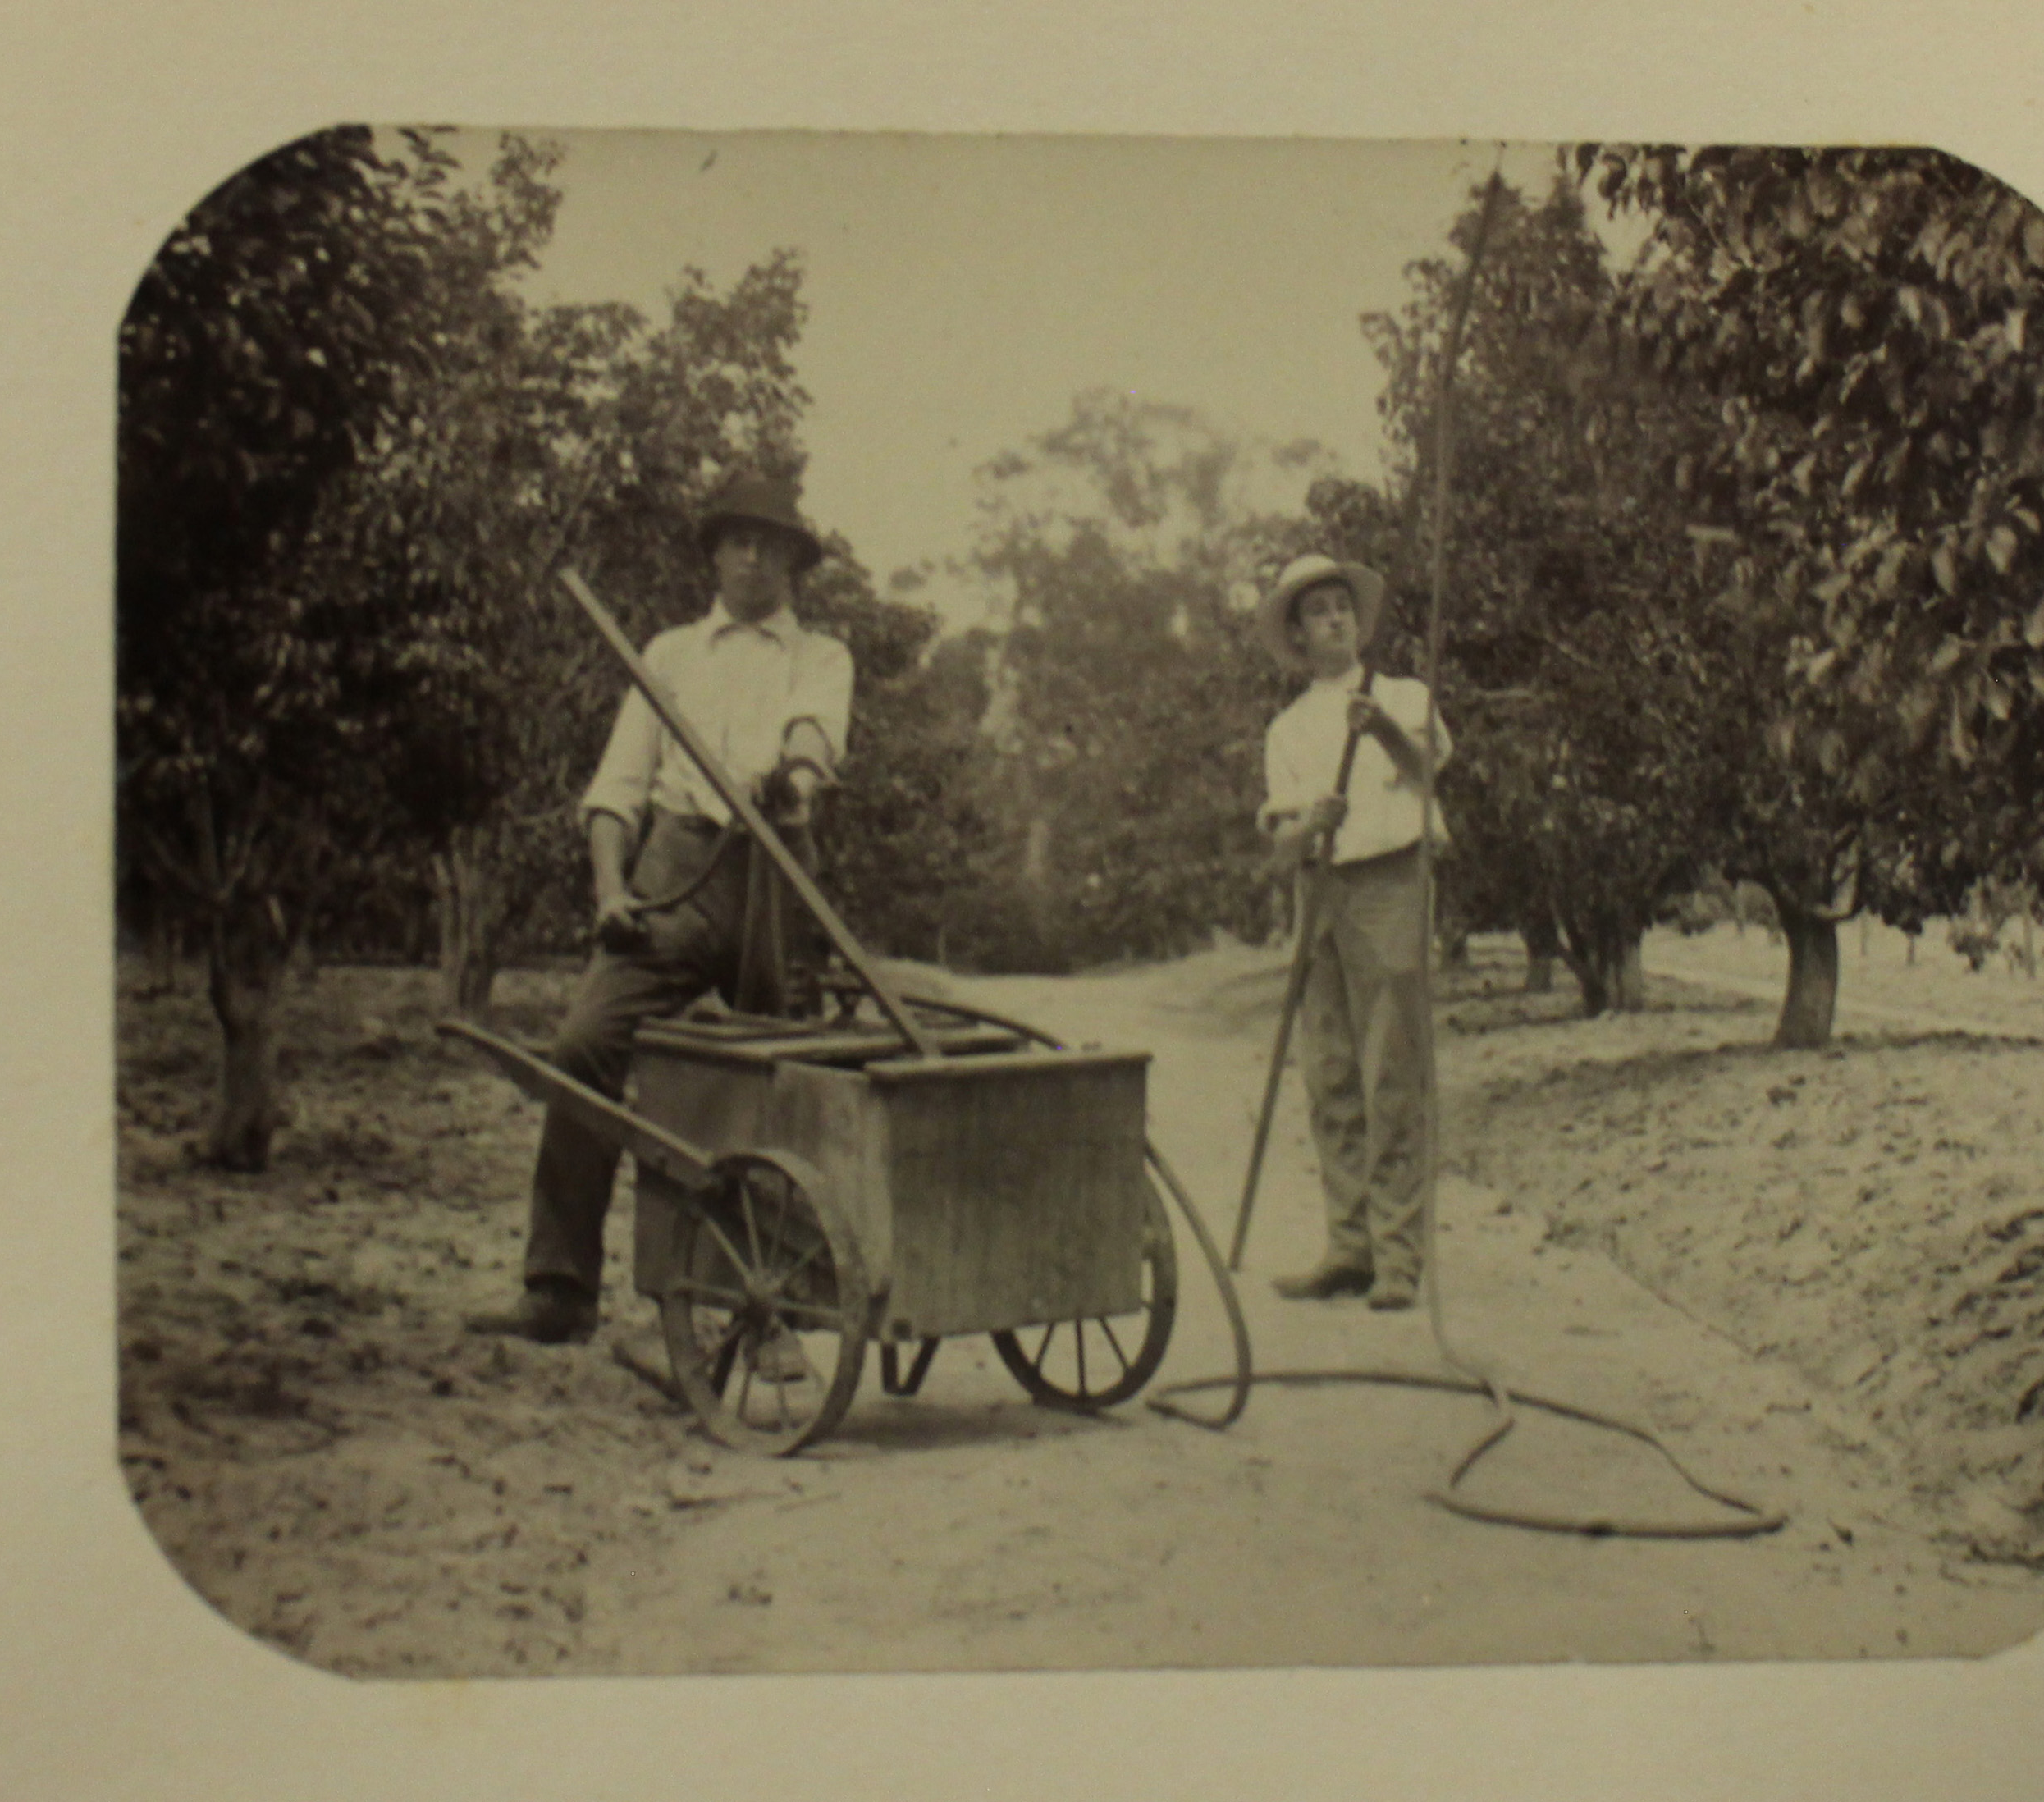
The Exhibition Pavilion built in 1884 was used for teaching
The course of instruction included practical horticulture in its various branches, botany and agricultural science as applied to horticulture.
A Certificate of Proficiency or a Diploma was awarded at the end of two or three years.

Slide 7
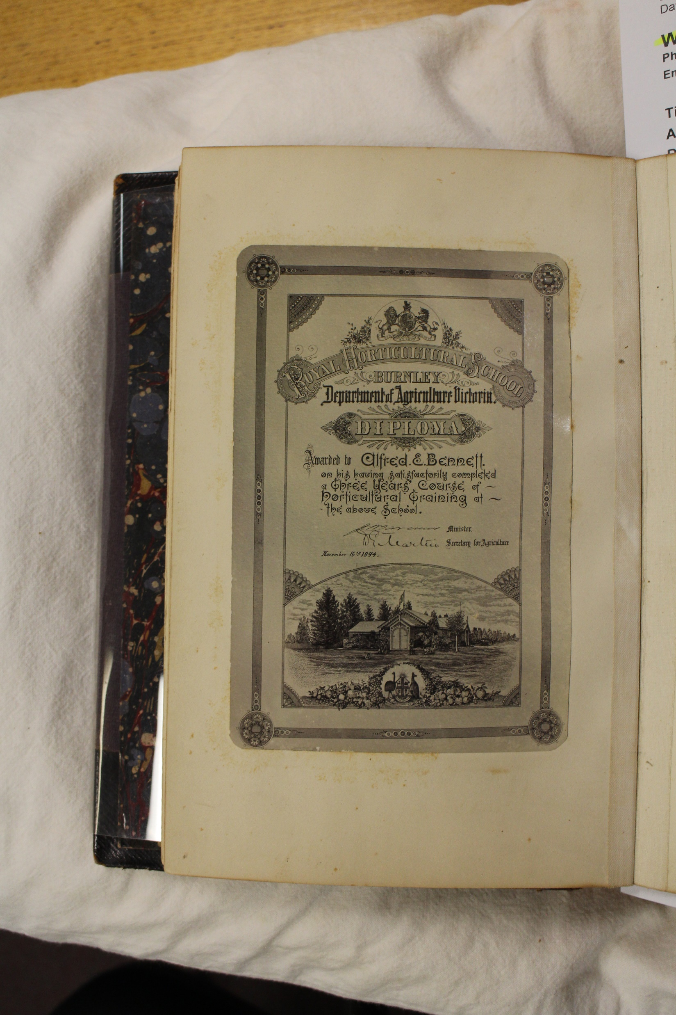
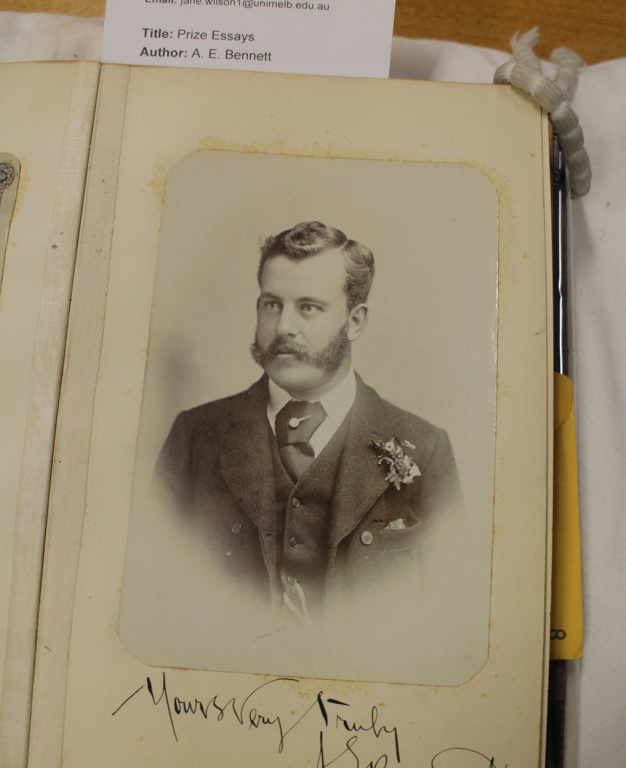
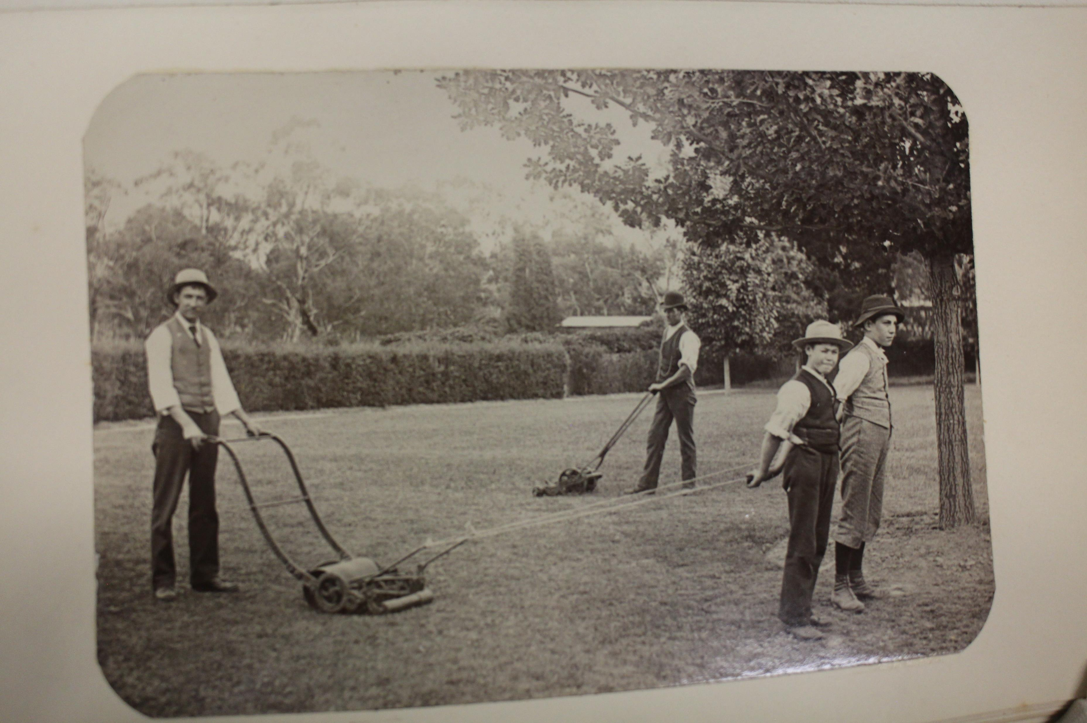
Alfred E. Bennett was one of the first students. He wrote a book about his time at Burnley for his twin brother

Slide 8
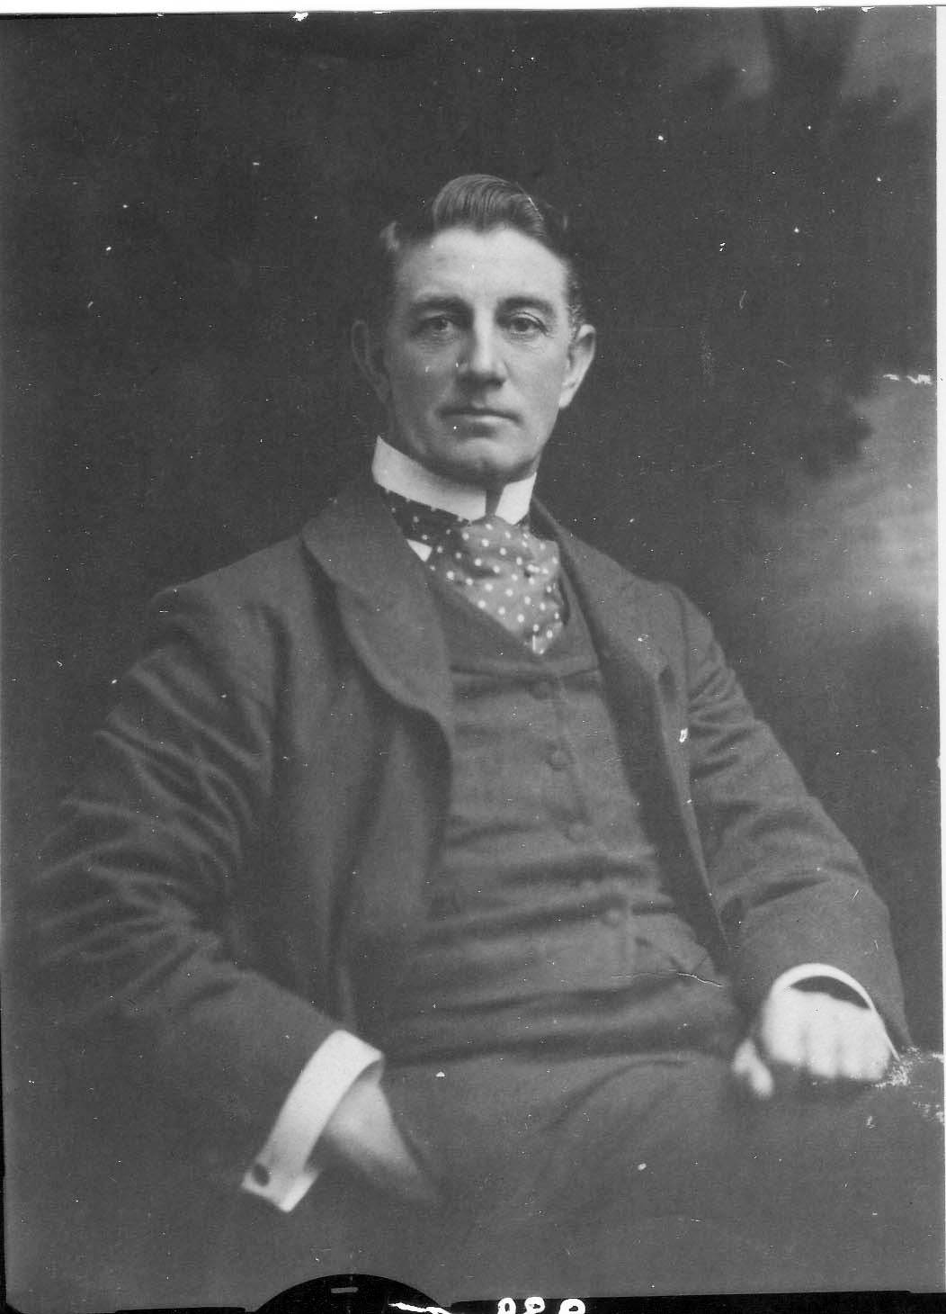
C. B. Luffmann was the first Principal 1897-1908

Slide 9
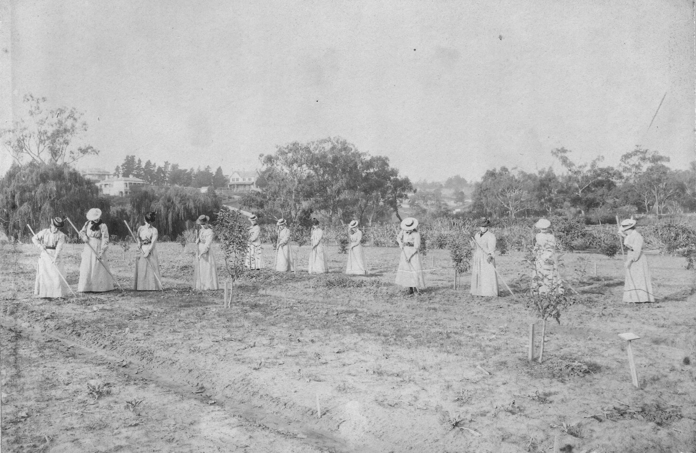
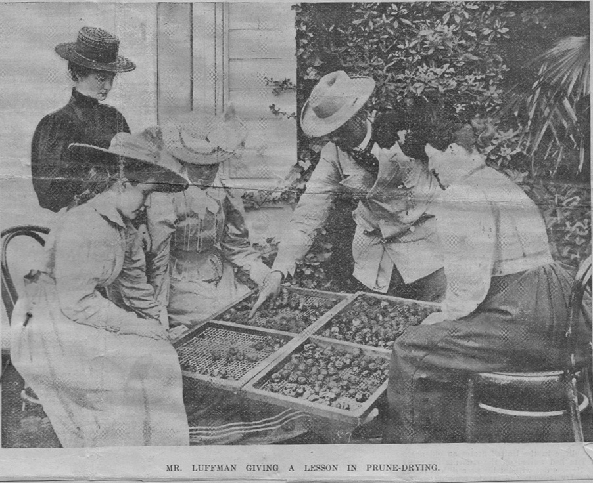
Women were permitted to complete the Certificate of Competency from 1898

Slide 10
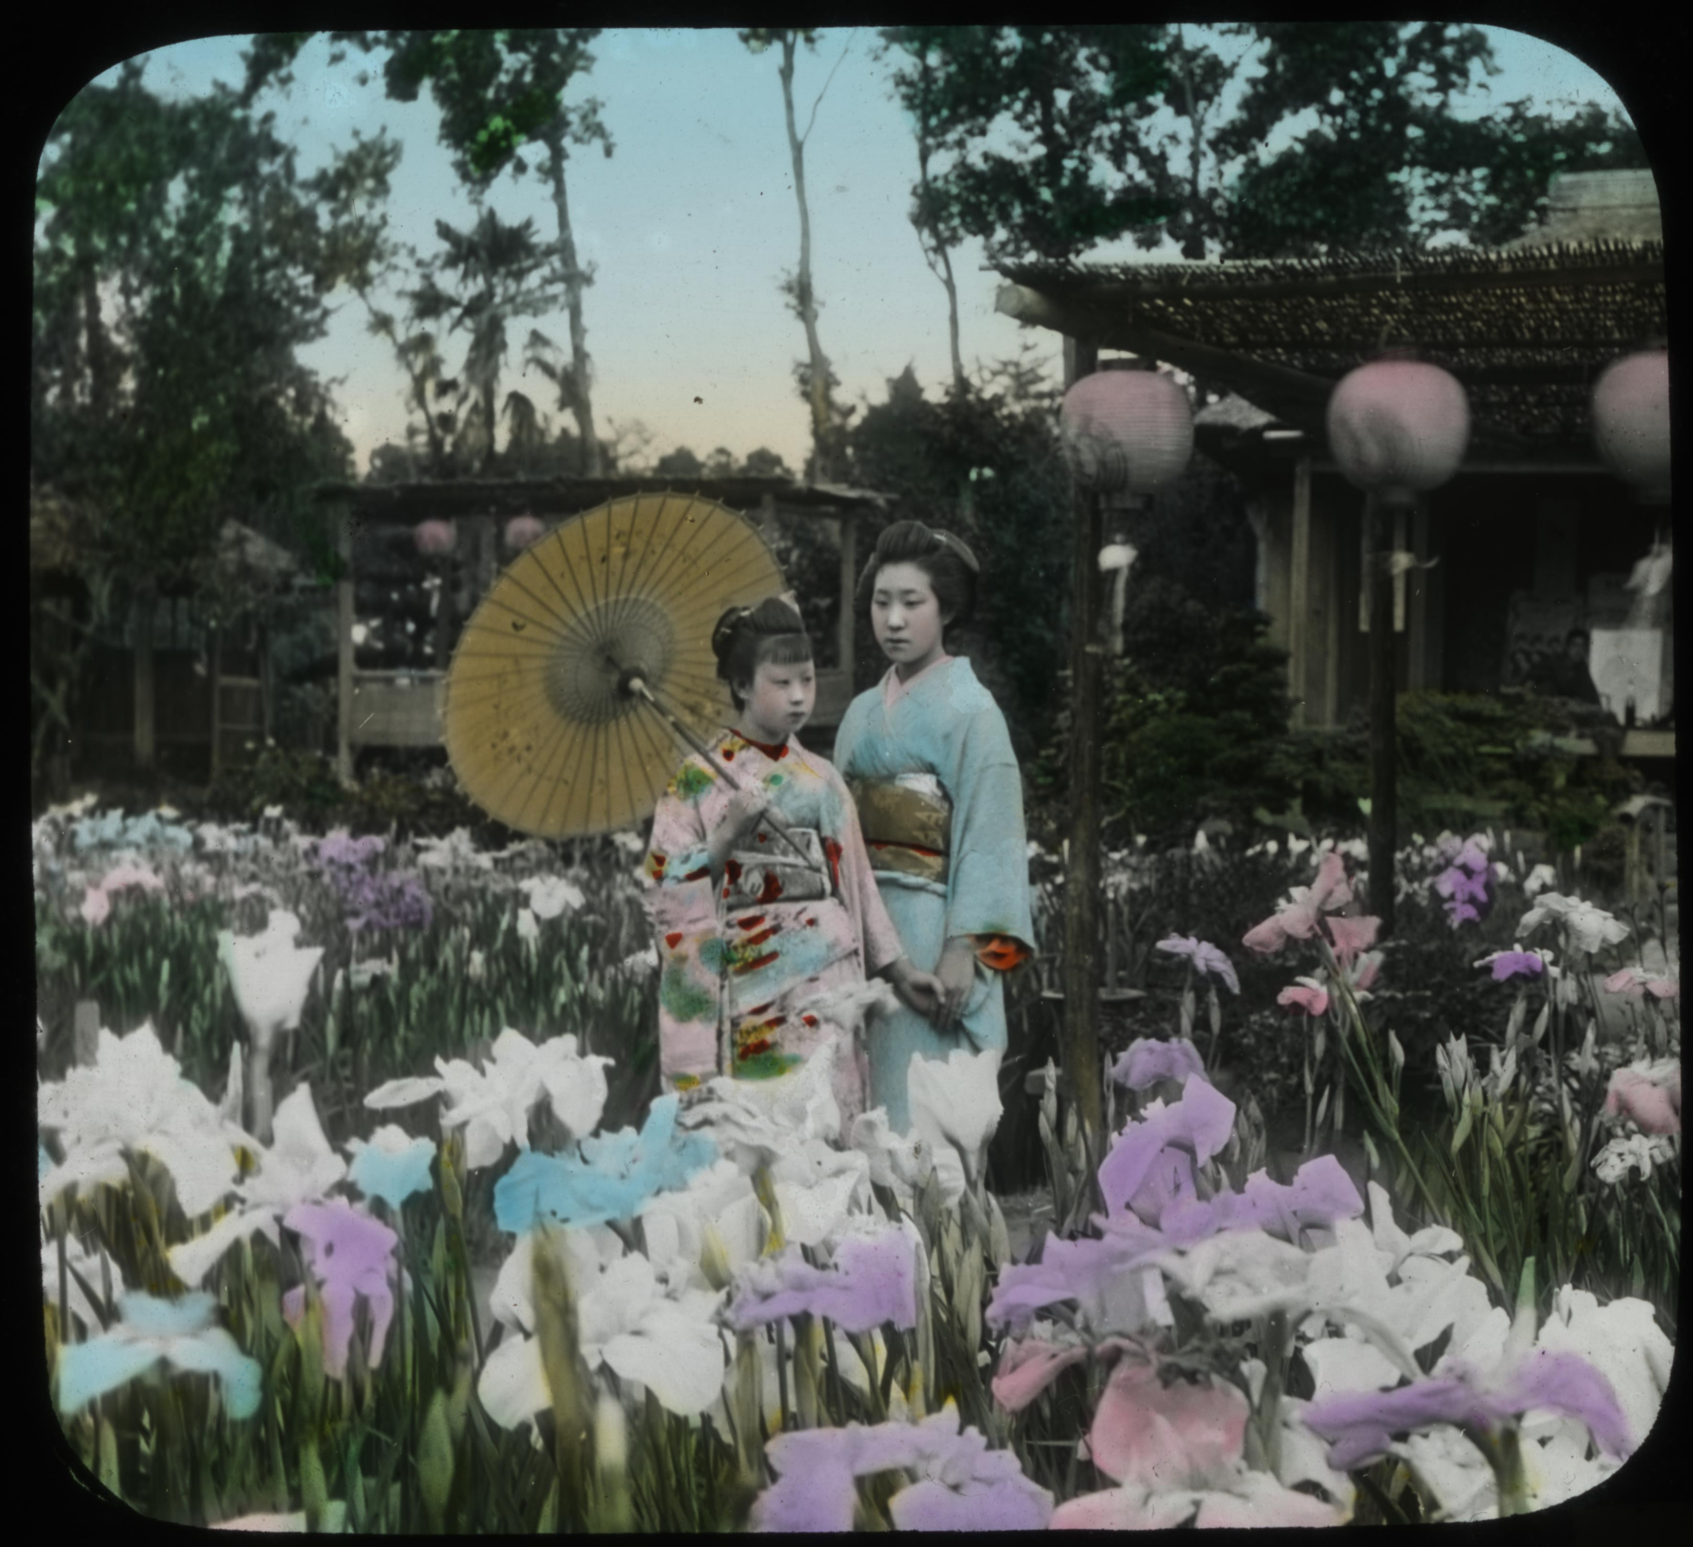
Glass Lantern Slides were used for teaching

Slide 11
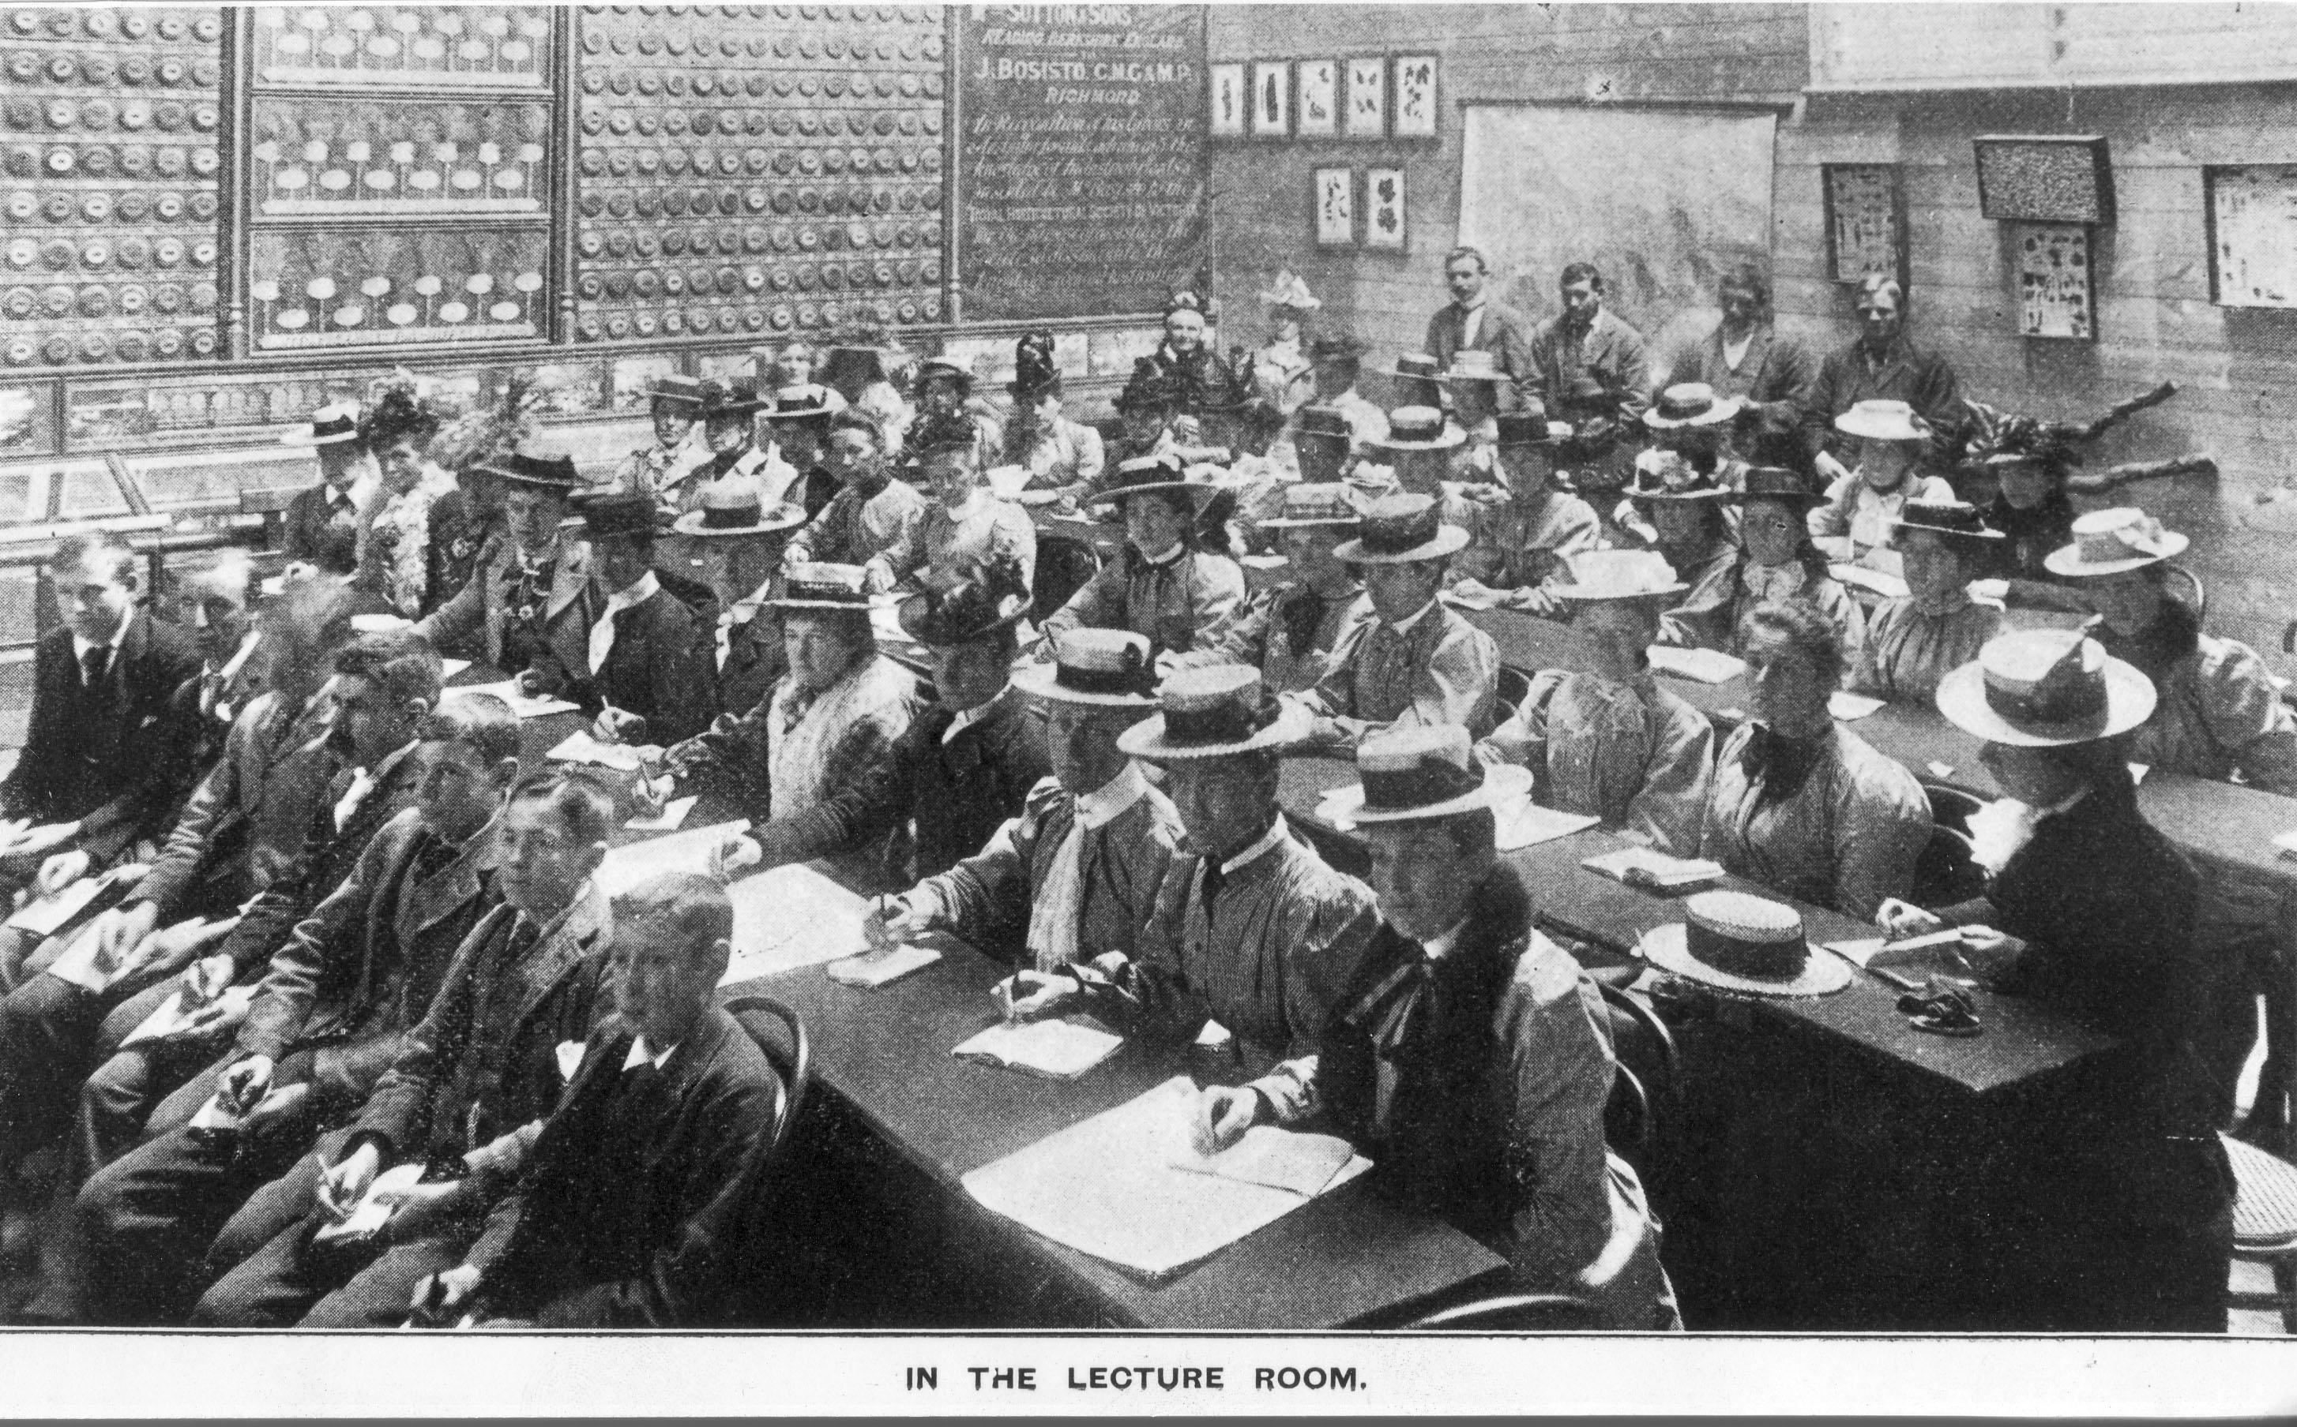

Slide 12
1917
BURNLEY SCHOOL OF HORTICULTURE AND PRIMARY AGRICULTURE
With the name change, the curriculum gradually changed to include animal management and agricultural science

Slide 13
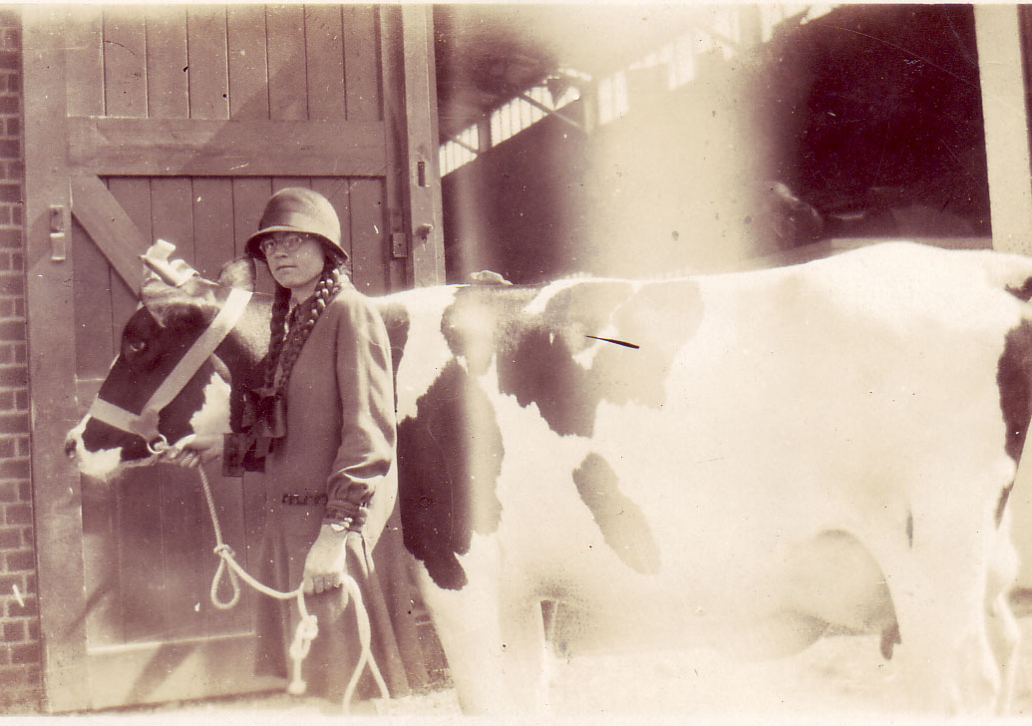
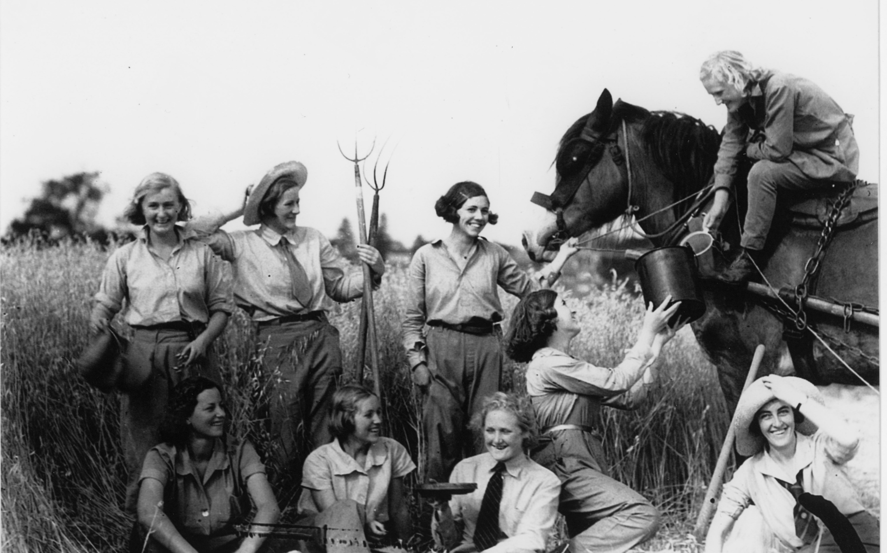
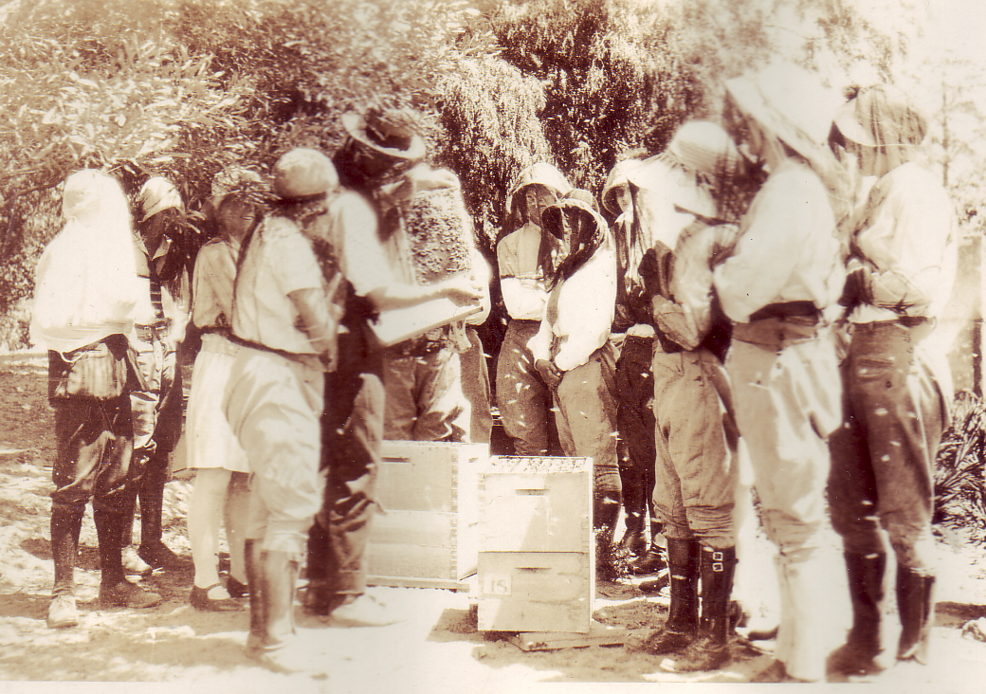
Half the students’ time was spent outside
There were weekly report cards and students had to keep a diary

Slide 14
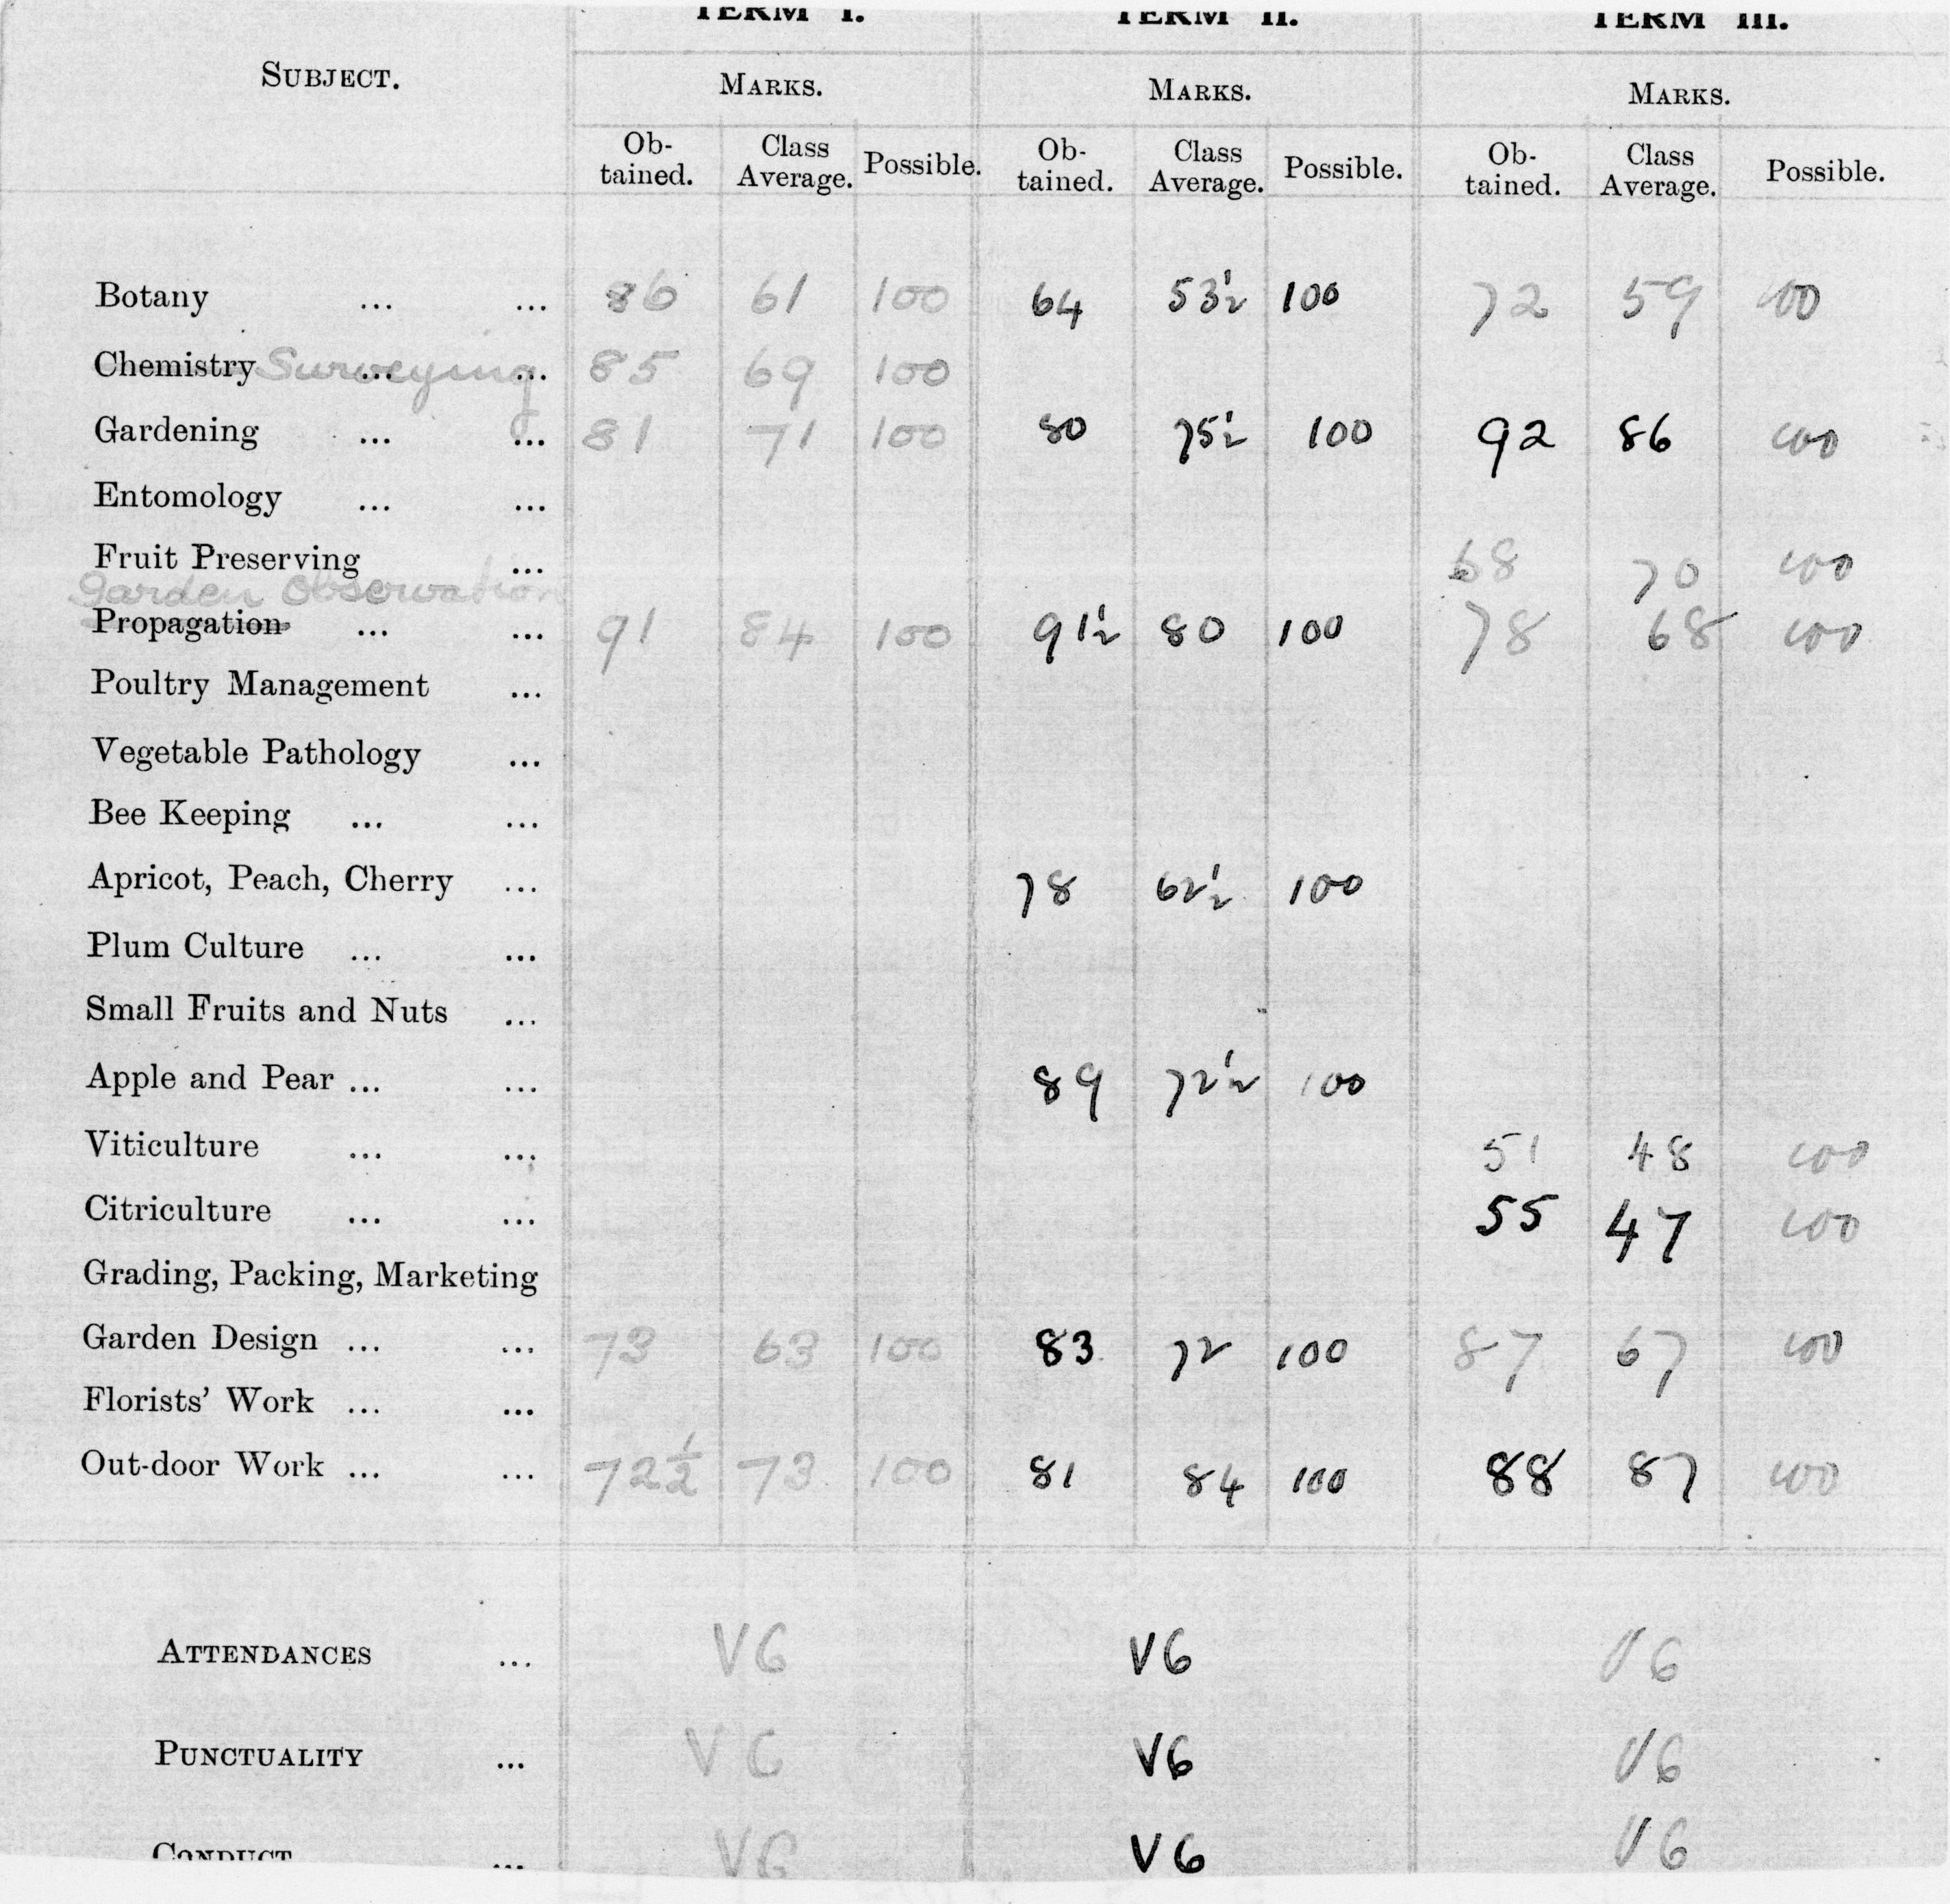
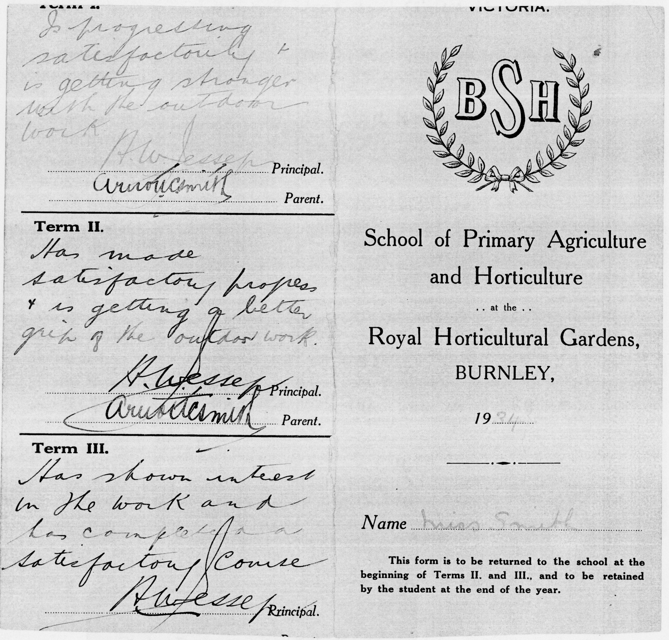
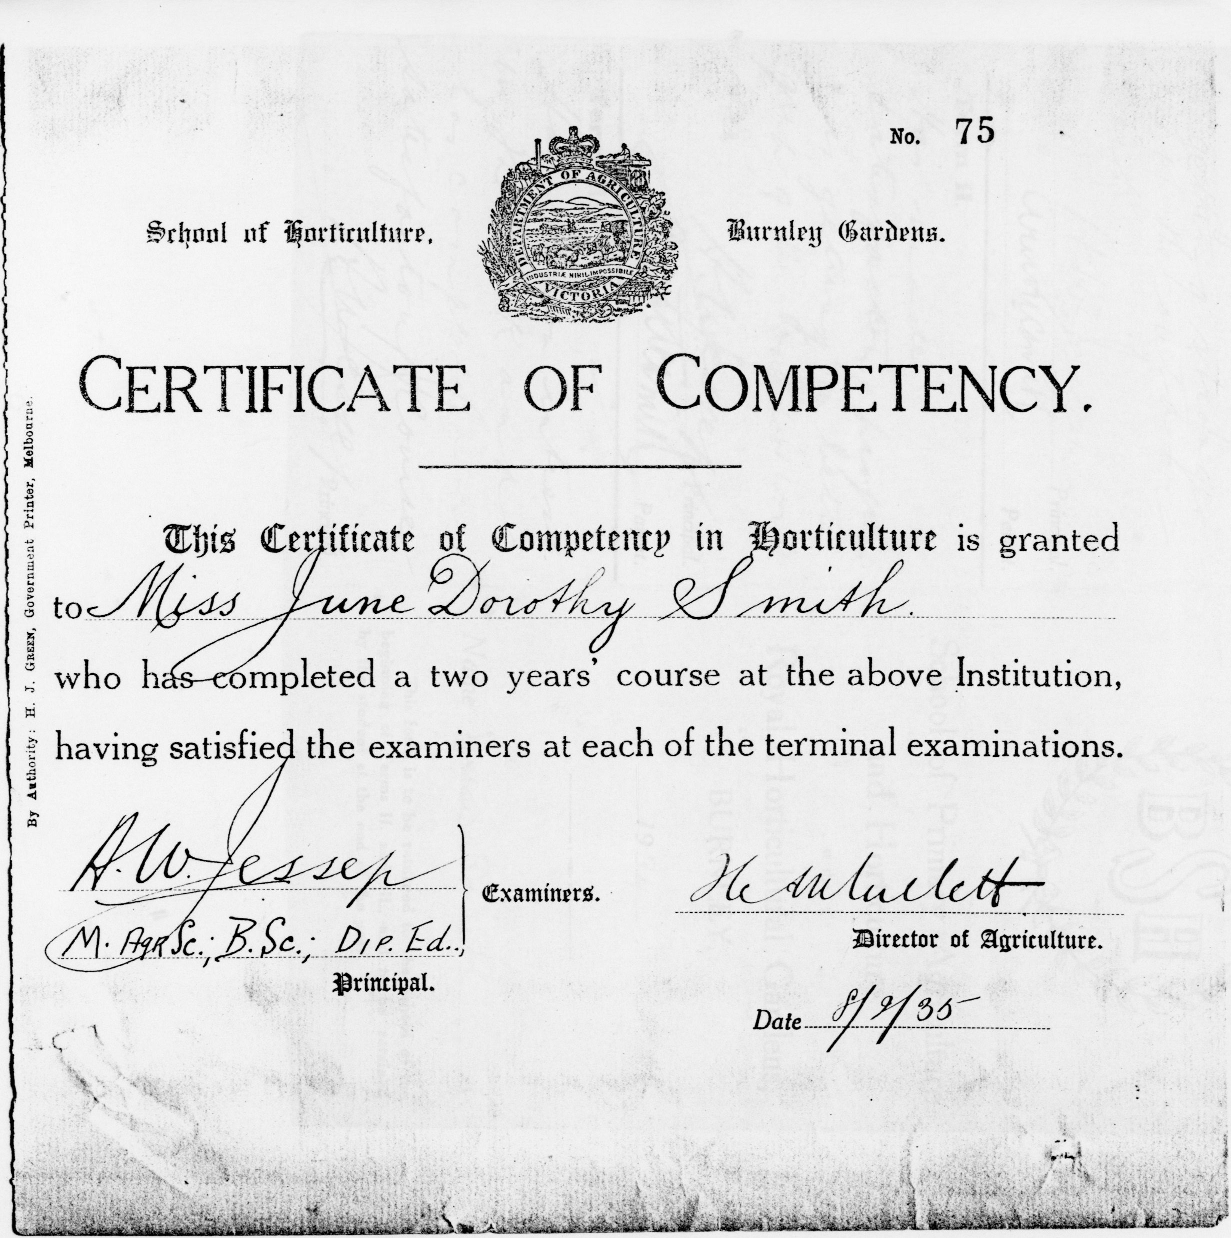
Report card and Certificate

Slide 15
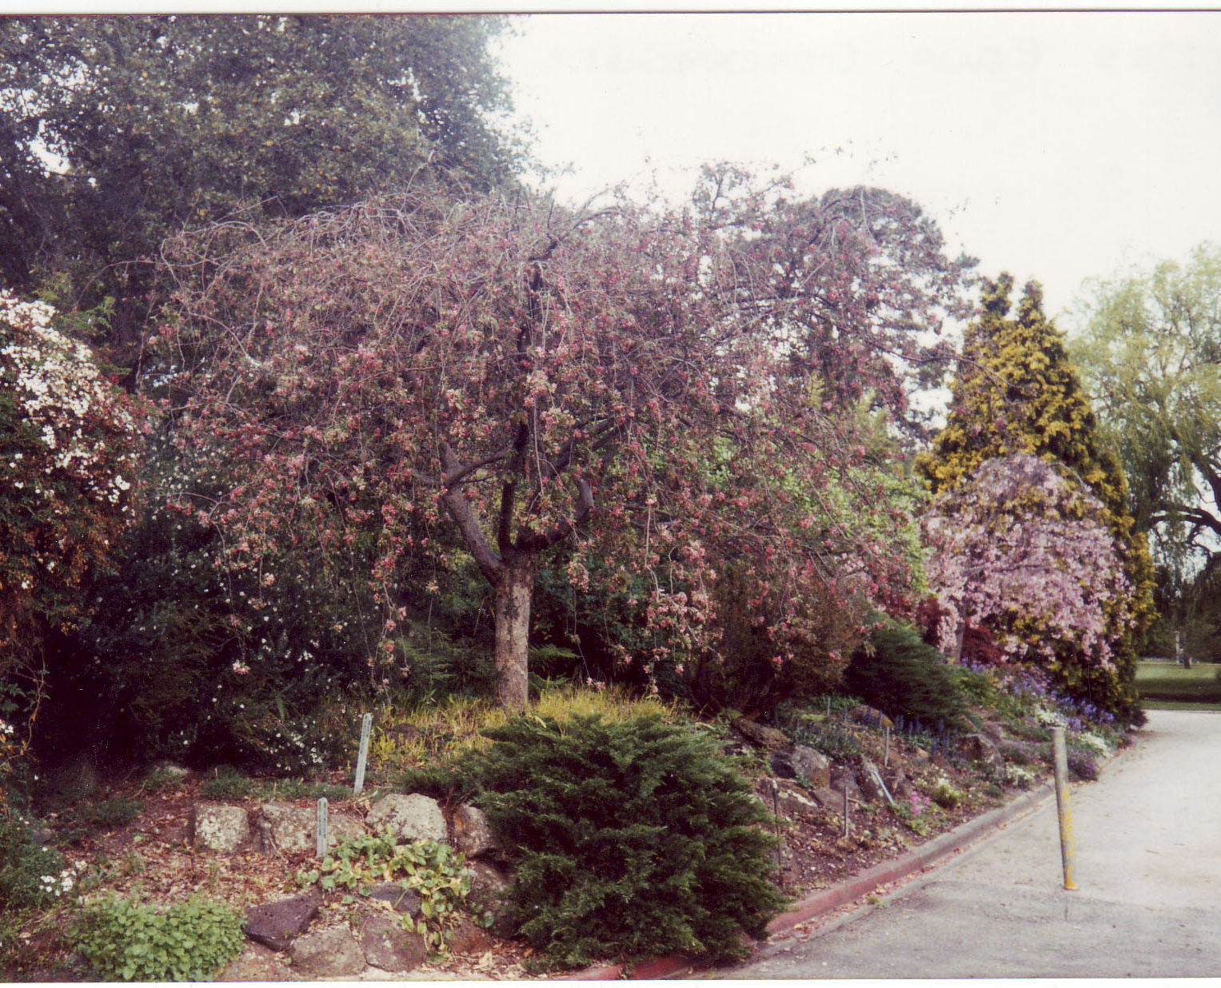
Landscape Design was an important element of instruction
Hilda Kirkhope taught Landscape Design and designed this Rock Garden. The students built it under her instruction

Slide 16
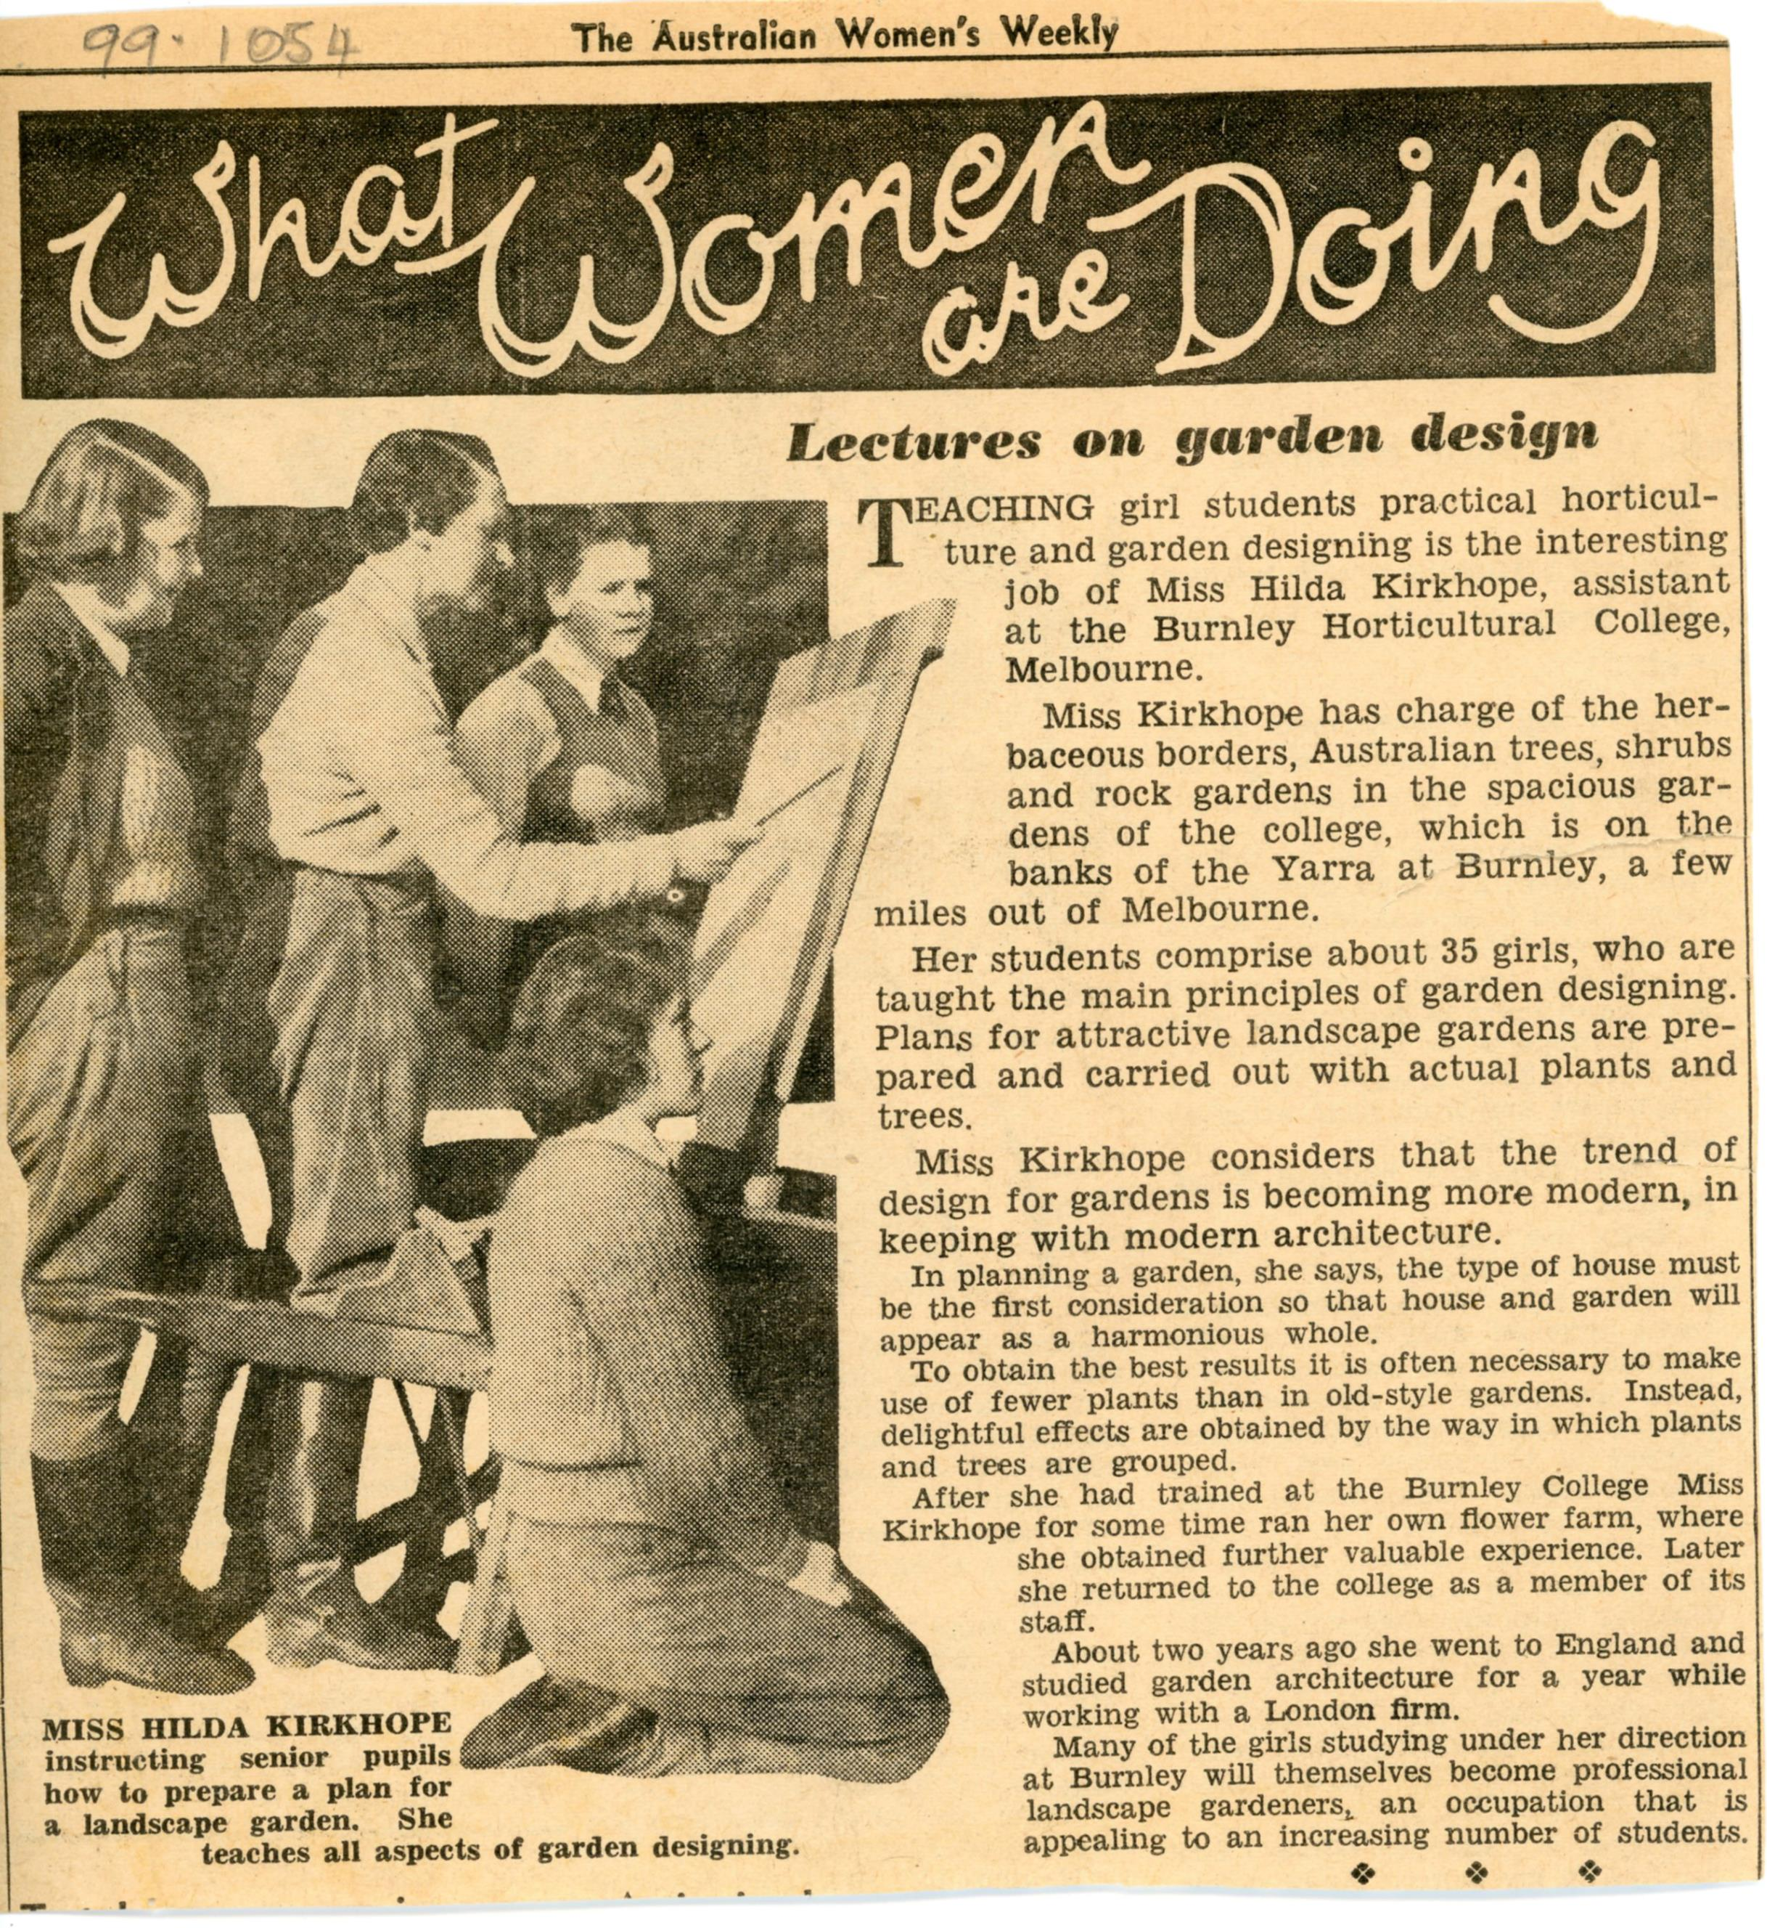

Slide 17
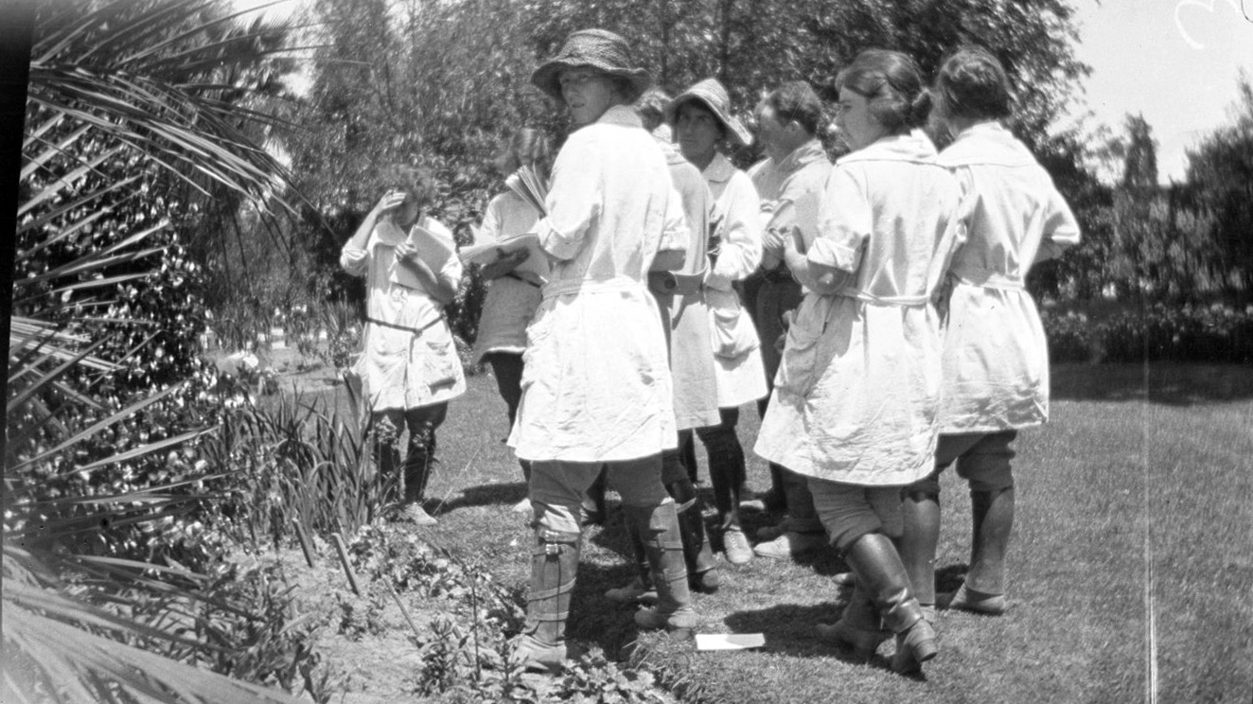
Plant identification was a very important subject

Slide 18
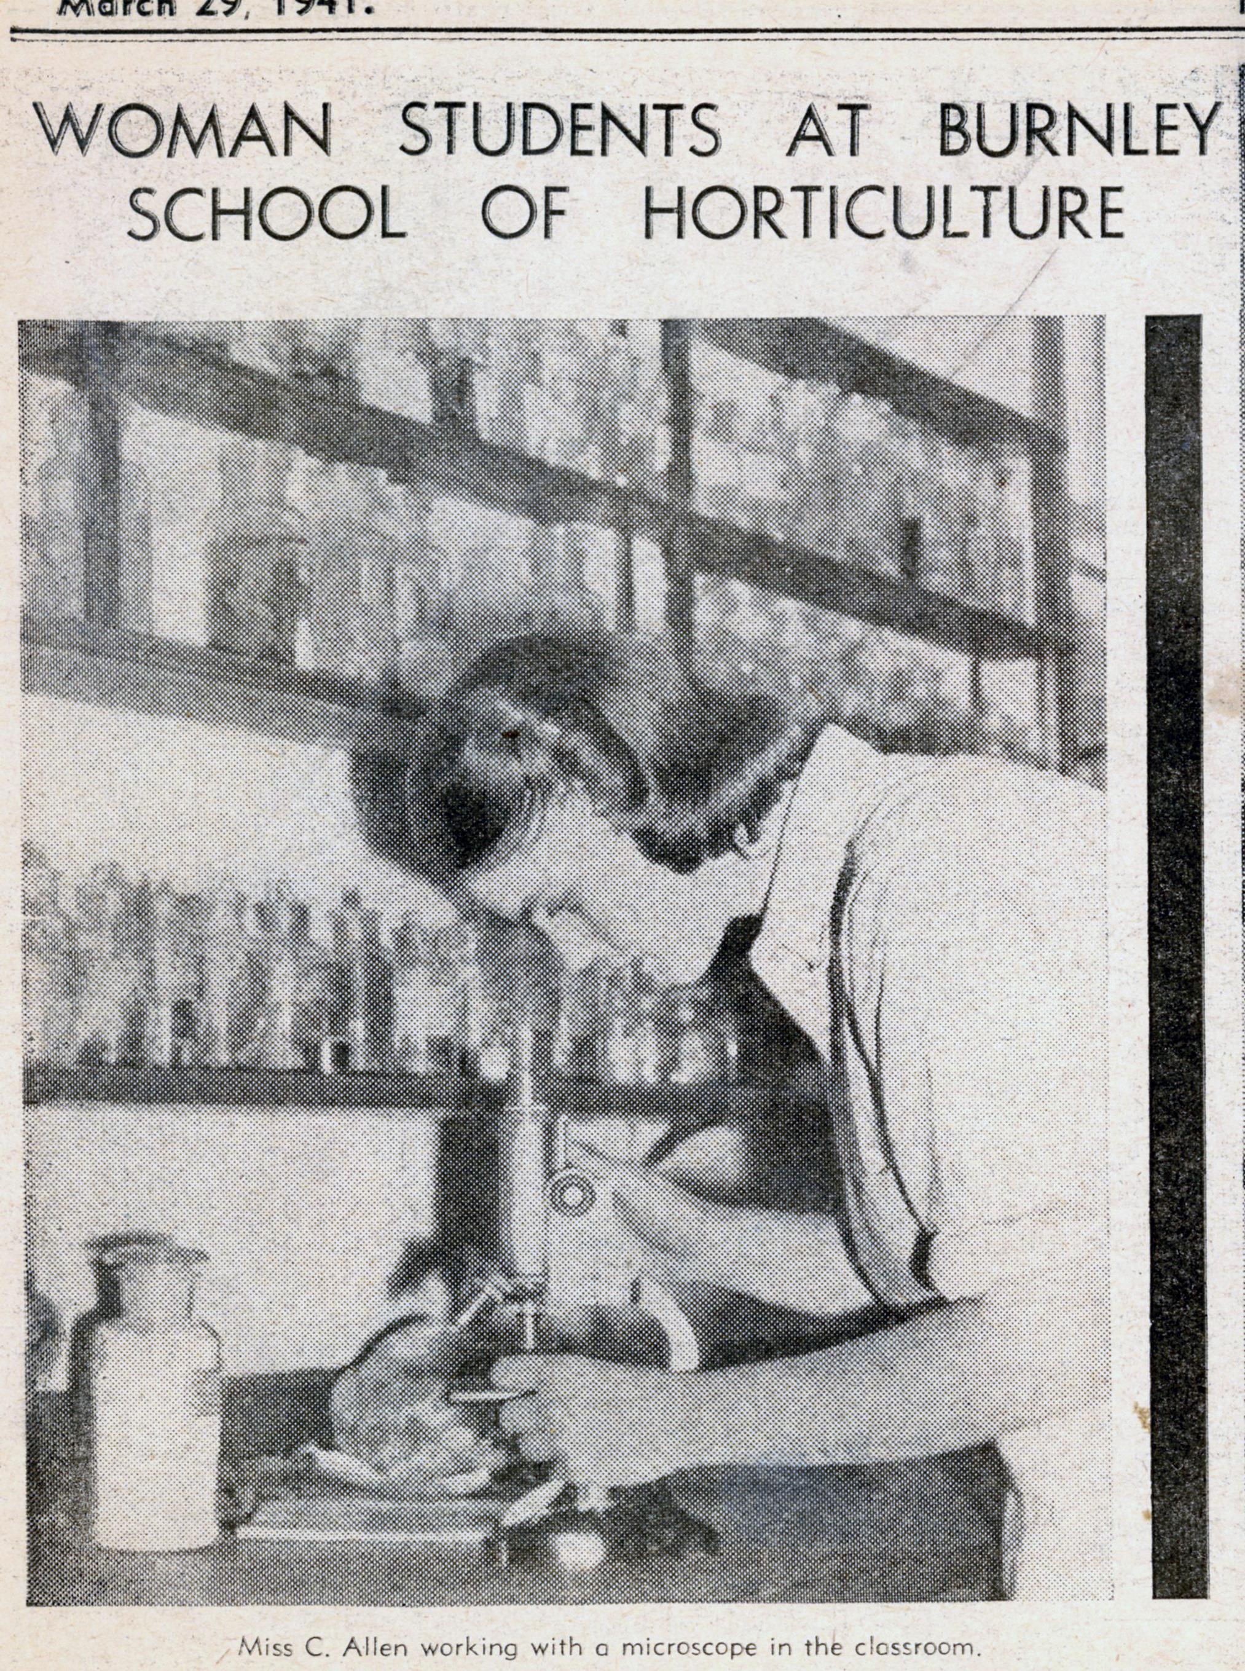

Slide 19
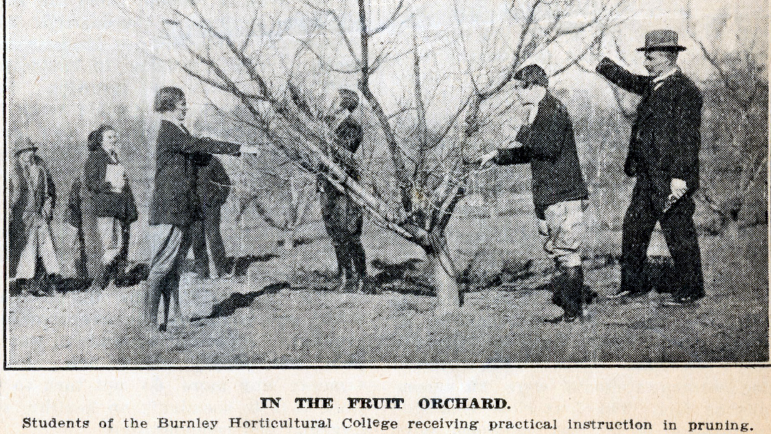

Slide 20
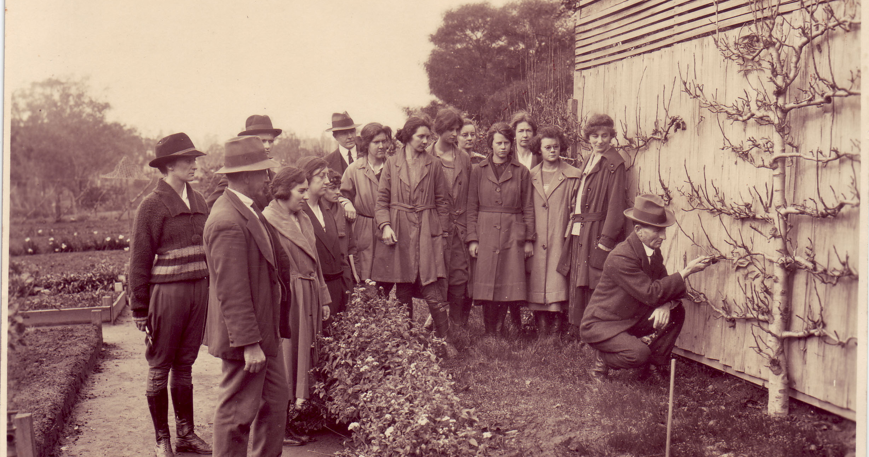

Slide 21
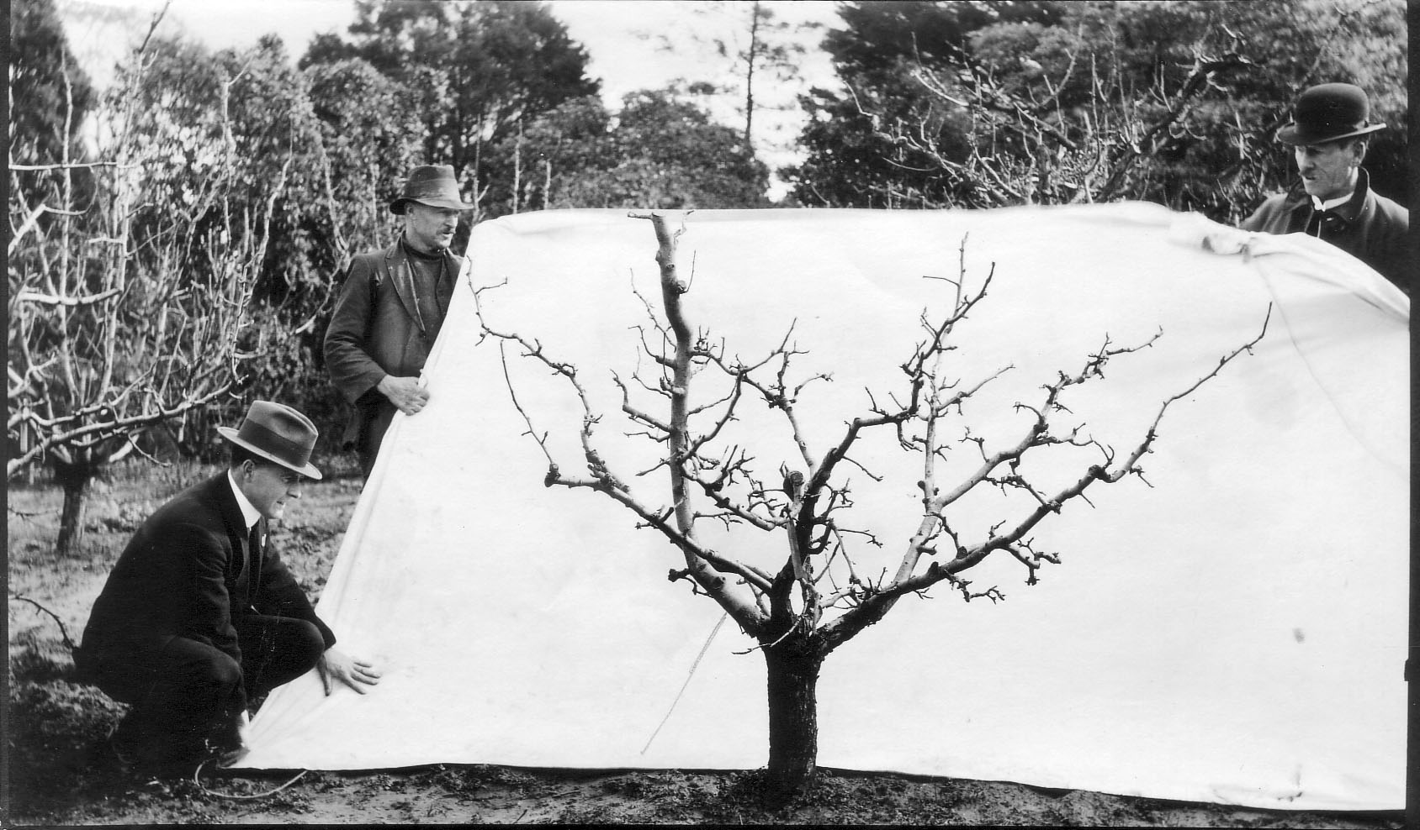
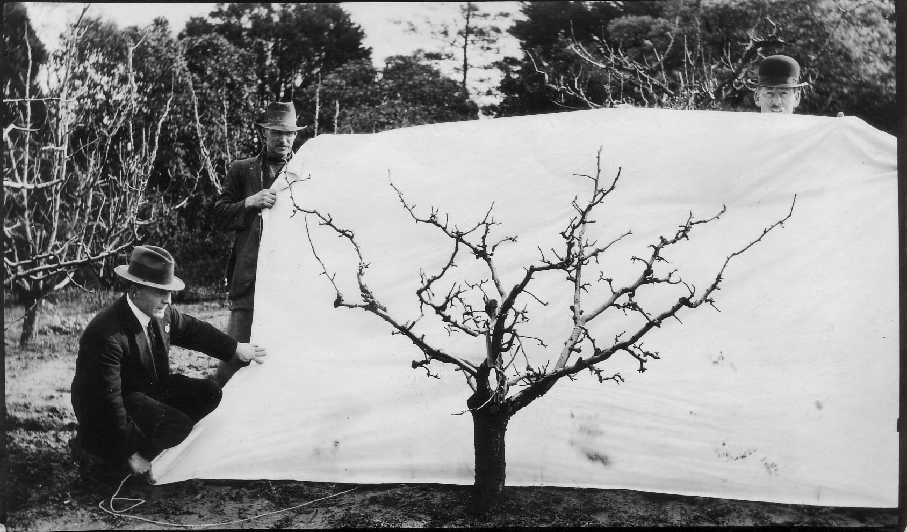

Slide 22
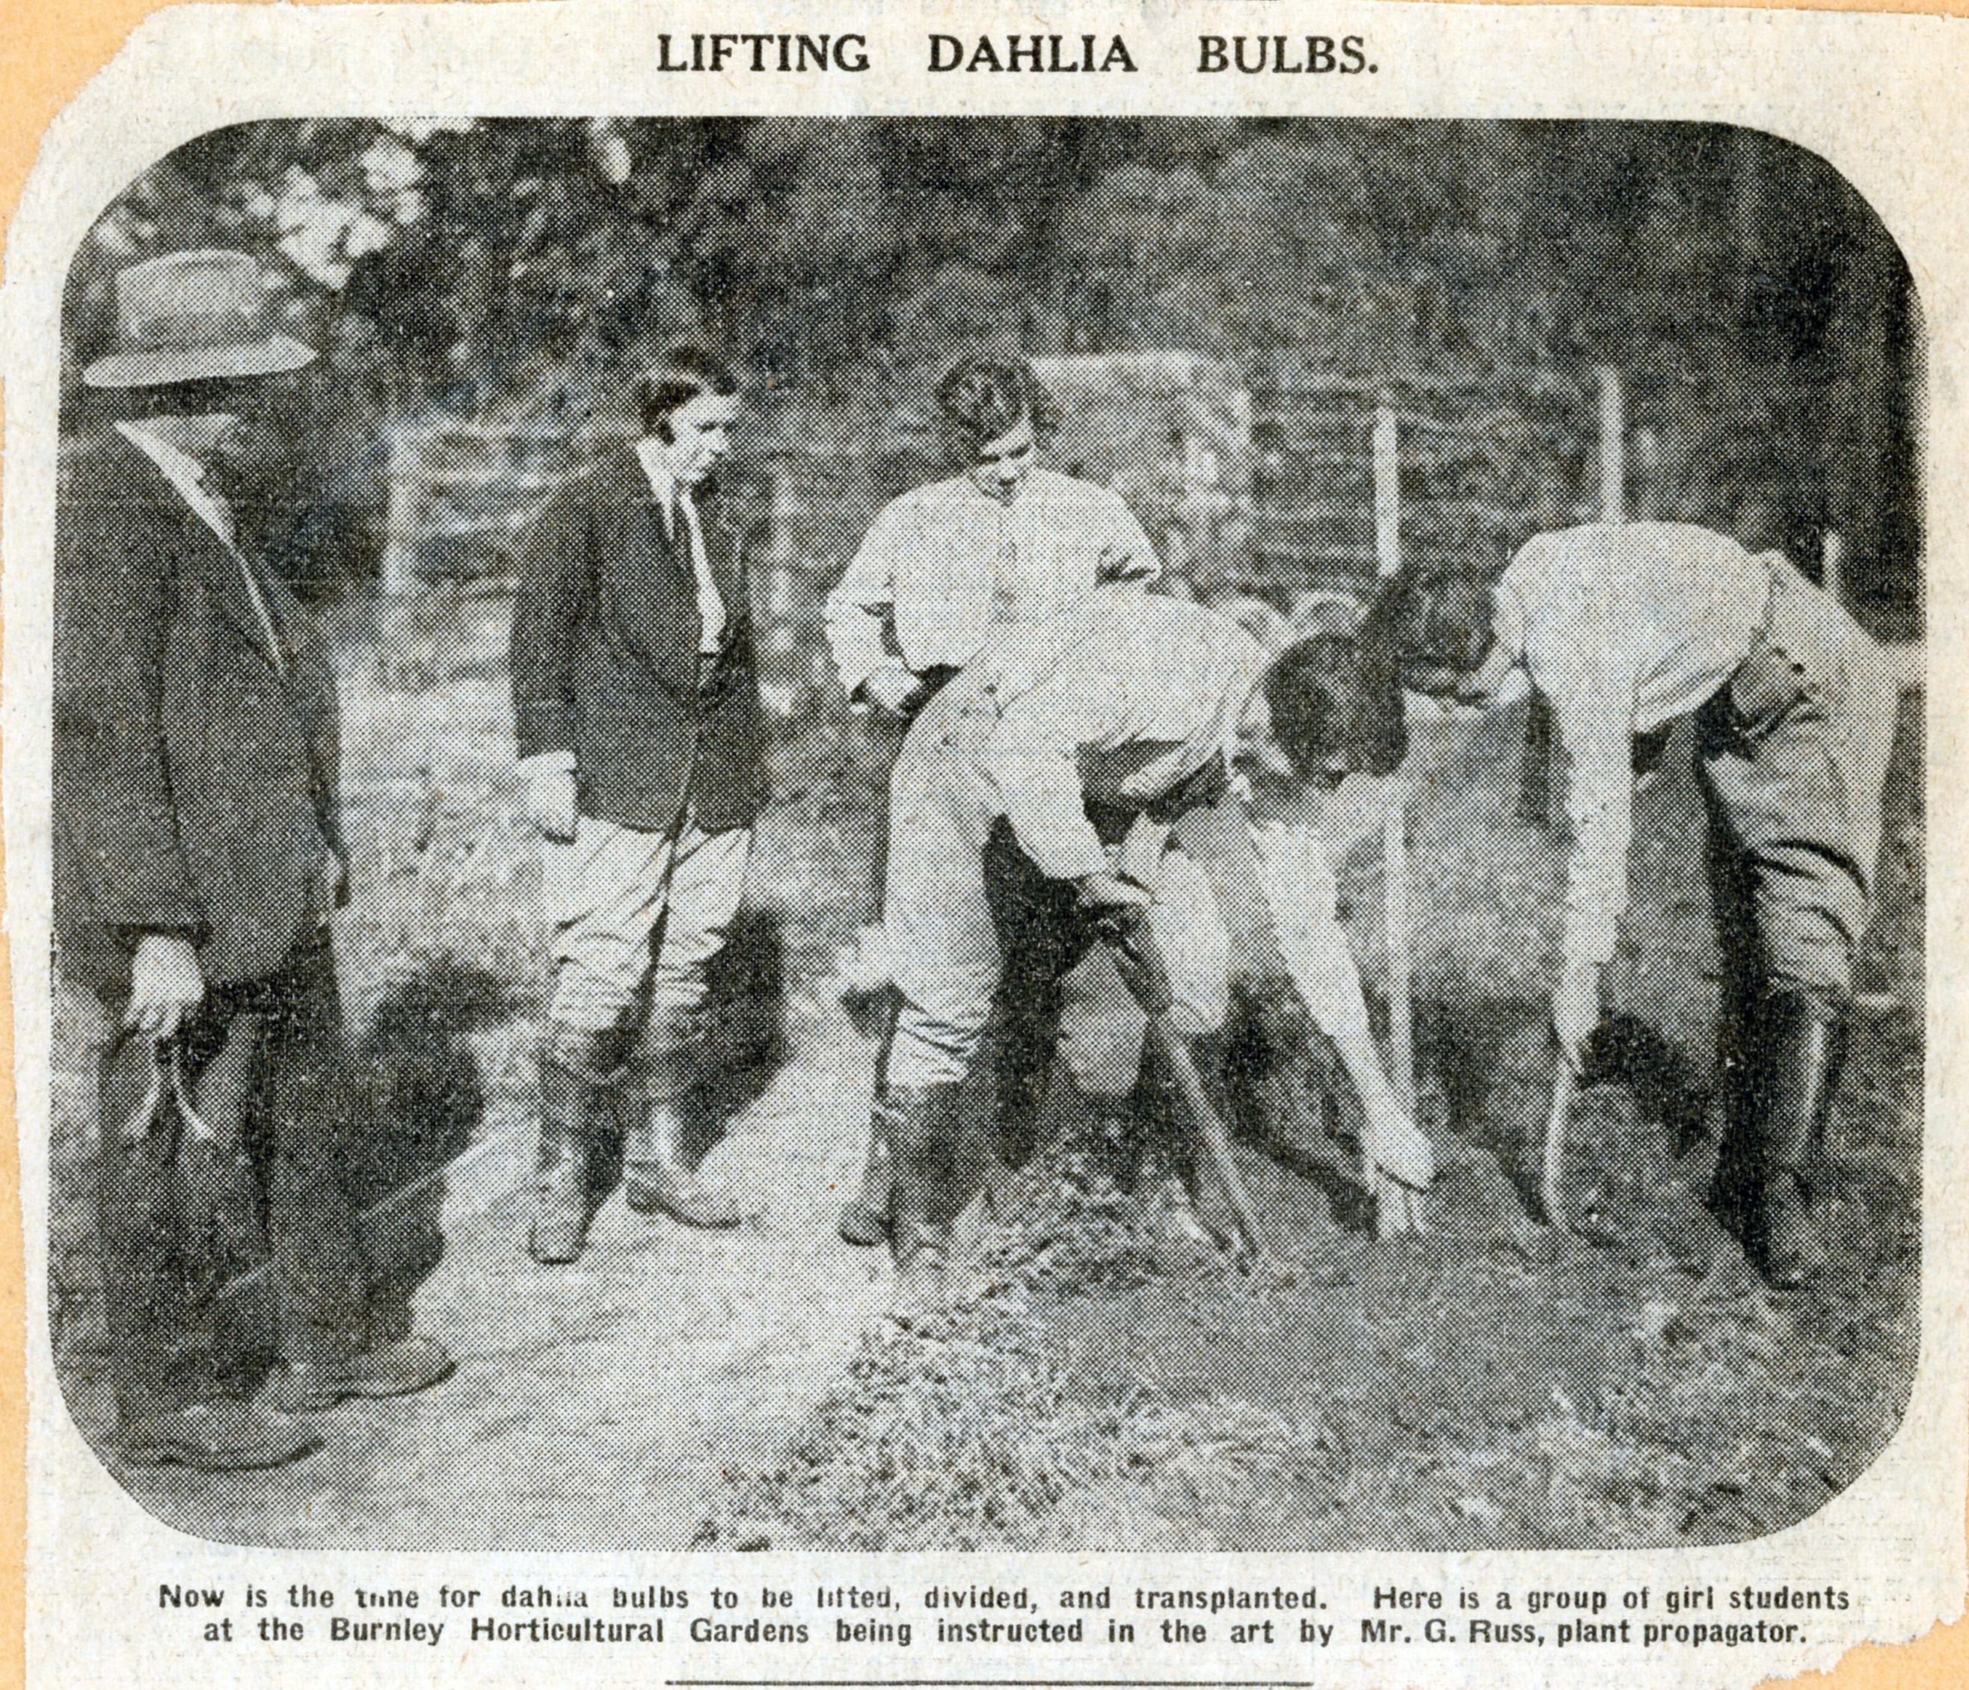

Slide 23
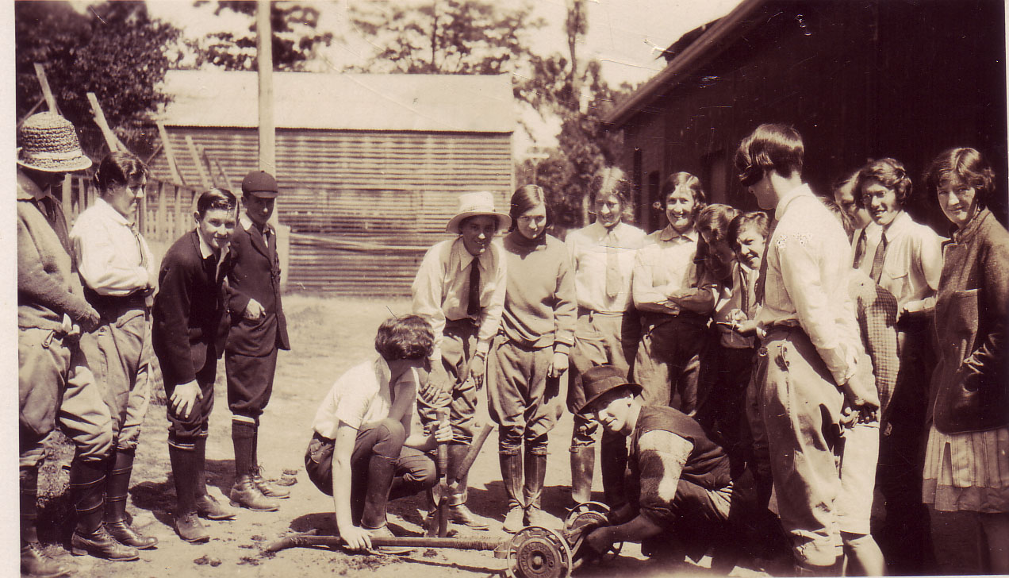

Slide 24
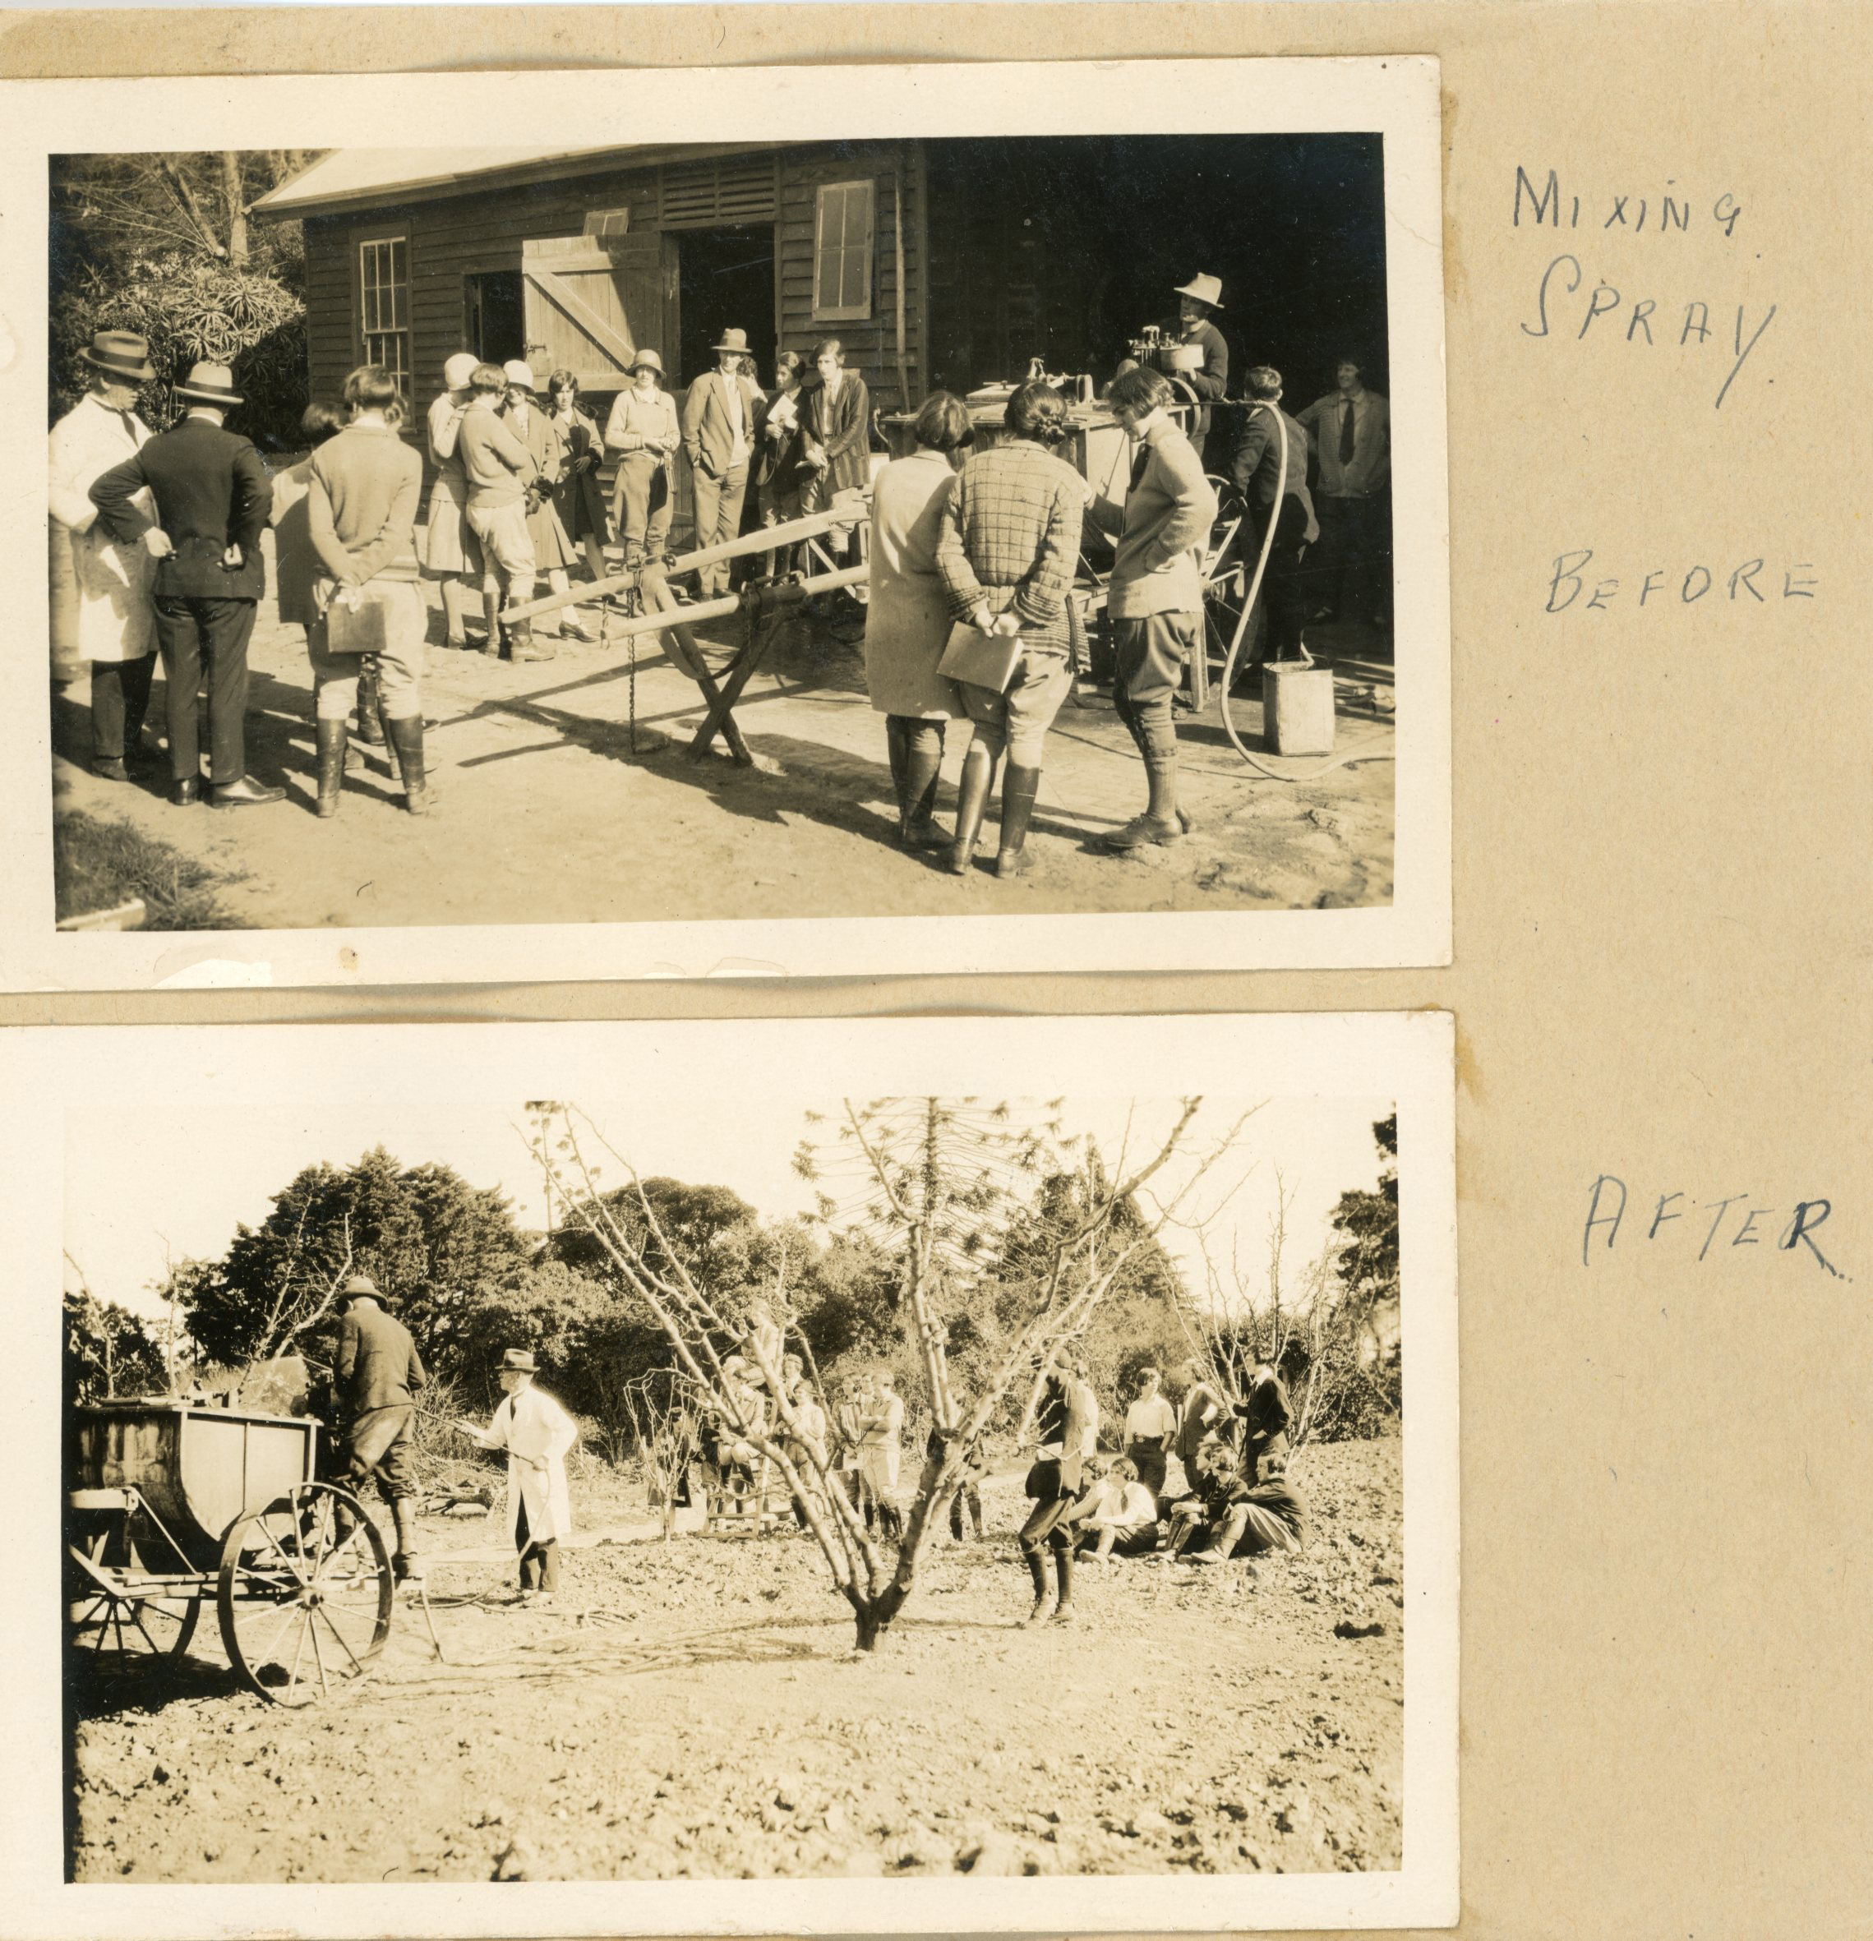

Slide 25
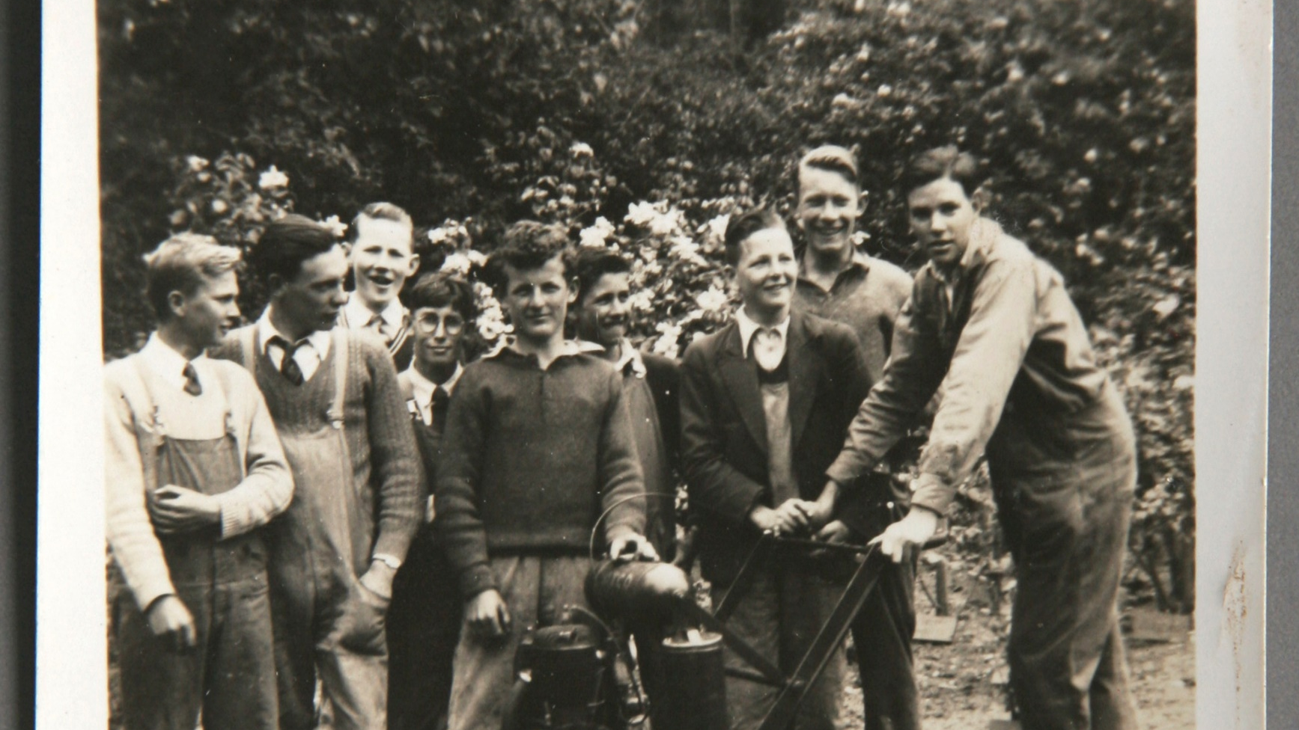

Slide 26
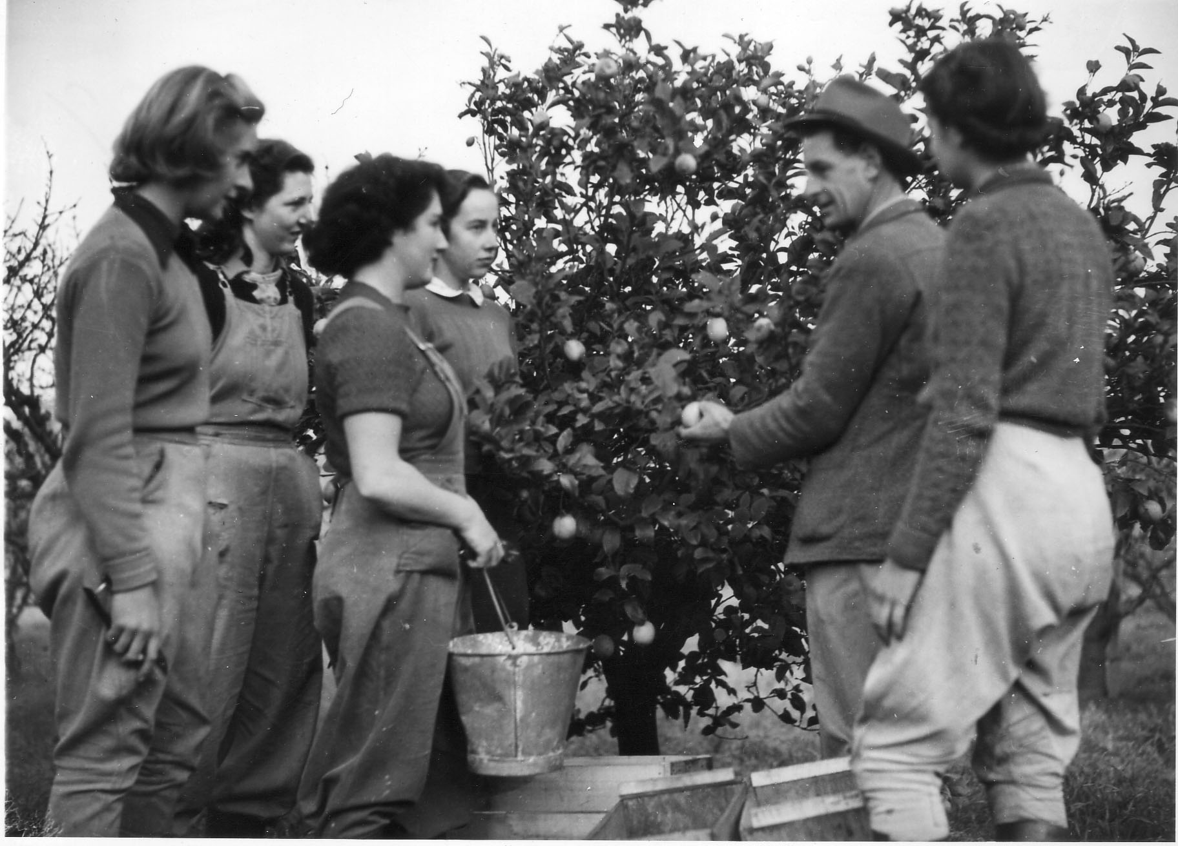

Slide 27
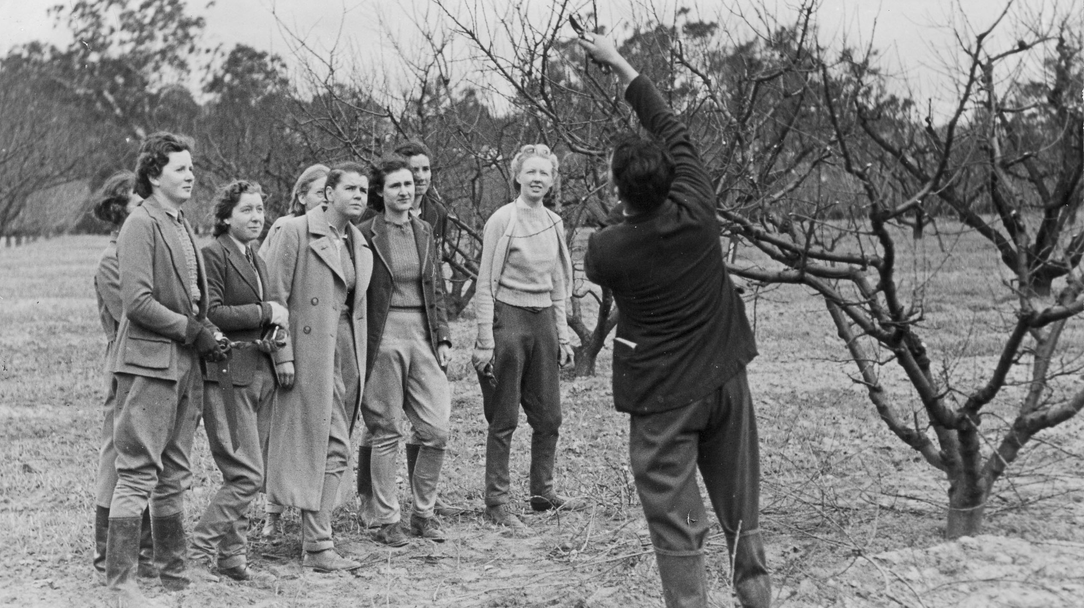

Slide 28
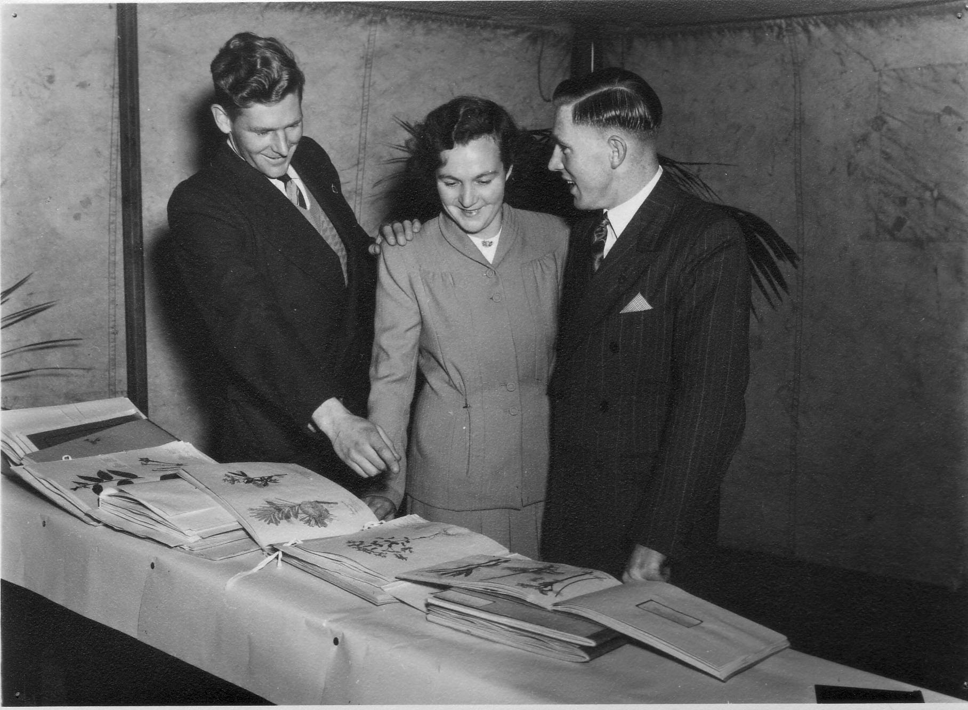
Returned service men and women were given an opportunity to train for a career in horticulture after WWII

Slide 29
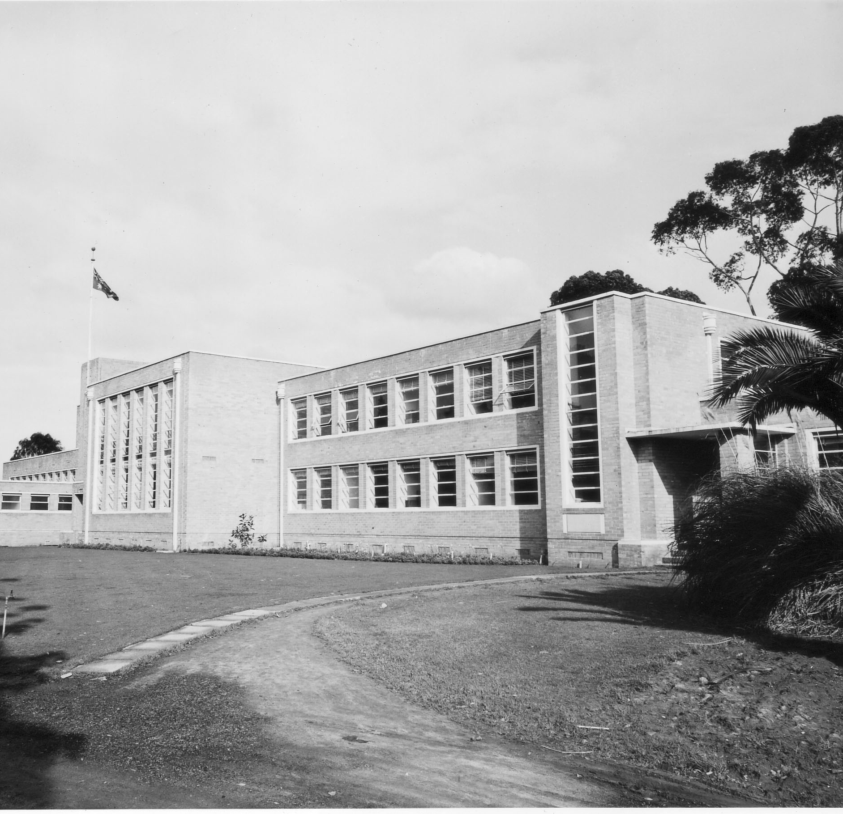
Funding from the Commonwealth Reconstruction Training Scheme allowed for the construction of a new School Building to replace the old Pavilion in 1949

Slide 30
DIPLOMA OF HORTICULTURE
Introduced in 1958 to allow students to compete for jobs requiring higher qualifications

Slide 31
BURNLEY HORTICULTURAL COLLEGE
The name was changed to help lift the image of the school and a College Logo was designed by Douglas Kneen, brother of the Principal, T. H. Kneen

Slide 32
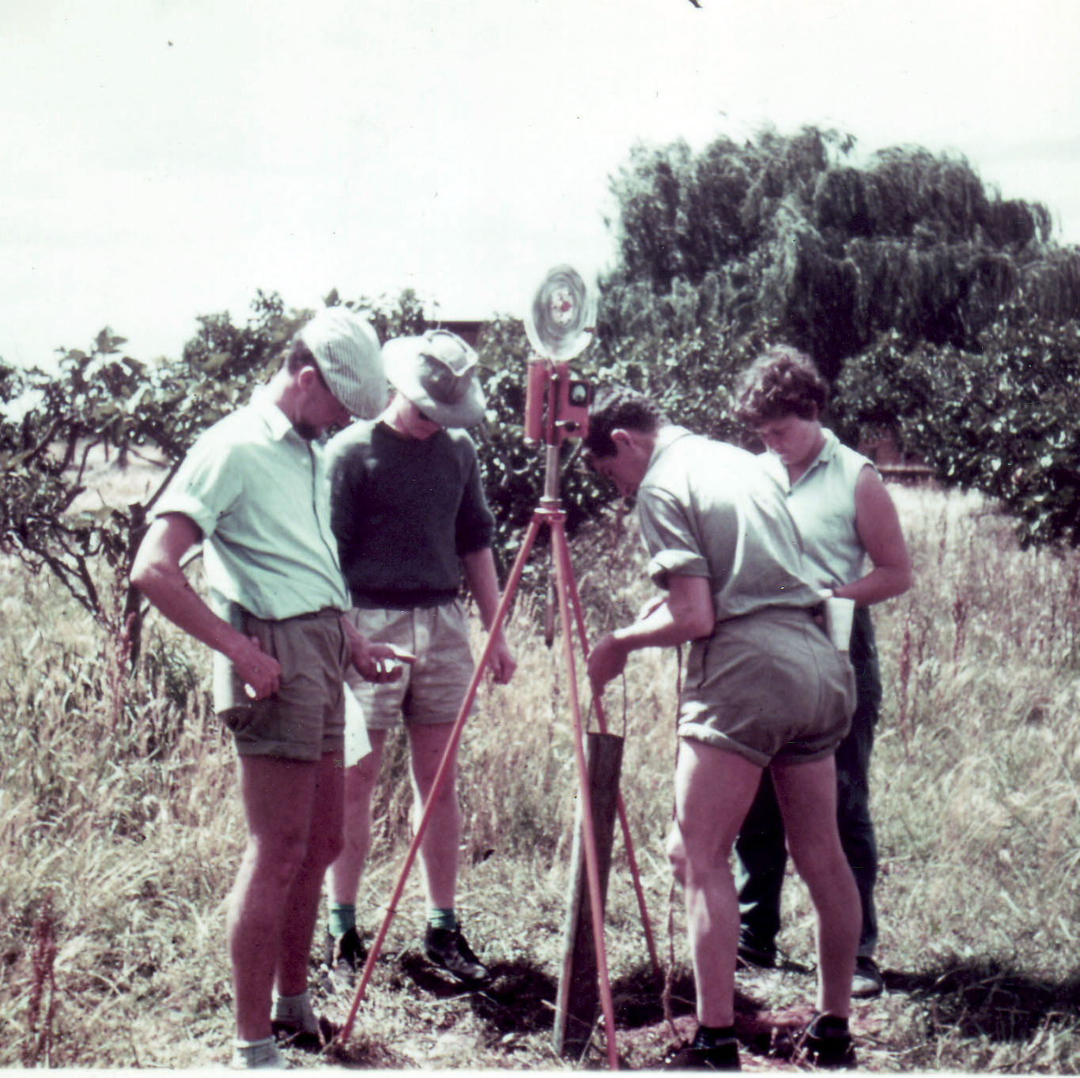
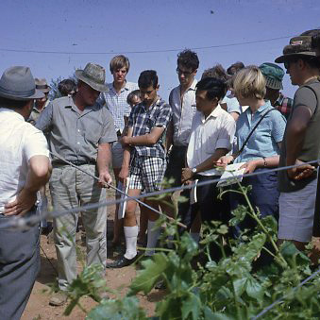
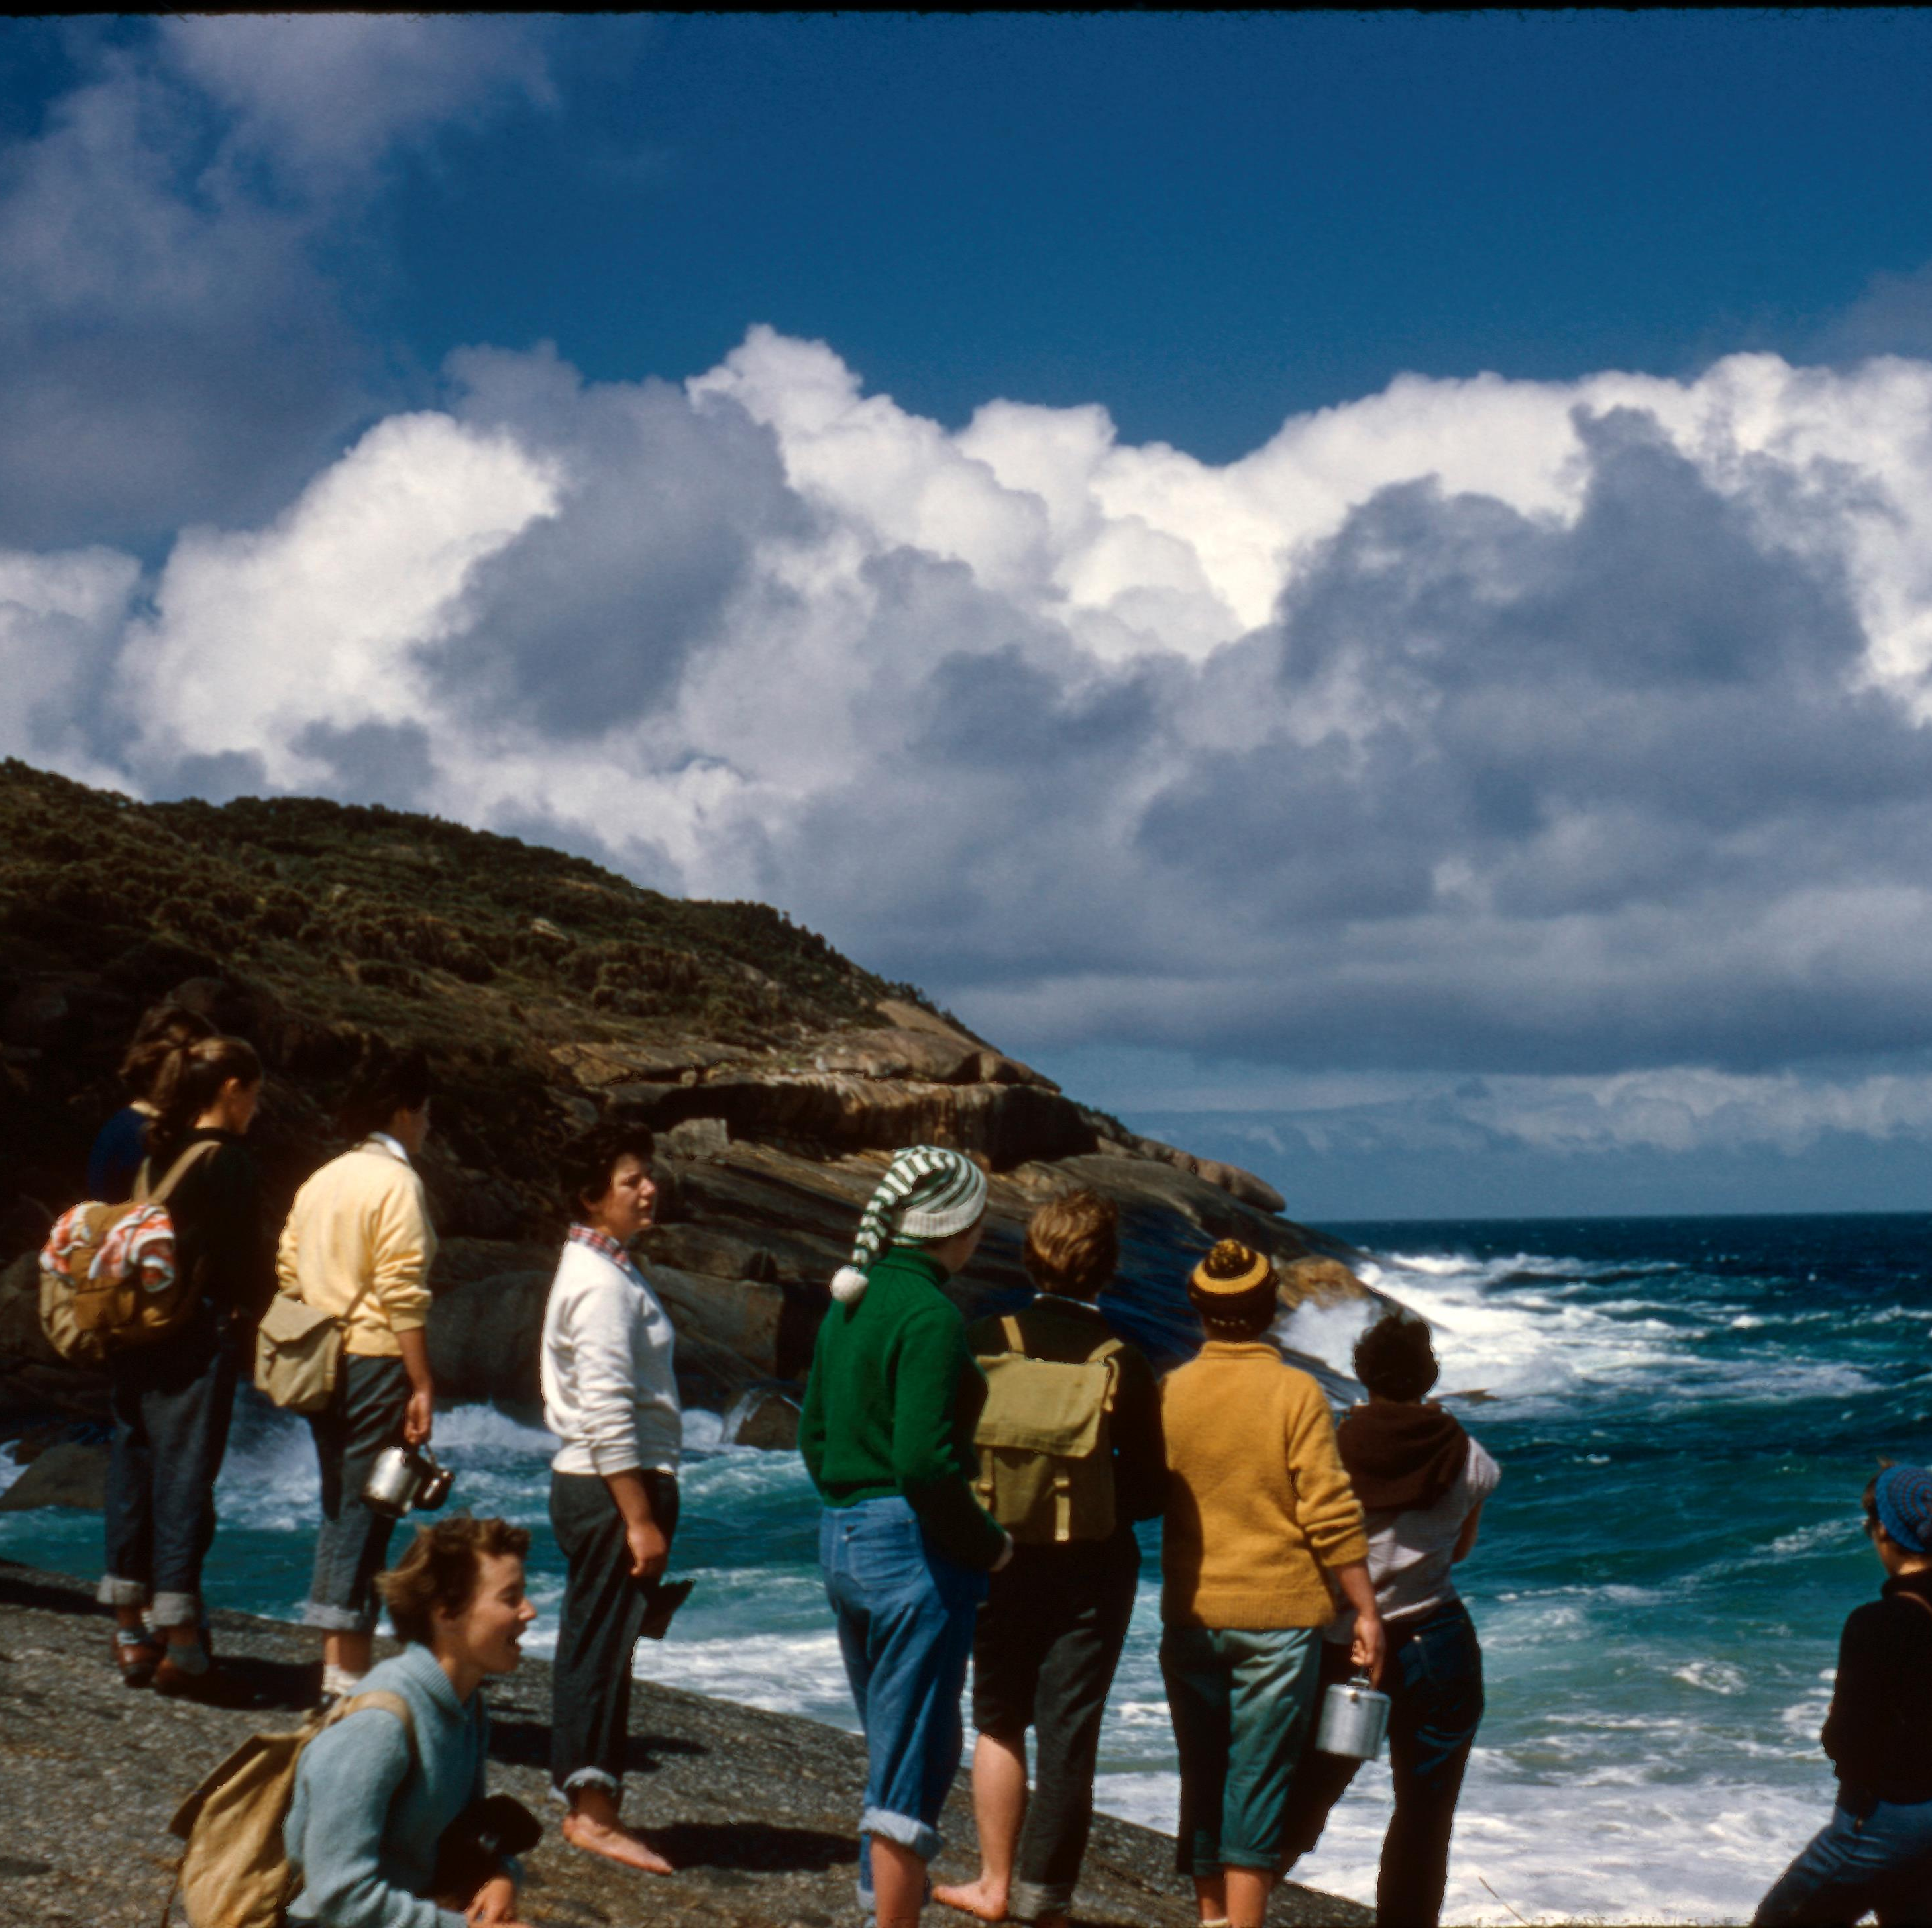
During the 1950’s and 1960’s Camps to Wilson’s Promontory and Sojourns to Tatura and Mildura Horticulture Research Stations became part of the Curriculum

Slide 33
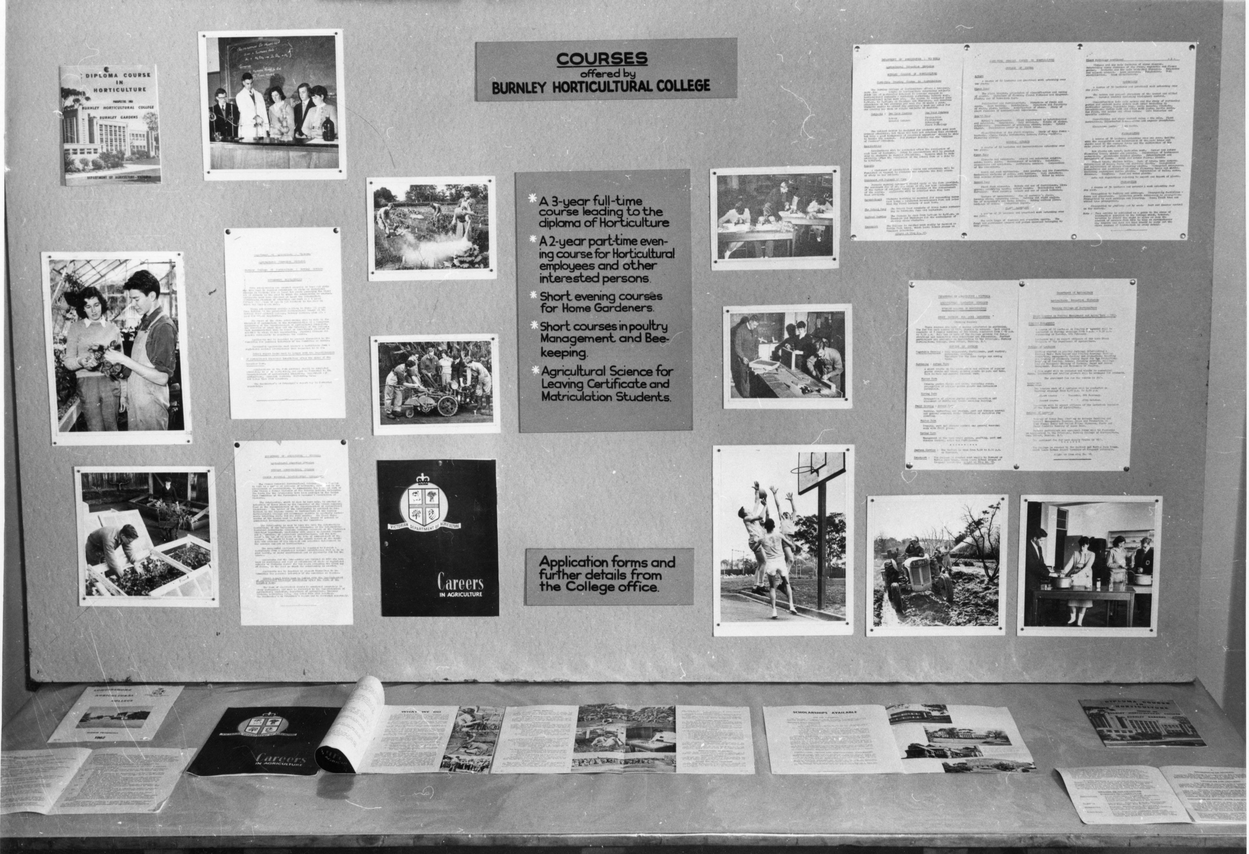
Courses offered in the 1960’s

Slide 34
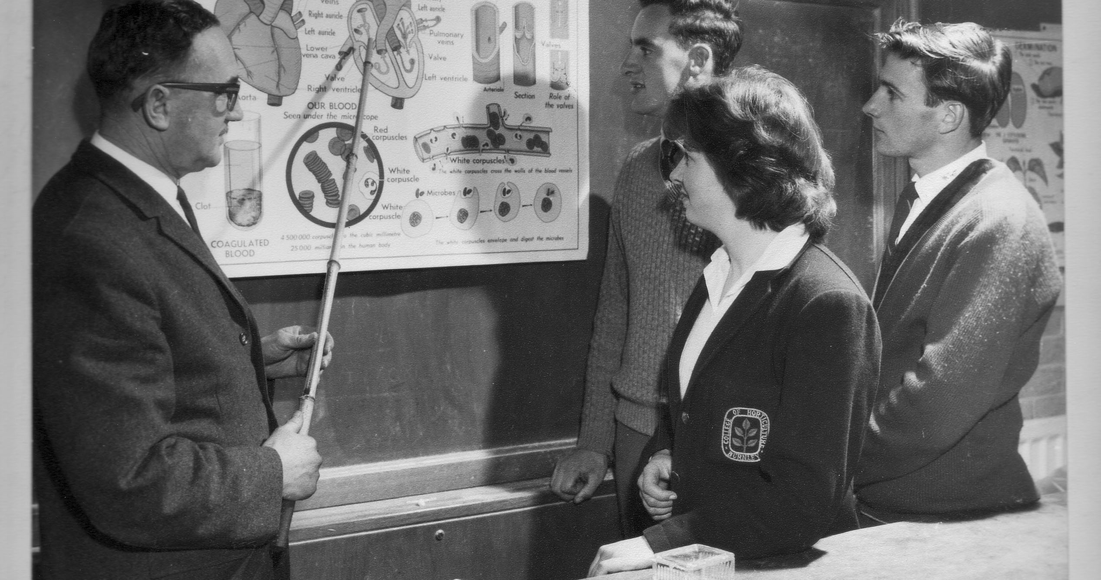

Slide 35
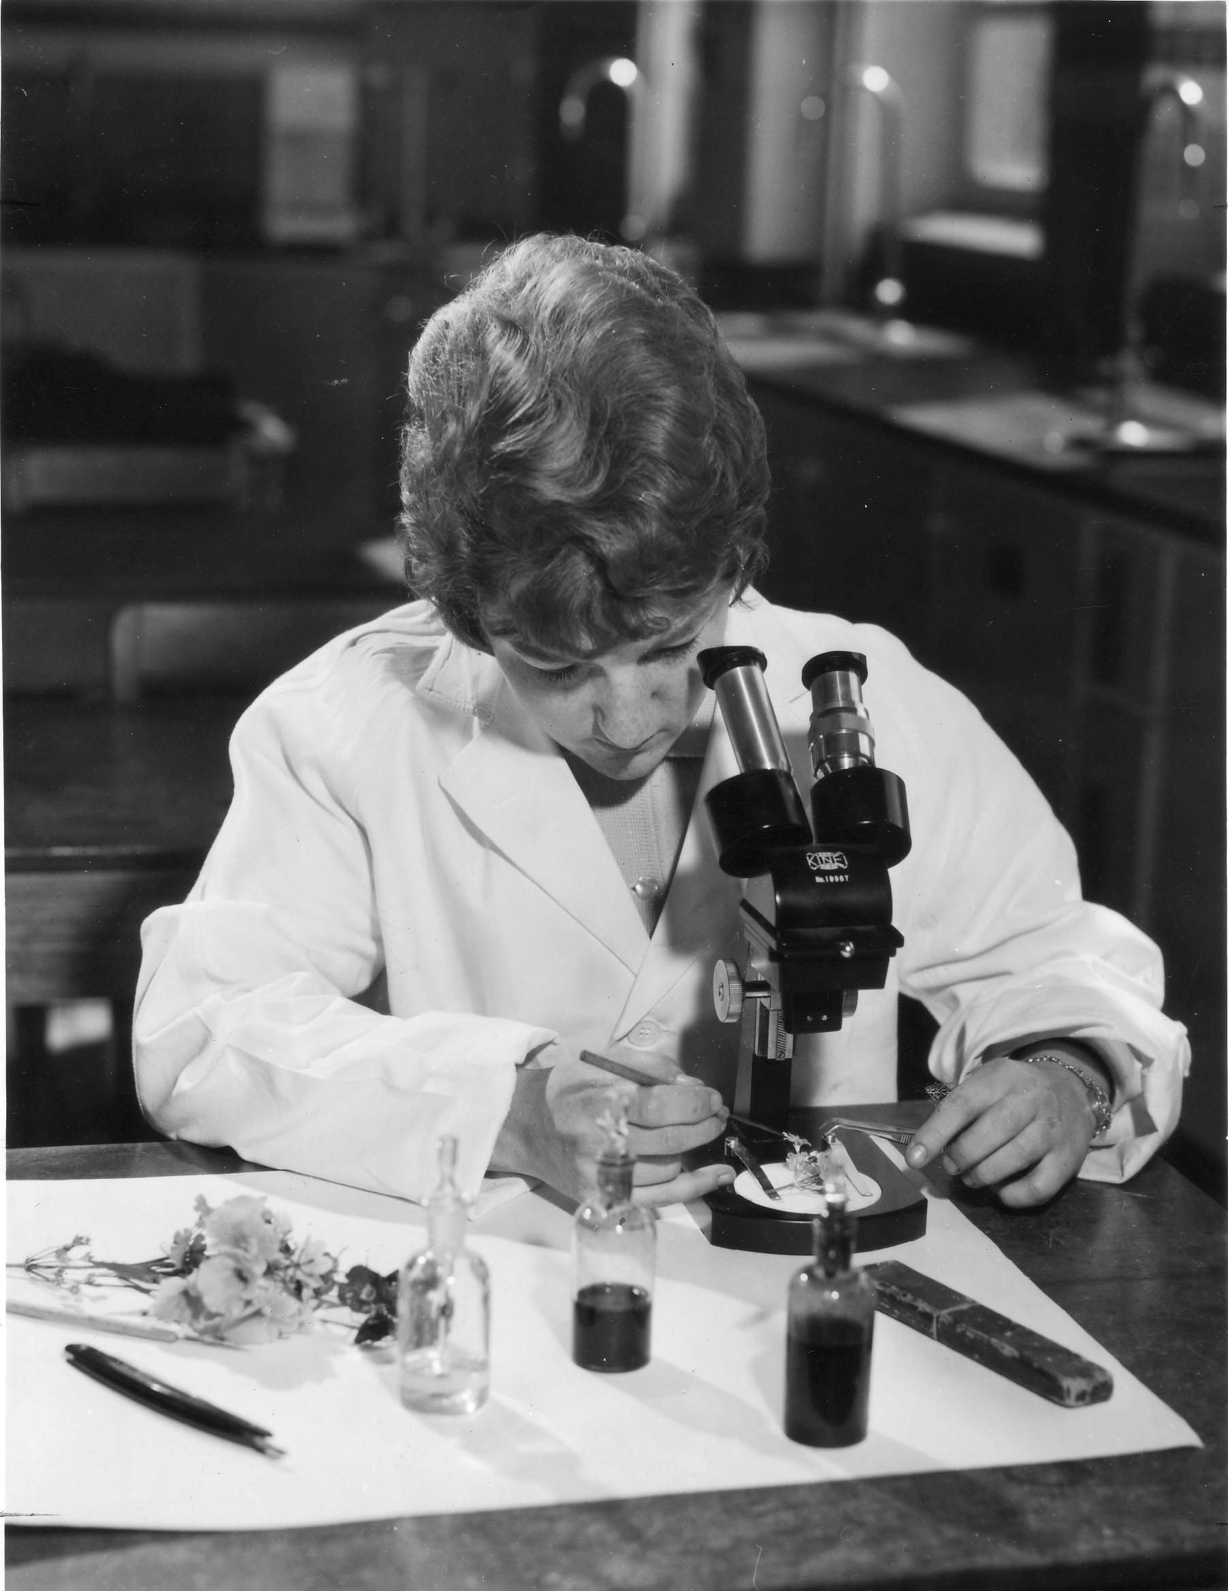
More emphasis on science

Slide 36
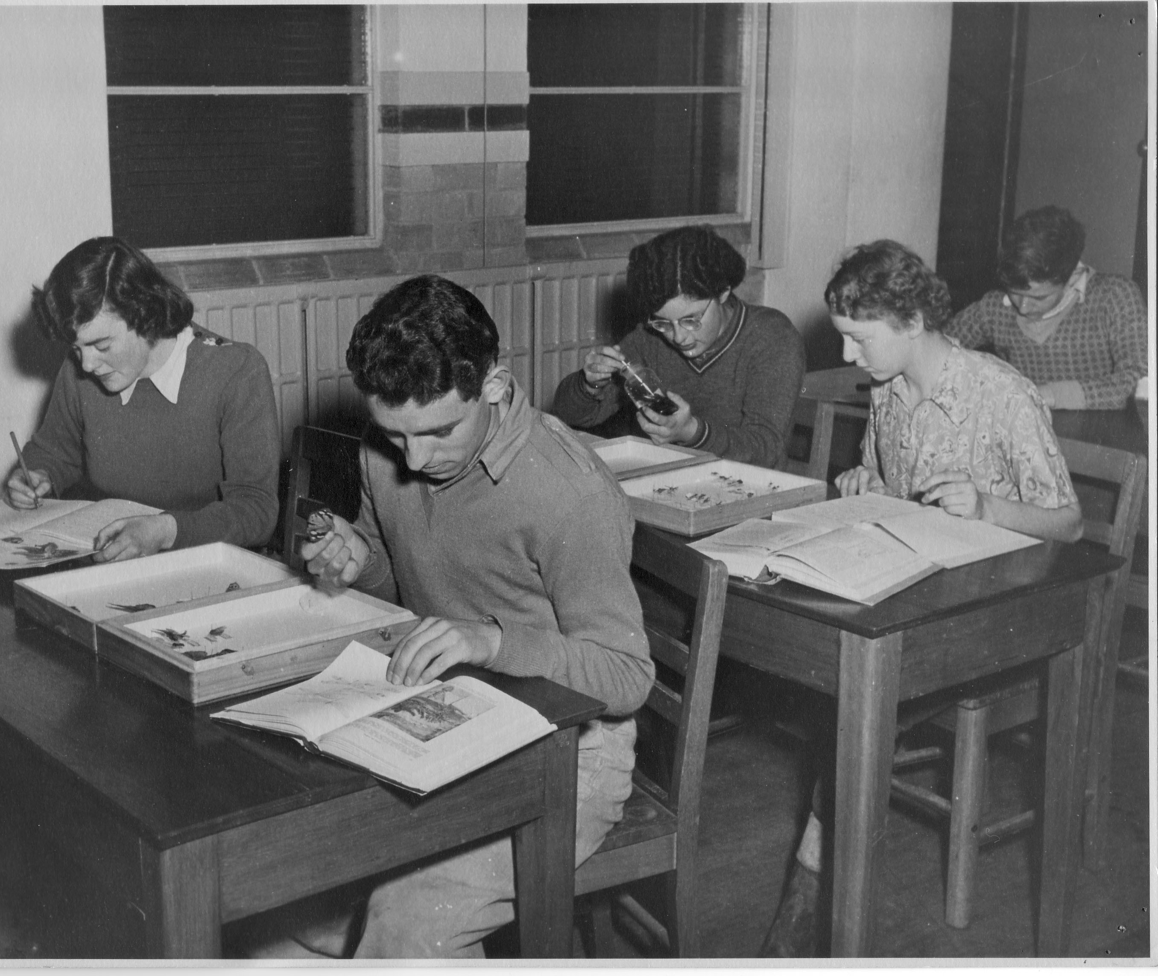
Students studying entomology with their own insect collections

Slide 37
DIPLOMA OF HORTICULTURAL SCIENCE
In 1967 a new Diploma was introduced with a more tertiary oriented content. Completion of this course could lead directly to University entry. A new emphasis on Chemistry and less Practical time.

Slide 38
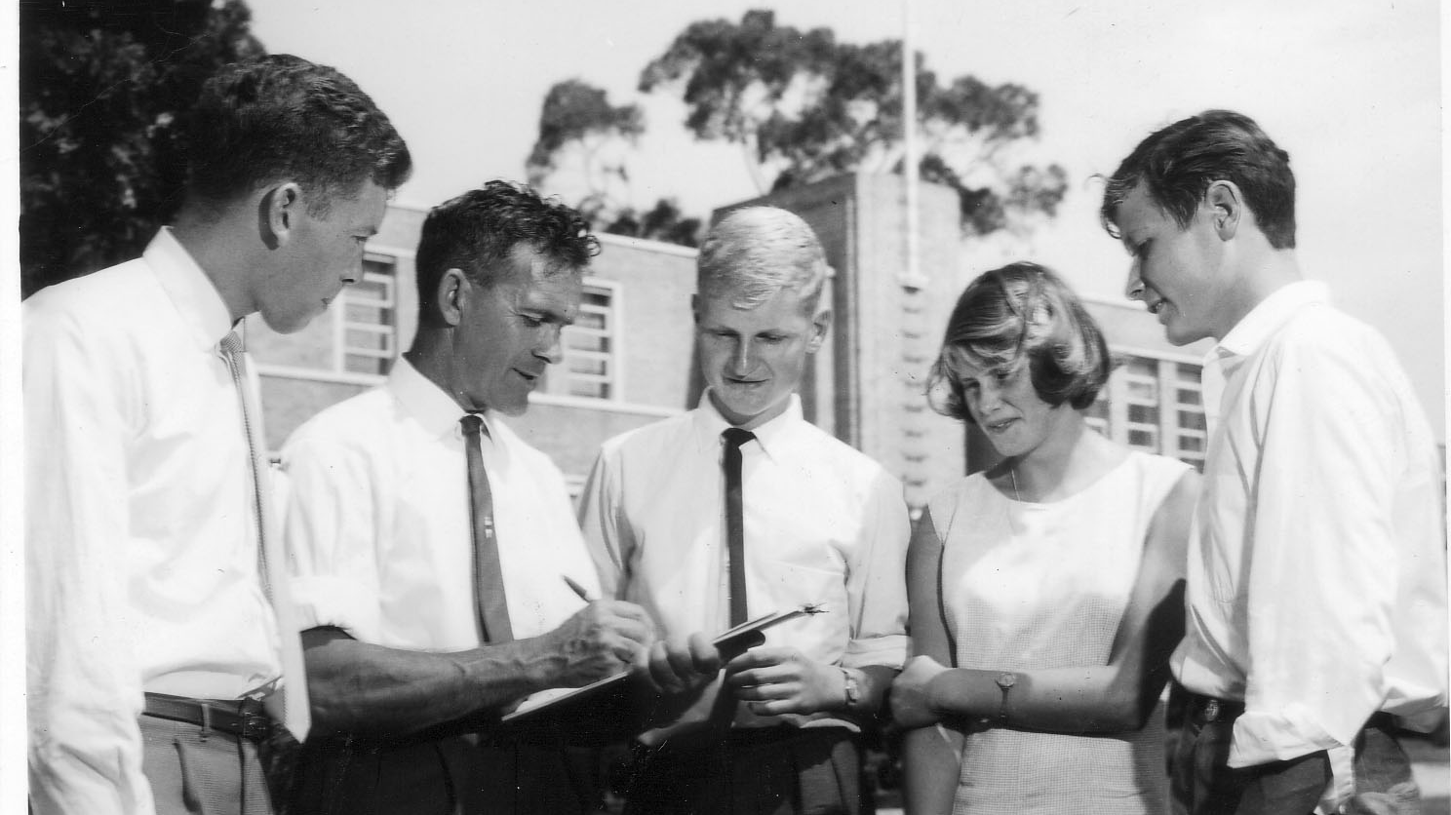

Slide 39
In the 1970’s and 1980’s
Increased time spent on Research Projects. Horticultural crop production and management gave way to more amenities training.

Slide 40
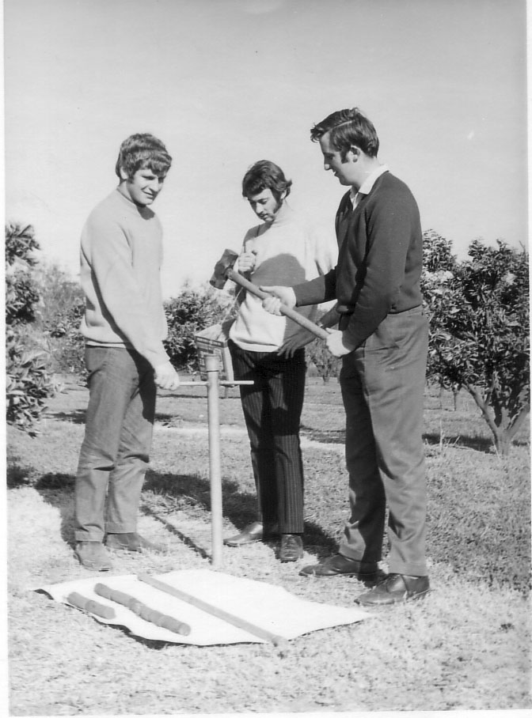
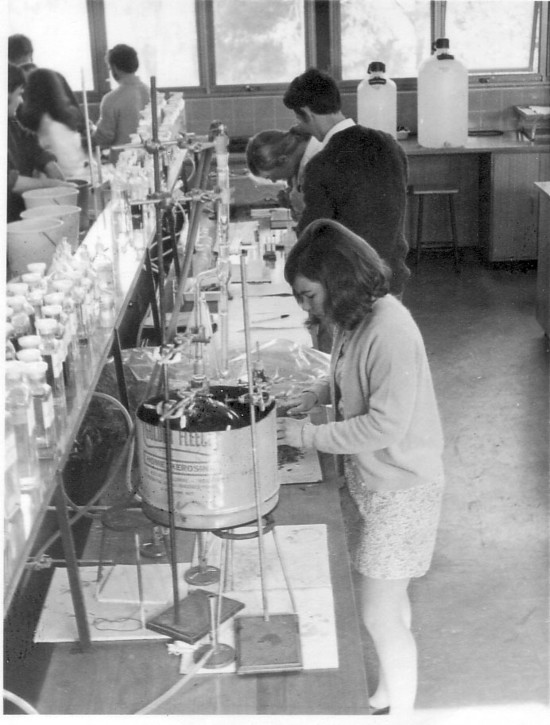
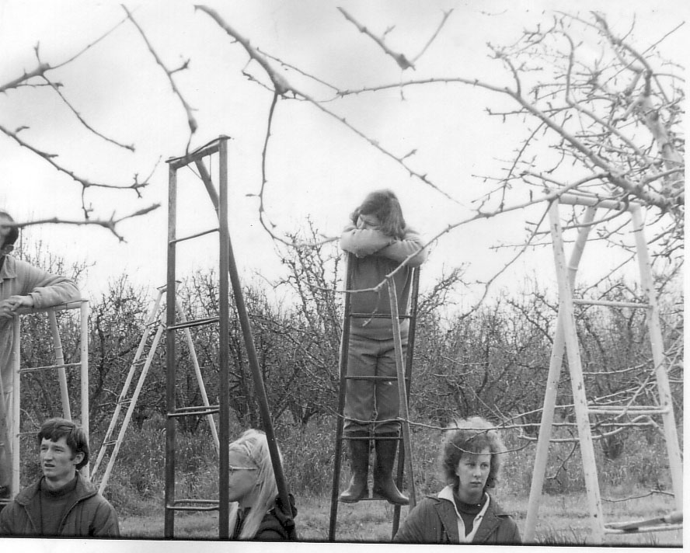

Slide 41
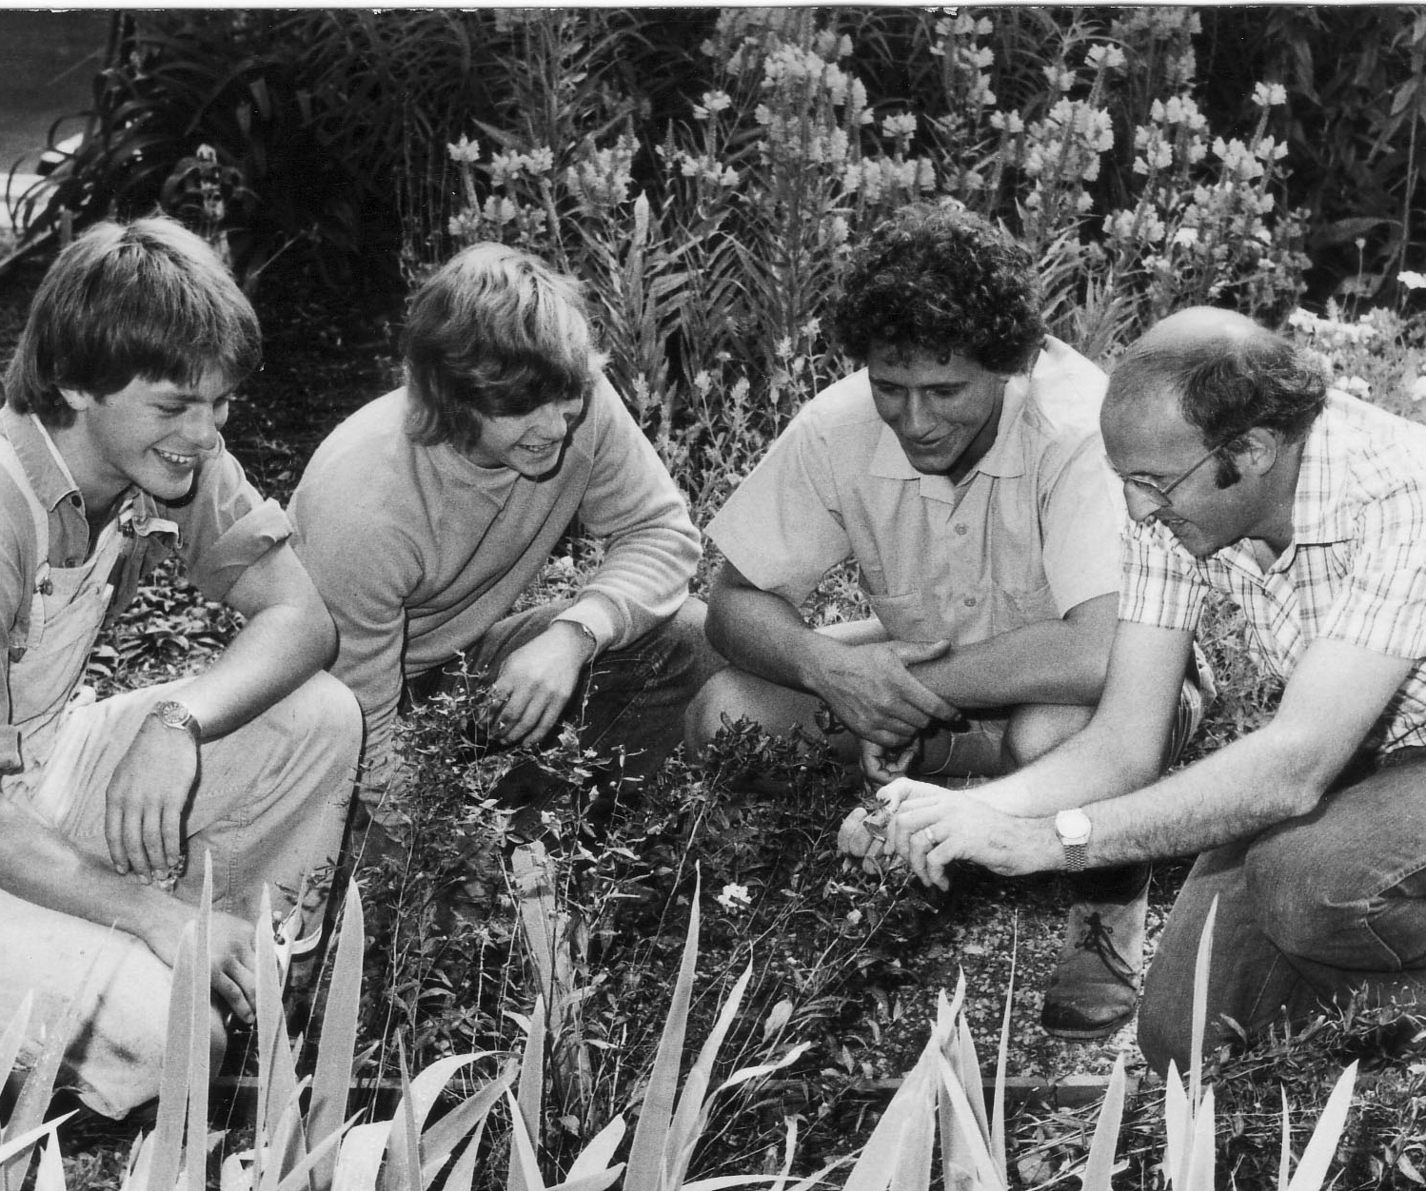
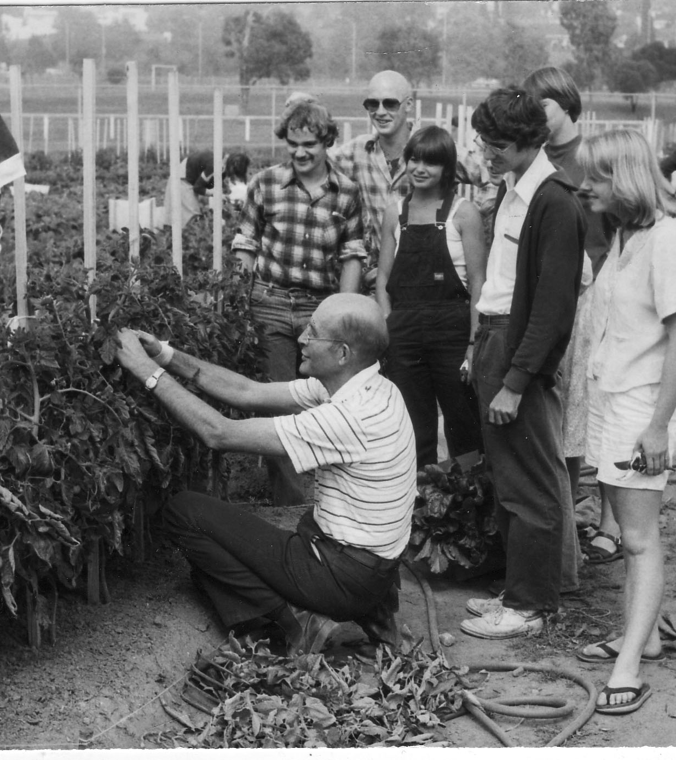
Plant identification and tomato growing

Slide 42
VICTORIAN COLLEGE OF AGRICULTURE AND HORTICULTURE
1983-1996
The College was no longer part of the Dept. of Agriculture. It was part of an autonomous organisation administered by a Council under the control of the Minister for Education

Slide 43
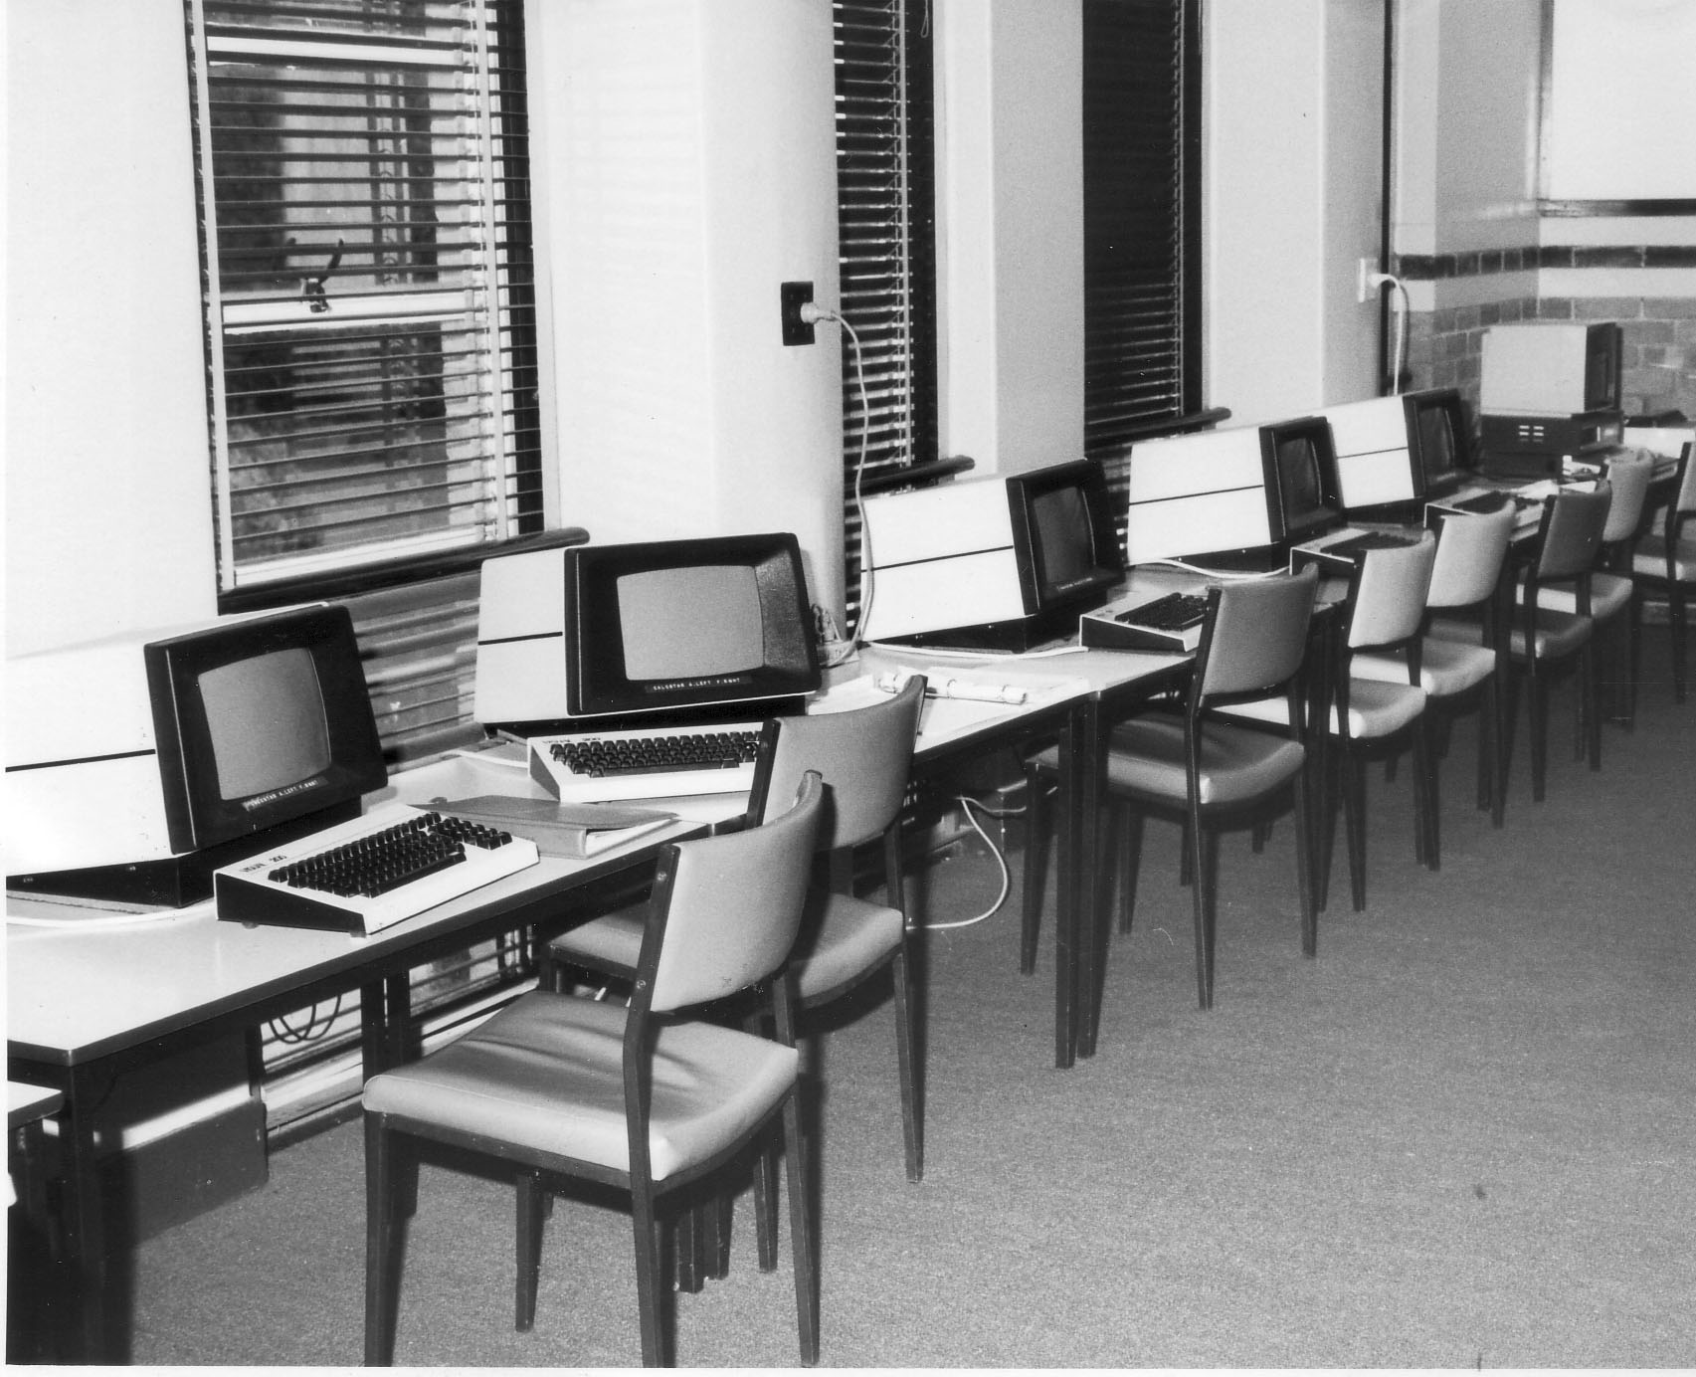
First computer room

Slide 44
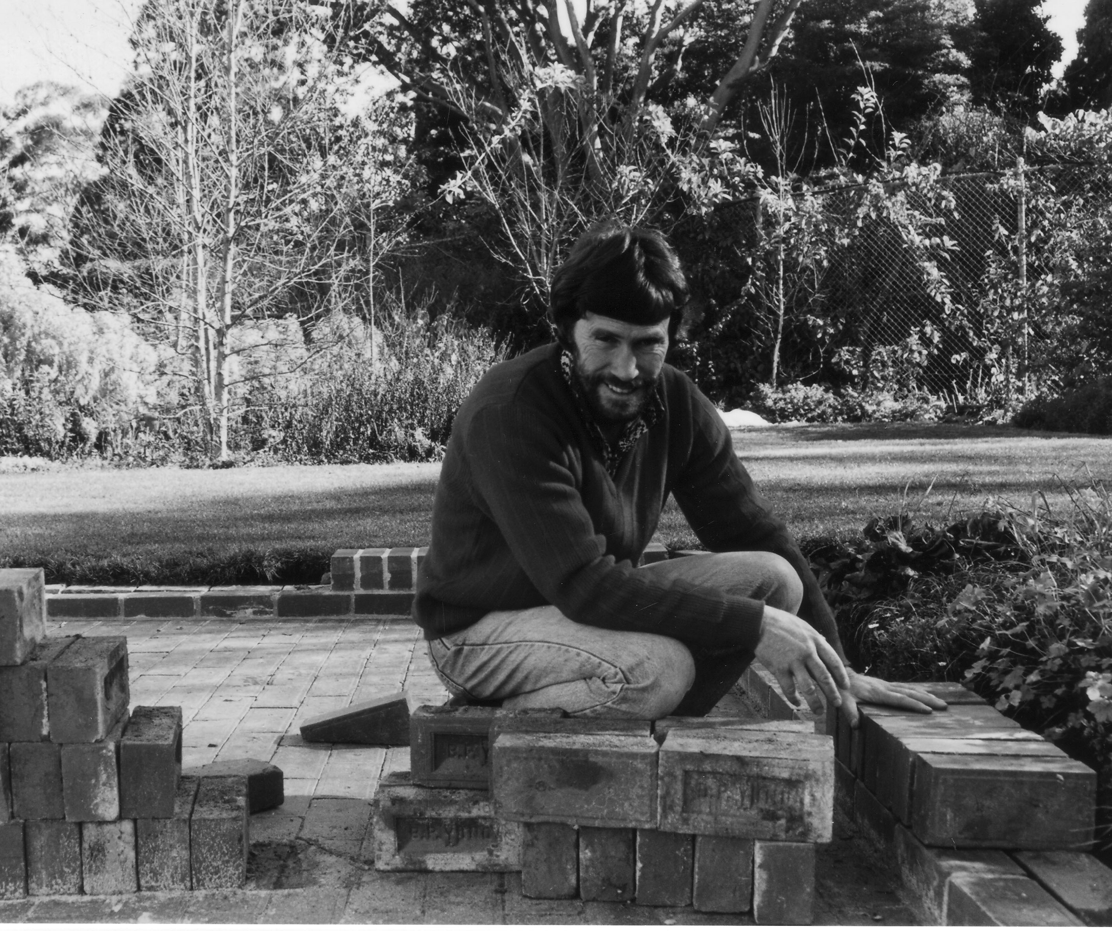
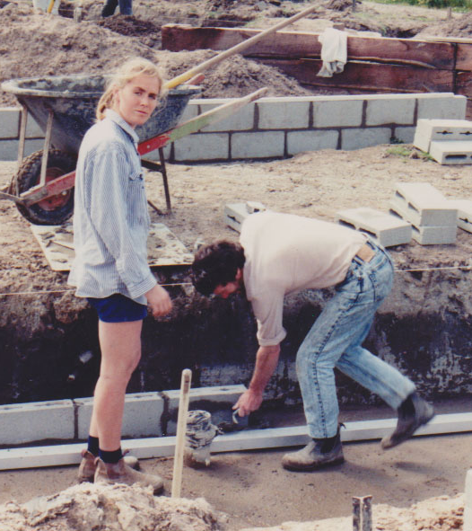
Landscape design and practice

Slide 45


Slide 46
ADVANCED EDUCATION COURSES REPLACED THE EXISTING DIPLOMA
The first intake for the Bachelor of Applied Science (Horticulture) was in 1985

Slide 47
ARBORICULTURE
Burnley was the leading institution in Australia for the teaching of Arboriculture

Slide 48


Slide 49



1991 Celebrating 100 years of teaching at Burnley

Slide 50
Now let’s look forward to the next 100 years at The University of Melbourne’s Burnley Campus

Slide 51



Burnley in a changing climate
Green infrastructure and urban horticulture research and teaching at Burnley
Creating liveable cities for people and biodiversity

Slide 52



We create and embed knowledge and technologies in smart design, construction and maintenance of green spaces, trees, parks, rain gardens, and green roofs and green walls in built environments.
We research urban horticulture and urban forests, people-plant interactions, the ecology and biodiversity of cities and the systems that sustain flourishing urban vegetation.
Our research informs our teaching programs at Burnley.

Slide 53

Urban Green Spaces: Function, Benefits and Design
Creating green spaces for more liveable, resilient cities
Parks and reserves, street verges and private gardens are examples of urban green spaces that support diverse types of vegetation and contribute significantly to the liveability and resilience of cities.
Our research contributes to a comprehensive knowledge base on species, plant traits and landscape designs for existing and future scenarios.
We work with urban land managers and communities to investigate how these spaces function to support social and environmental benefits (ecosystem services) and how best to design and manage them for optimal outcomes.

Slide 54

Urban Trees and Urban Forestry
Improving life in cities and beyond with trees
Our urban tree research is helping councils, property owners, the design community and construction industry maximise the multiple benefits of urban trees through appropriate species selection, site preparation, monitoring, maintenance and management.
We work in global partnerships to research the design and management requirements for flourishing urban forests.

Slide 55

Urban Ecology and Biodiversity
Helping people and nature thrive in built environments
We advance urban ecology knowledge through research into the diversity and distribution of organisms in cities, investigating how urbanisation affects their ecology and the ecosystem processes that sustain them.
We develop smart solutions to help nature thrive alongside humans in different types of urban contexts and green infrastructure scenarios.

Slide 56

Green Roofs
Creating vegetated landscapes on city rooftops around the world
Our long-term green roof research program is supported by three research and demonstration green roofs at our Burnley campus. We have developed an extensive body of research including:
Evaluating plant species for Australian green roofs based on plant characteristics, habitat templates and performance
Developing and testing novel green roof substrate mixes
Quantifying hydrology and building energy benefits of green roofs
Investigating psychological benefits and determining preferred green roof types

Slide 57

Plants and Water in the Landscape
Integrating water sensitive urban design for flourishing vegetation and cool cities
We investigate plant-water relationships and Water Sensitive Urban Designs (WSUD), helping to build sustainability and resilience into urban greening projects for healthy vegetation and cool cities.
We work with research partners to investigate and design more effective and efficient smart water solutions for urban planning and city landscapes.

Slide 58

Food Production for Urban Landscapes
We research diverse topics in urban agriculture in Australia and around the world and explore the role of urban agriculture in modern-day cities.
We investigate plant growth and maintenance requirements, urban-specific production methods, social aspects of urban agriculture and mainstream and alternative crops (fruit and vegetables).

Slide 59
Acknowledgements
The University of Melbourne acknowledges the Traditional Owners of the unceded land on which we work, learn and live: the Wurundjeri Woi Wurrung and Bunurong peoples.
The University also acknowledges and is grateful to the Traditional Owners, Elders and Knowledge Holders of all Indigenous nations and clans who have been instrumental in our reconciliation journey.
We recognise the unique place held by Aboriginal and Torres Strait Islander peoples as the original owners and custodians of the lands and waterways across the Australian continent, with histories of continuous connection dating back more than 60,000 years. We also acknowledge their enduring cultural practices of caring for Country.
We pay respect to Elders past, present and future, and acknowledge the importance of Indigenous knowledge in the Academy. As a community of researchers, teachers, professional staff and students we are privileged to work and learn every day with Indigenous colleagues and partners.
In making this Acknowledgment of Country we commit to respectful and responsible conduct towards all others according to the Traditional lores of this land, particularly at times of formal ceremony.
The University of Melbourne Burnley Campus Archives
“Green Grows Our Garden”, by A. P. Winzenried
Slides provided by Associate Professor Claire Farrell in Green Infrastructure, Director of the Burnley Campus
Kirsten Binns-Smith, for her assistance with this Exhibition

