Slide 1
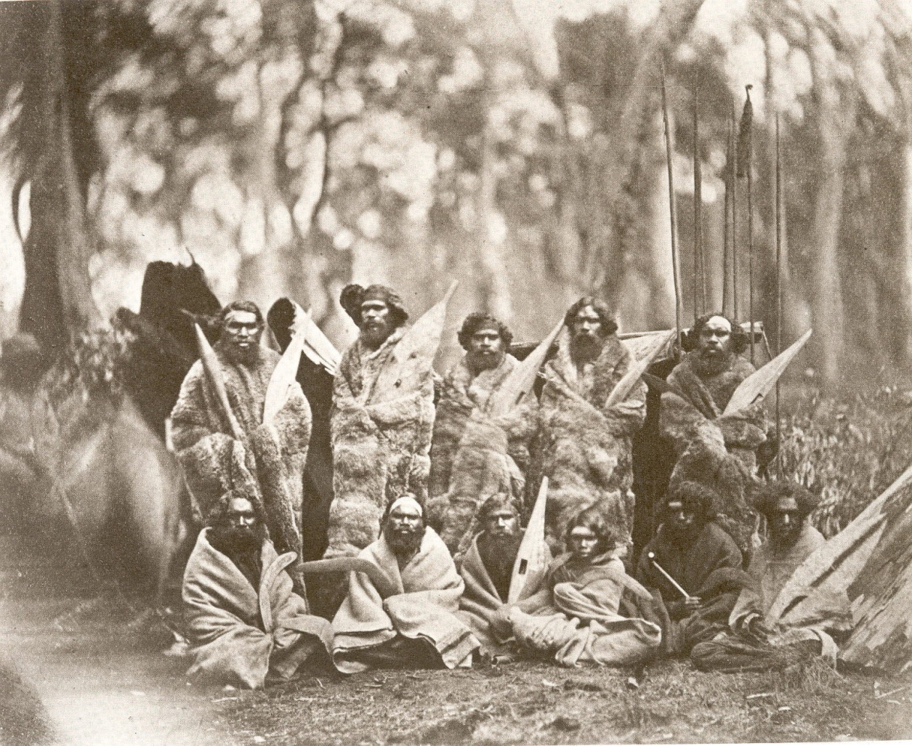
The Economic strategies of Aboriginal society
Dr Gary Presland FRHSV
School of Geography, The University of Melbourne

Slide 2
Acknowledgement of country
I acknowledge that we are meeting on the land of the Wurundjeri willam clan, who are part of the Kulin nation, and I pay my respects to their elders, past and present.

Slide 3
Aboriginal social organisation
Nation
Kulin
Boon wurrung Watha wurrung
Woi wurrung Djadja wurrung
Taun wurrung
Ngarai-illam wurrung
Language Groups
eg. Wurundjeri-balluk, Marin-balluk (These groups are named and each identifies with a particular ‘estate’)
Clans
The day-to-day (economic) functioning units; unnamed, based on family affiliation
Bands

Slide 4
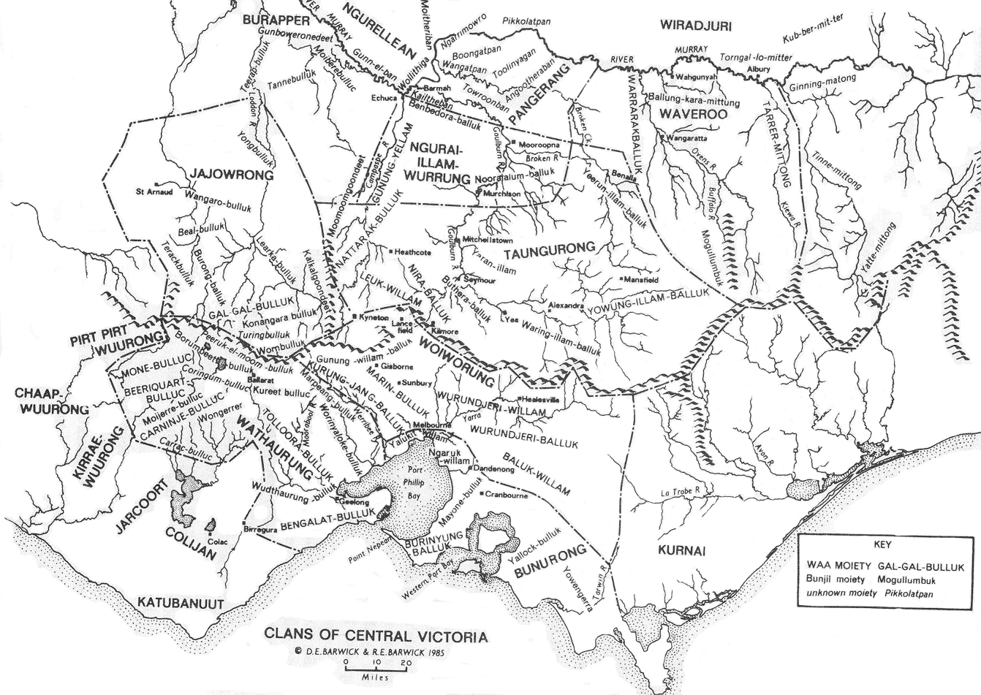
Map from D. Barwick, Aboriginal History, 1985

Slide 5
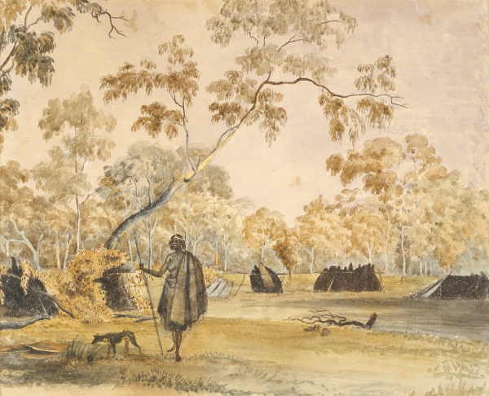
J Cotton (c. 1847), watercolour: ‘Native encampment on the banks of the Yarra’

Slide 6
Gathering and Hunting
Sexual division of labour: men hunt; women gather
Myth 1: Men provided the bulk of food by their hunting activities.
Fact: Women usually provided a higher percentage of the food, through gathering
Myth 2: Hunter-gatherers lived a ‘hand-to-mouth’ existence, constantly chasing food and water.
Fact: All daily needs could be satisfied with about 4-5 hours work, per day

Slide 7
Living off the land
‘Their natural food consists of the meat of the country when they can kill it, but chiefly roots, of which the favourite is that of a plant very much like the dandelion.’ (Thomas Winter, 1837)
‘They depend for food almost entirely on animals and roots’ (James Dawson 1881);
‘Of the 940 [plant] species recorded as used for food in Victoria, 296 (32%) were used for their underground parts.’ (Gott, 2005)

Slide 8
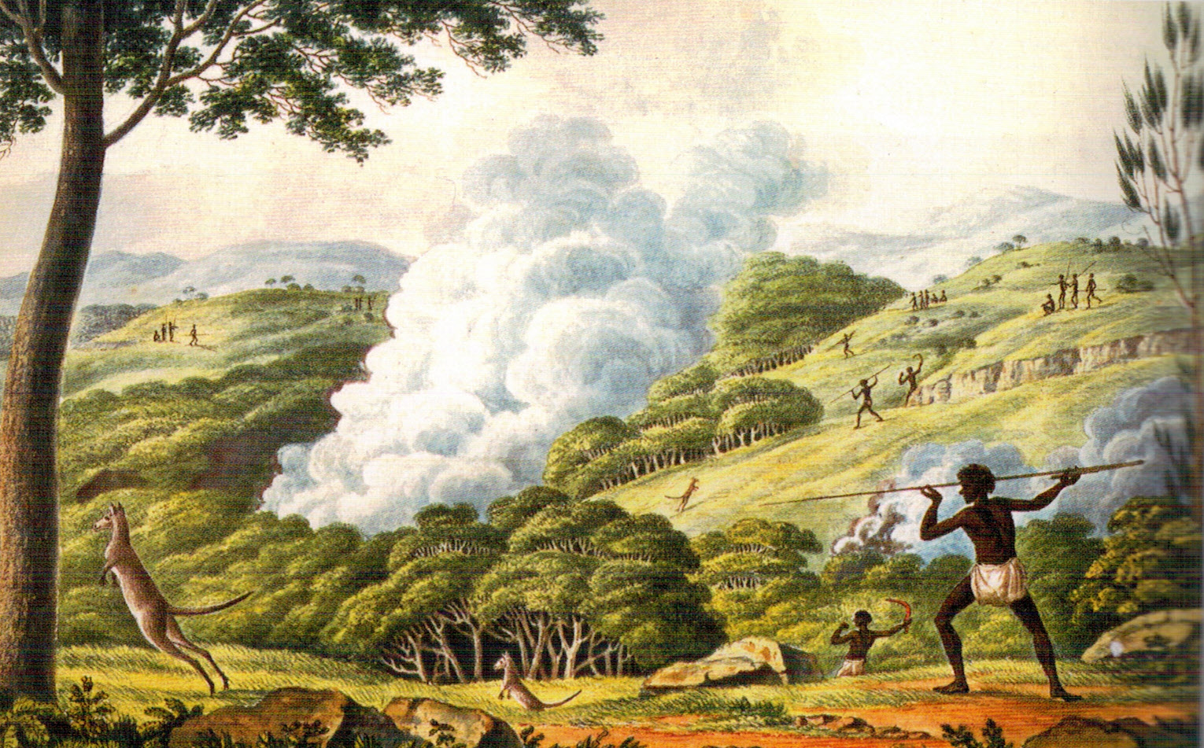
There was more to the use of fire than hunting kangaroos! While it is true that fire was sometimes used to drive game from cover, the major purpose of burning practices was much more subtle. It was a means of achieving a bigger supply of plant foods.

Slide 9
Fire as a management tool
Fire was applied to particular areas, usually with a frequency of 3-5 years. This maintained an open woodland regime and:
maximised the growth of herbaceous species with tubers, e.g. lilies, orchids, murnong;
promoted and maintained species diversity in tussock grasslands, by creating sufficient space between tussocks to allow herbaceous species to develop;
also had impacts on local animal species

Slide 10
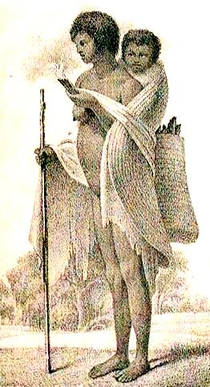
The rôle of women
Use of digging sticks in the work of gathering tubers, served to promote the growth of herbaceous species:
by helping to combine the nutrients in the ashes with the soil around the plants;
by aerating the soil;
by thinning out the plants.

Slide 11
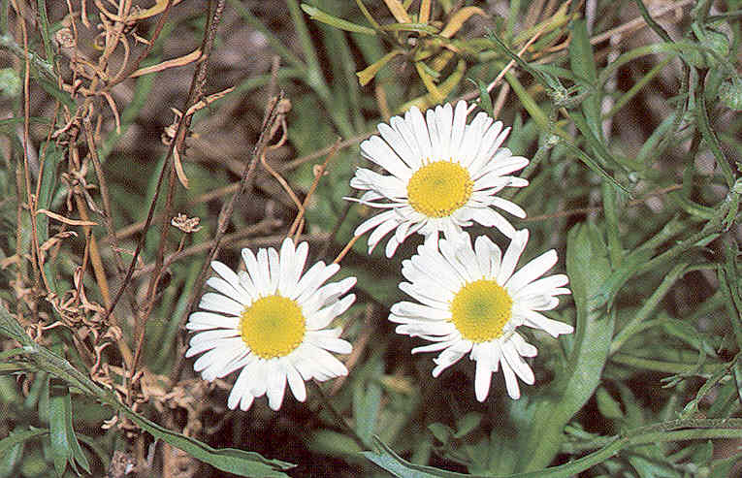
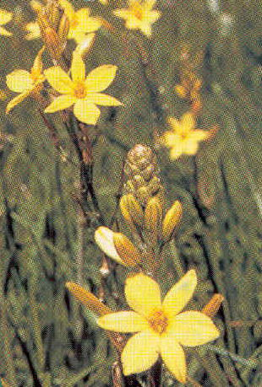
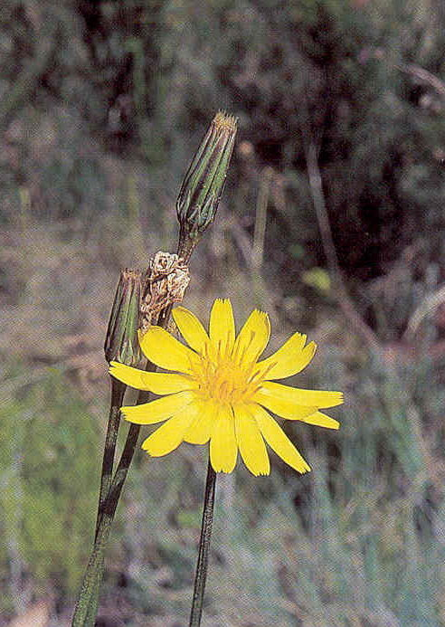
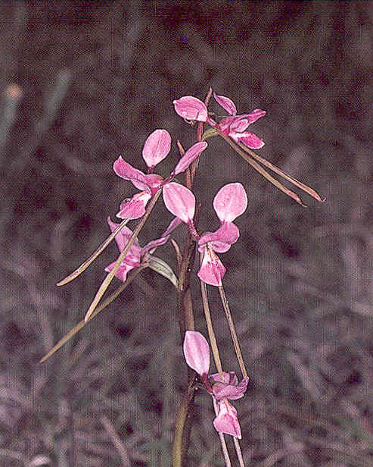

Slide 12
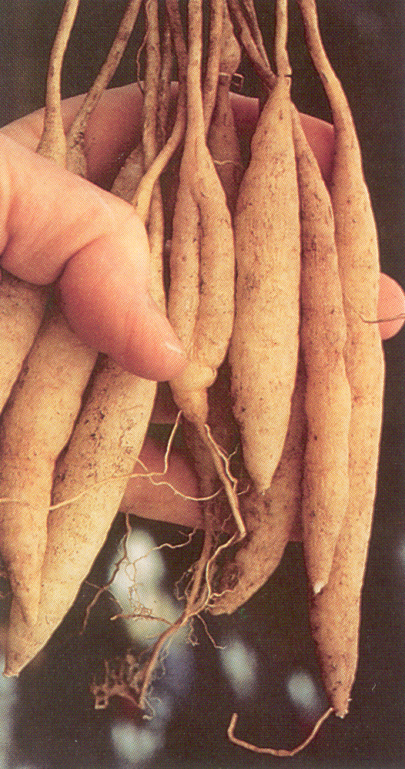
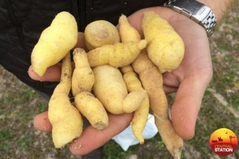
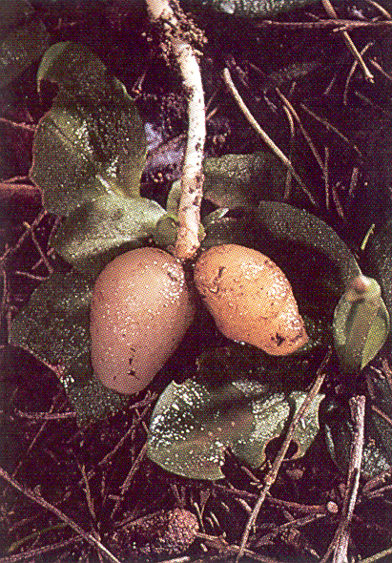
Murnong tubers
Vanilla lily tubers
Orchid tubers

Slide 13
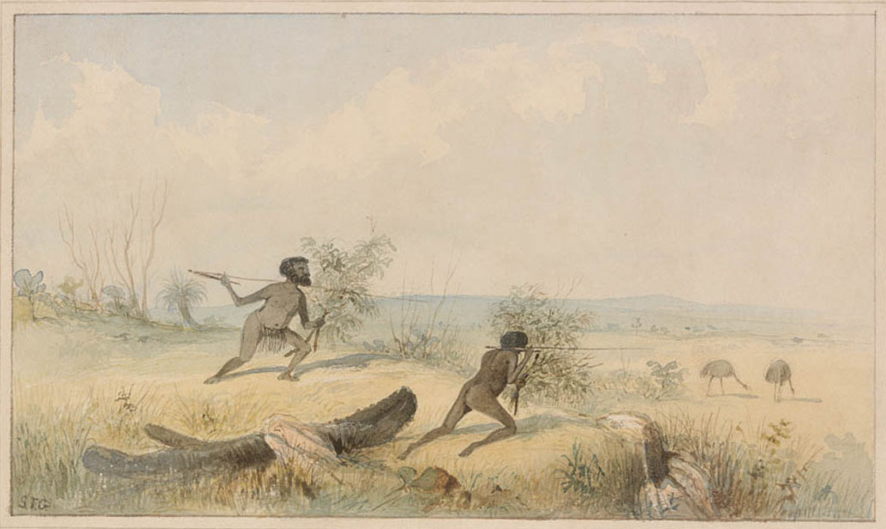
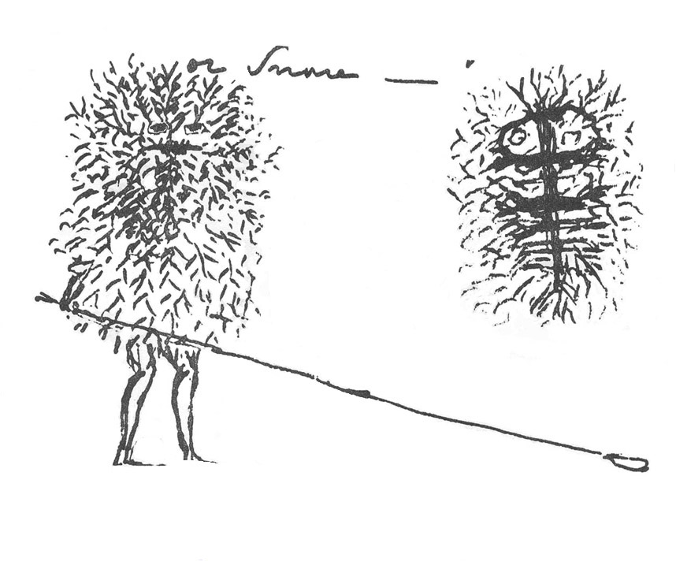
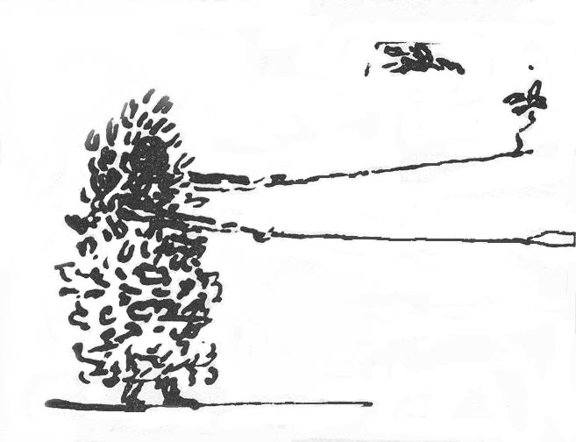
Hunting strategies

Slide 14
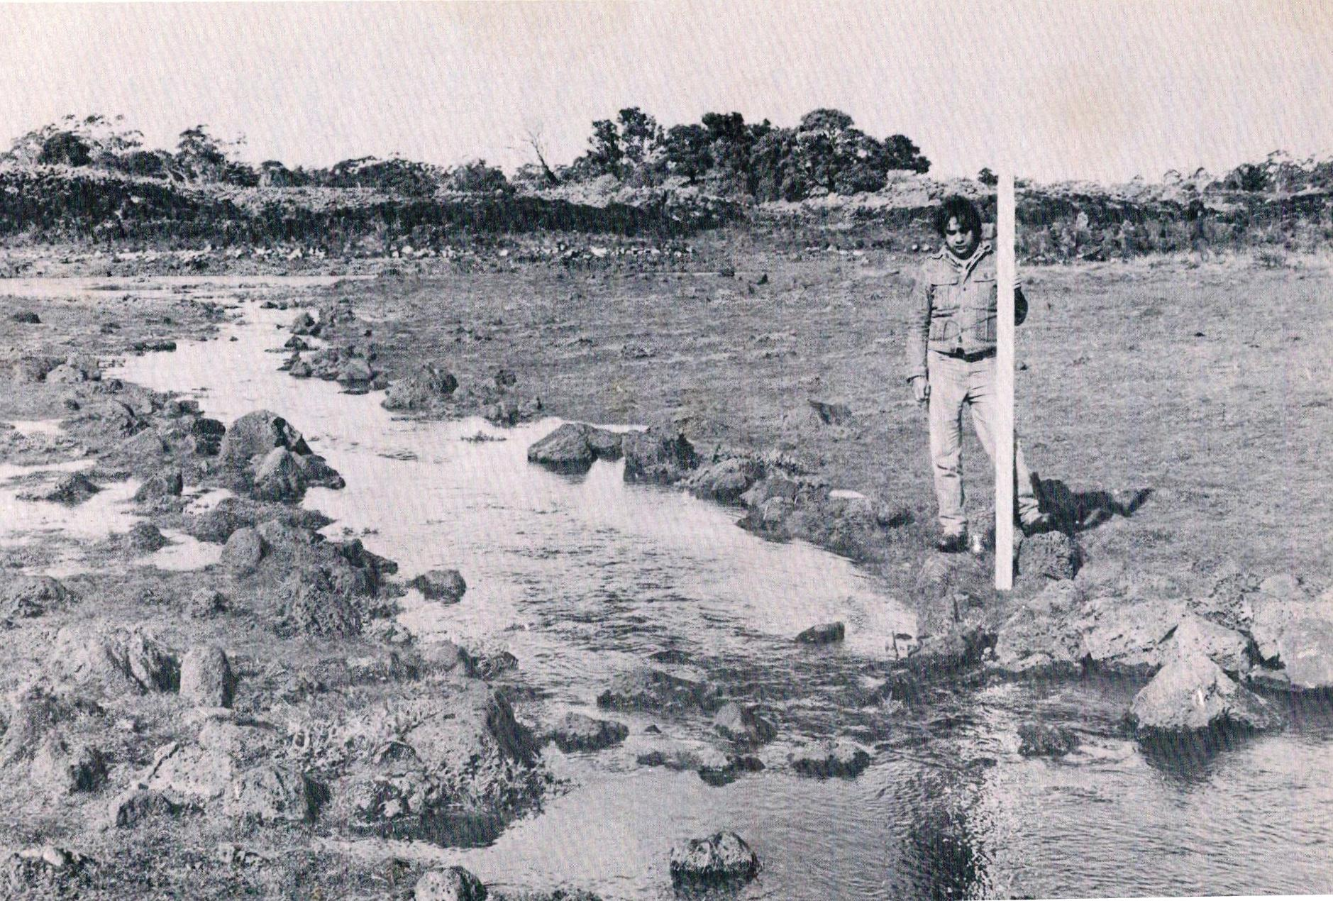
Eel trapping systems

Slide 15
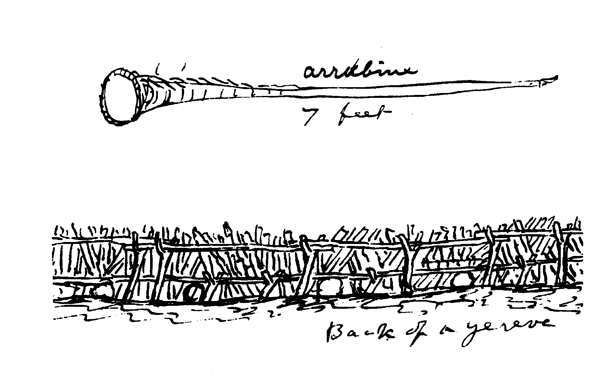
We went up the river till we came to rocks … crossed it at a place the natives had made for catching fish.
James Flemming on Maribyrnong River1803

Slide 16
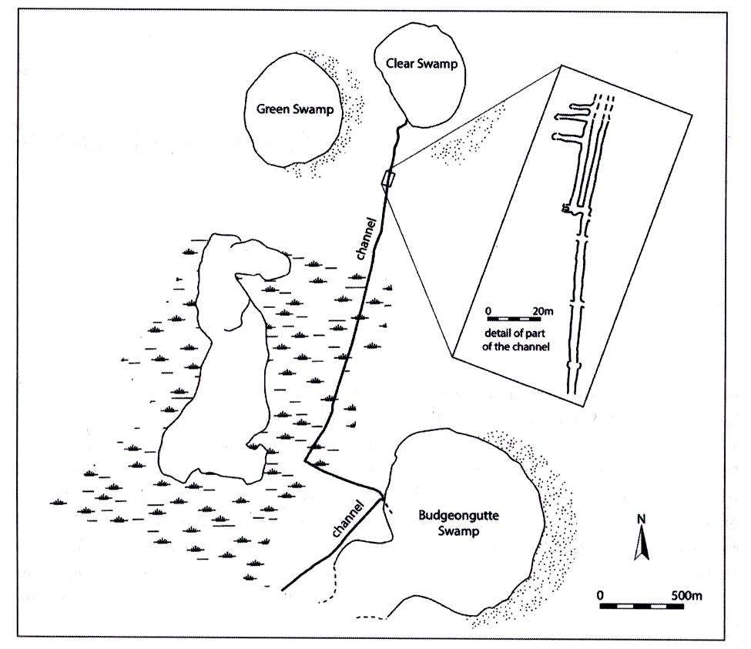
Toolondo channel
The length of the
artificial canal was
almost 4 km;
The channel was up to
2.5 m wide and as much
as 1 m at its deepest;
it extended the range of
eels, by connecting two
wetland areas that lie in
different drainage basins

Slide 17
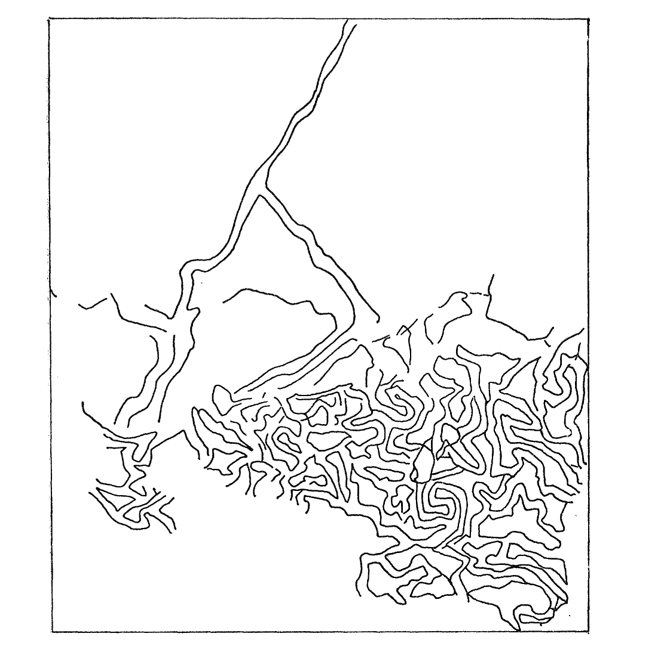
Elaborate eel trap on slopes of Mount William
At the confluence of this creek with the marsh observed an immense piece of ground trenched and banked, resembling the work of civilized man but which on inspection I found to be the work of the Aboriginal natives, purposely constructed for catching eels … These trenches are hundreds of yards in length. I measured one treble line for a distance of 500 yards … An area of at least 15 acres was thus traced over.
George Augustus Robinson
9 July 1841

Slide 18
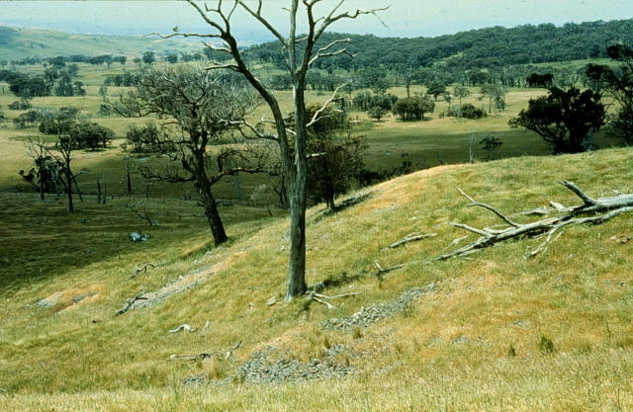
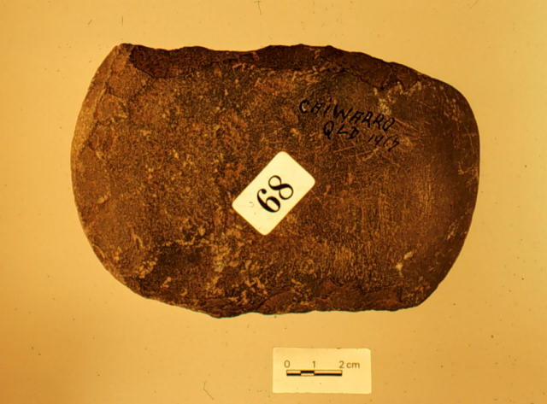
Exchange networks
Operated over long distances
Were the subject of well defined practice
Edge-ground hatchet head
A part of the Mount William stone quarry

Slide 19
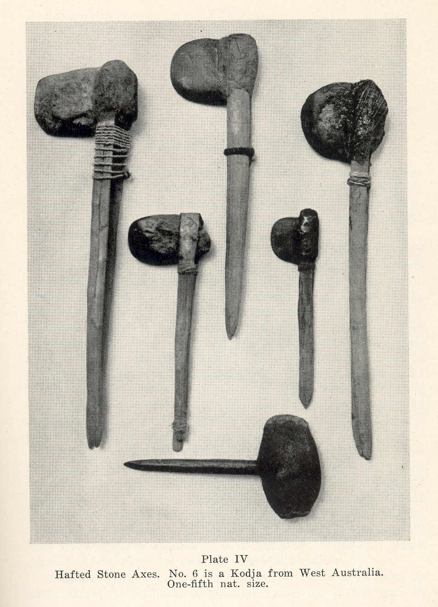
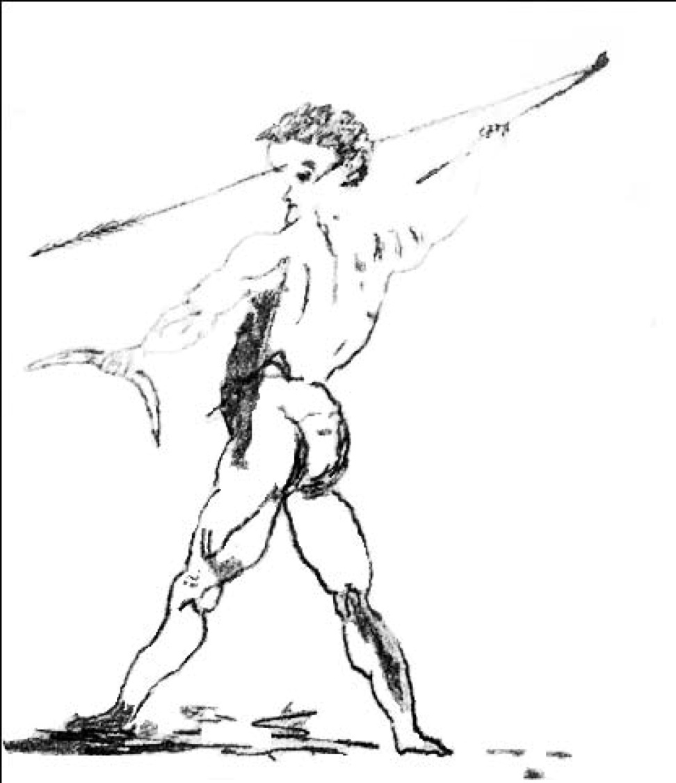

Slide 20
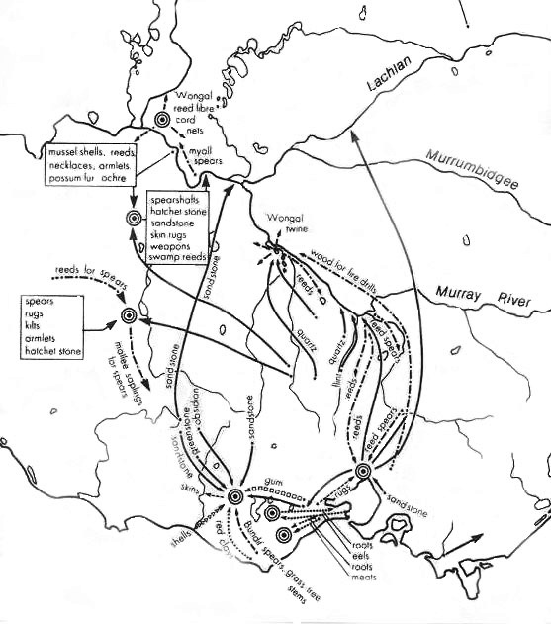
Trade routes and goods, to and from Mount William

Slide 21
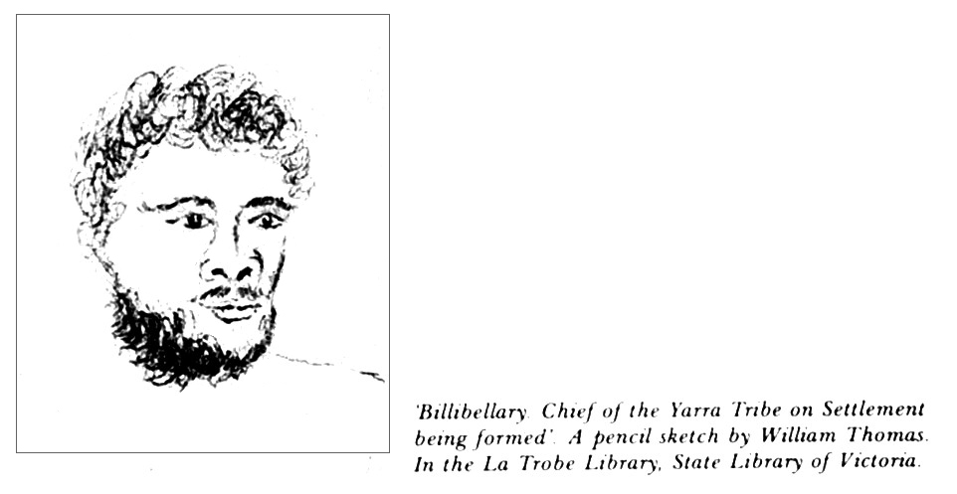

Slide 22
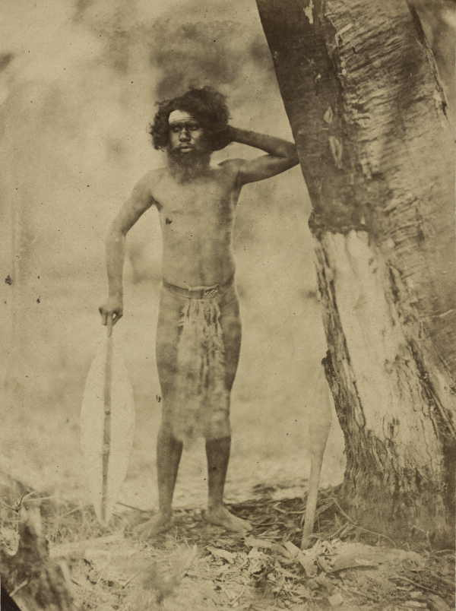
Thank you for listening
Questions are welcome
Photograph by Antoine Fauchery, 1857

