Slide 1



Slide 2

Saint Patrick’s College

Slide 3
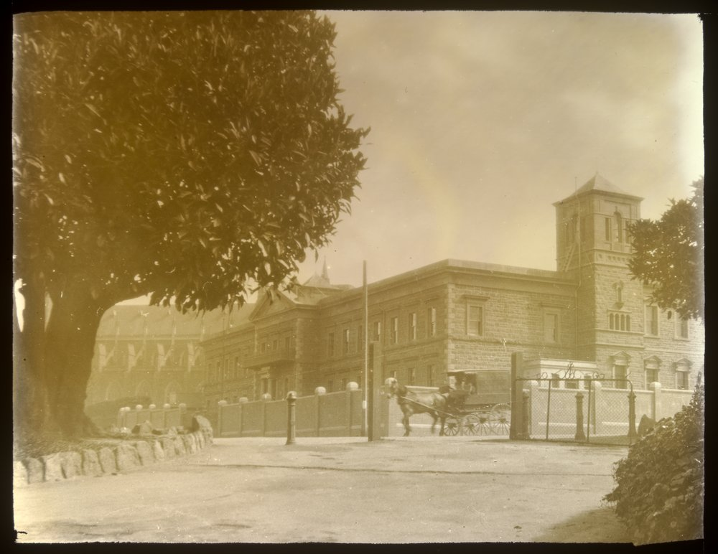

Slide 4
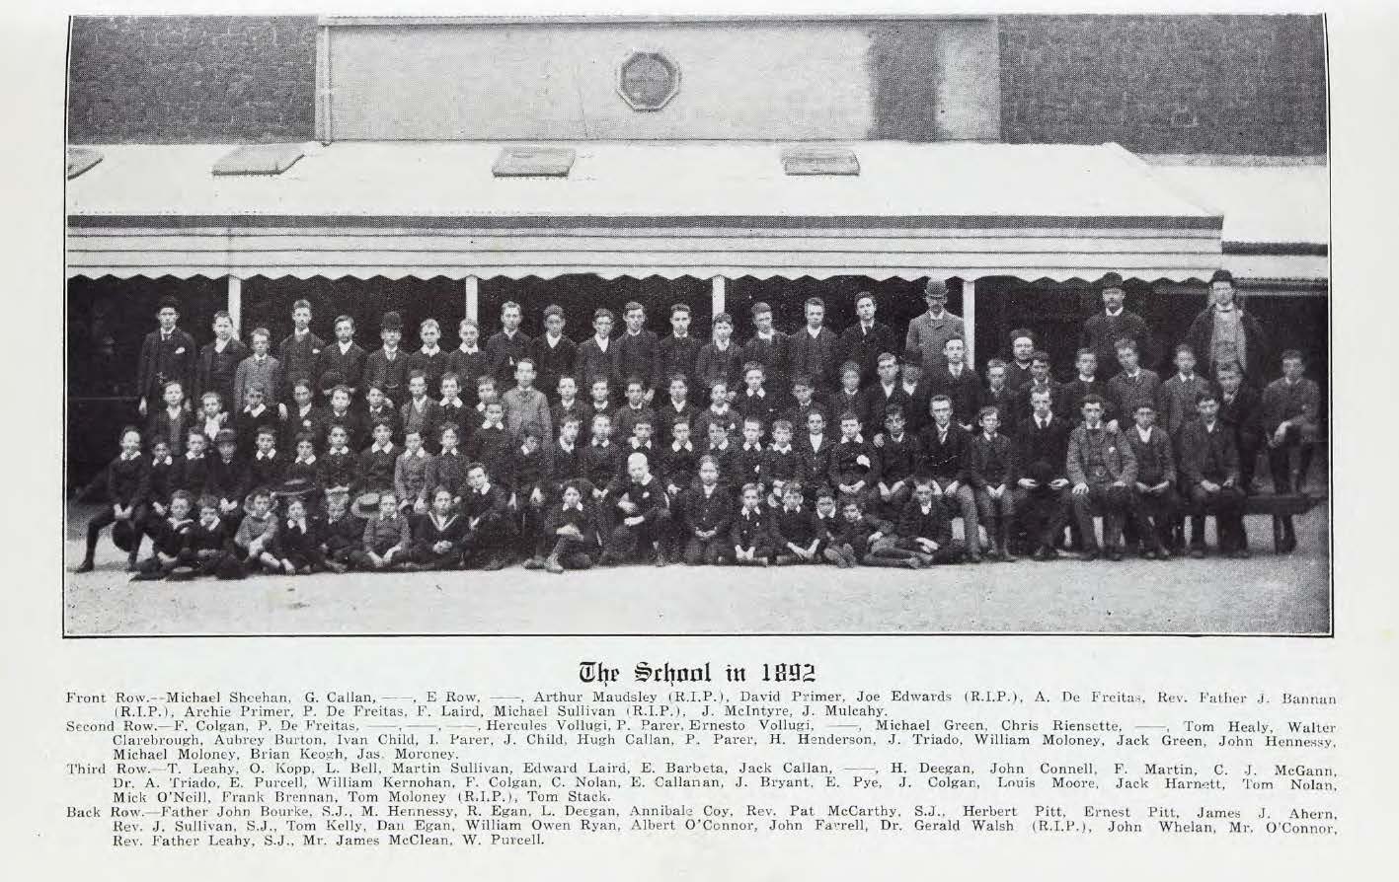

Slide 5
St. Patrick’s College
Roll of Honour 1914-1919
Joseph Arundle
Augustin Barbeta
Harold Burke
Barry Burns
Hugh Callan
Francis Callinan
Walter Clareborough
Horace Coates
Reginald Corder
William Cunningham
John Donovan
William Dowell
Bernard Gilliman
John Hammond
John Harrison
John Hassett
Arthur P. Henderson
Thomas Hosking
Victor Lusic
Albert Maudsley
Cecil A McAnulty
John McKenna
William Montgomery
Leo Mulkearns
Michael O’Donnell
Harold Smith
Francis Stewart
Francis Tarrant
Michael J. Walsh

Slide 6
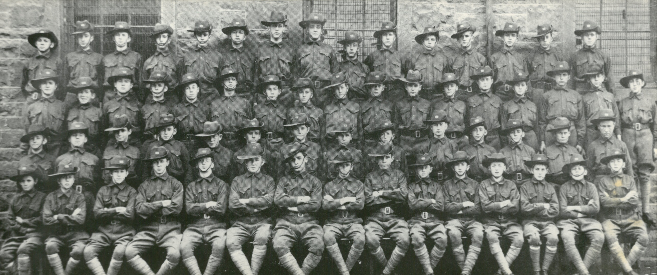
St. Patrick’s College Cadet Unit 1912

Slide 7
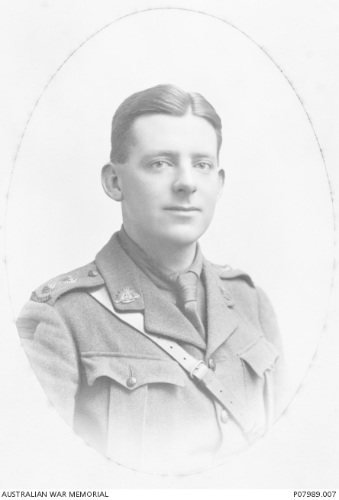
Harold Burke

Slide 8
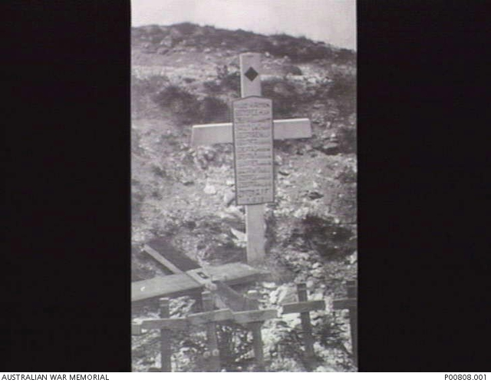
William Dowell

Slide 9
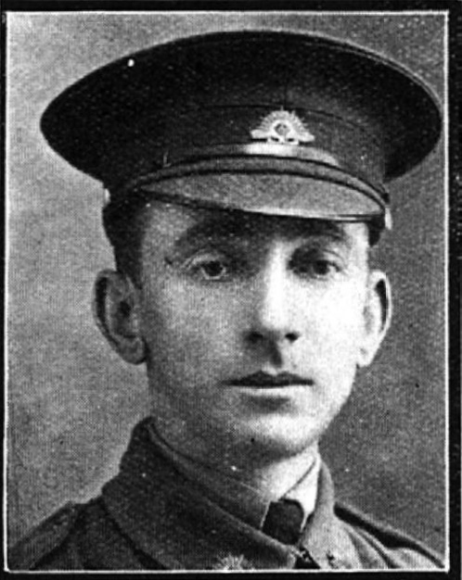
Jack Hassett

Slide 10
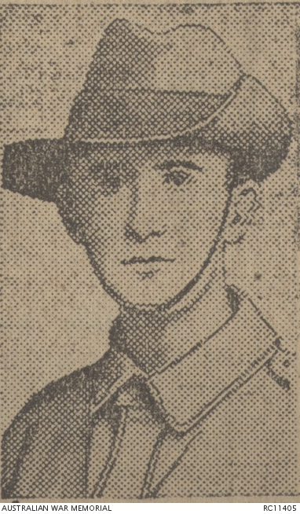
Cecil A. McAnulty

Slide 11
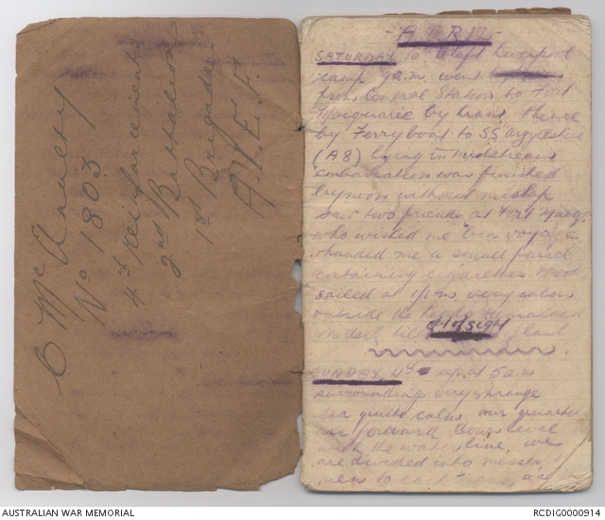
Cecil A. McAnulty’s War Diary

Slide 12
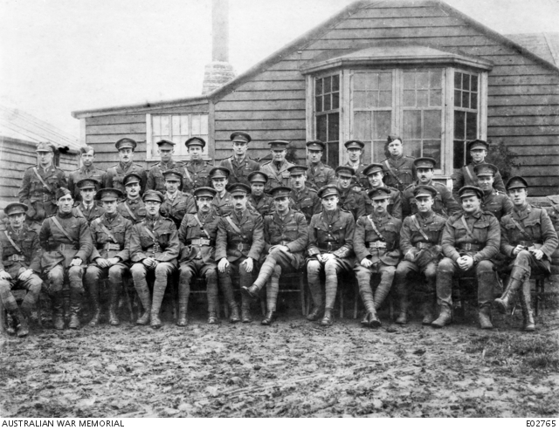
No. 3 Squadron, Australian Flying Corp – Francis Tarrant

Slide 13
Walter Clareborough

Slide 14
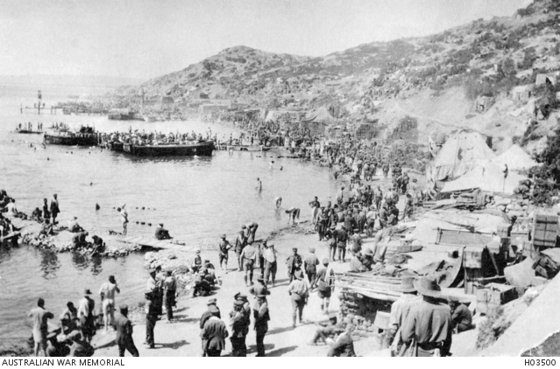

Slide 15
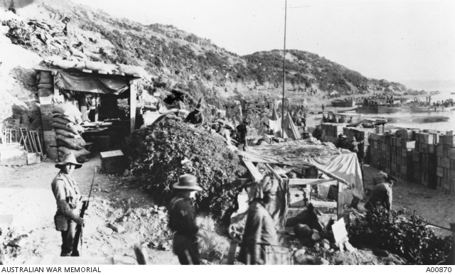

Slide 16
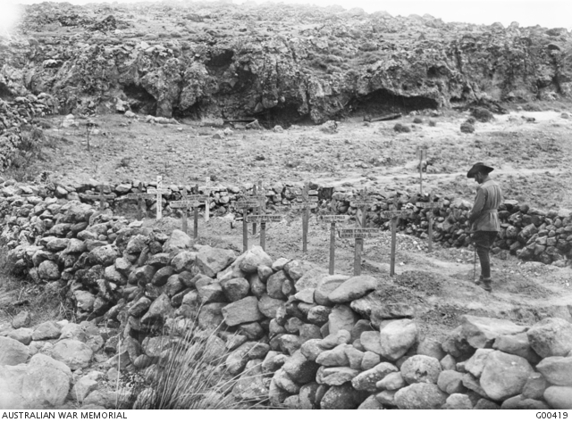

Slide 17
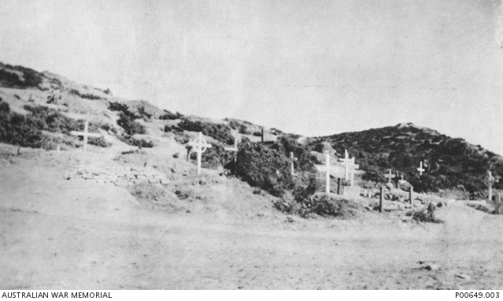

Slide 18
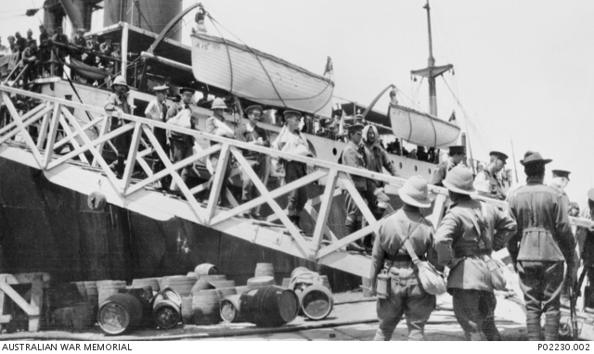

Slide 19
